Slide 1
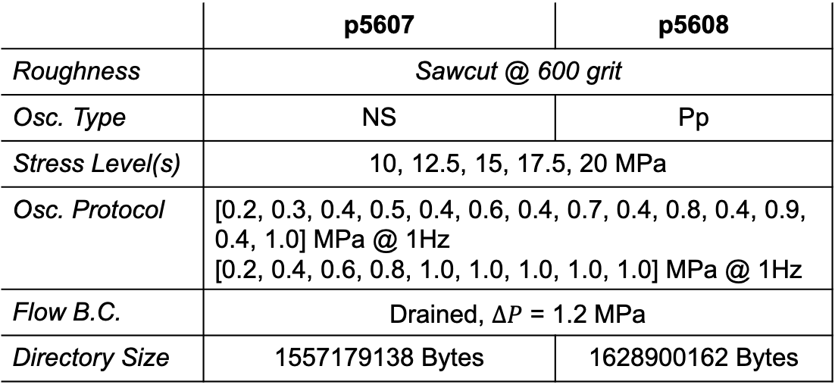
Experiments p5607 & p5608 – A quick look
Receivers
Transmitters
 | p5607 | p5608
Roughness | Sawcut @ 600 grit
Osc. Type | NS | Pp
Stress Level(s) | 10, 12.5, 15, 17.5, 20 MPa
Osc. Protocol | [0.2, 0.3, 0.4, 0.5, 0.4, 0.6, 0.4, 0.7, 0.4, 0.8, 0.4, 0.9, 0.4, 1.0] MPa @ 1Hz [0.2, 0.4, 0.6, 0.8, 1.0, 1.0, 1.0, 1.0, 1.0] MPa @ 1Hz
Flow B.C. | Drained, $∆P$ = 1.2 MPa
Directory Size | 1557179138 Bytes | 1628900162 Bytes
Excitation freq: 0.5 MHz
Time b/w pulses: 0.2 ms
Recording freq: 25 MHz

Slide 2
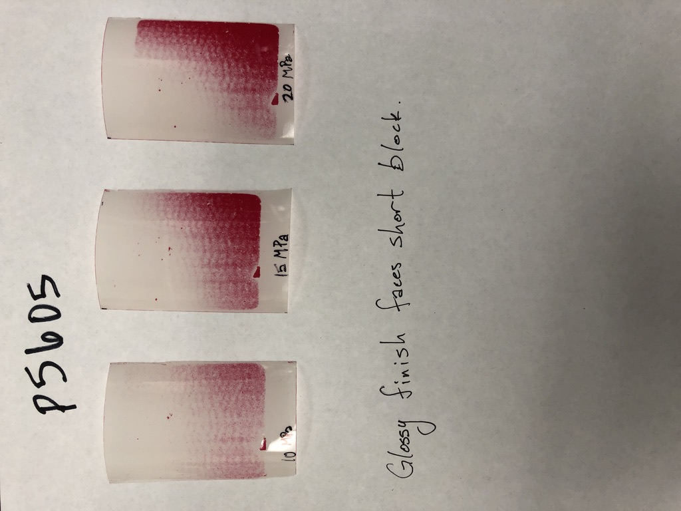
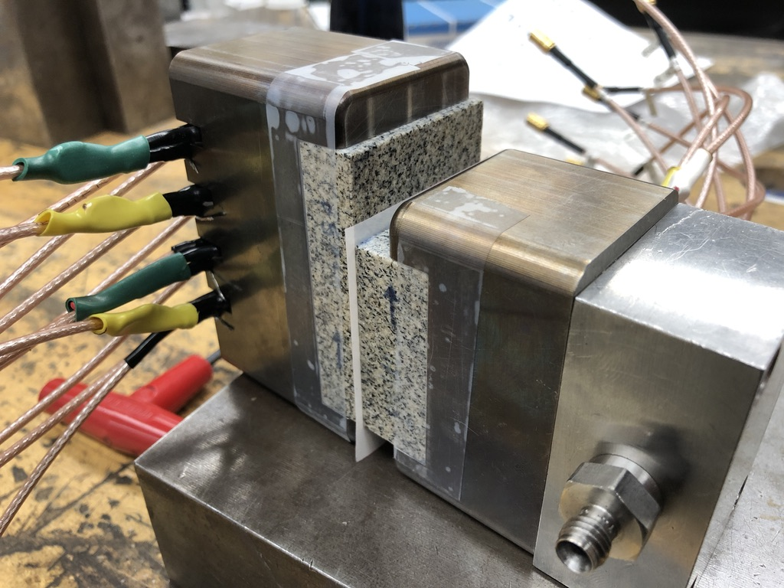
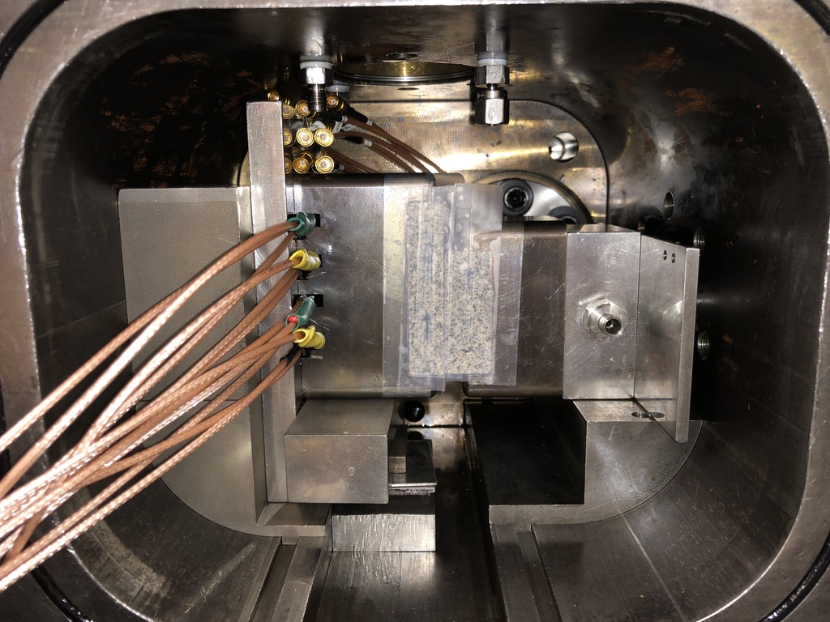
p5605 – pressure sensitive film
Follow-up with pressure films in vertical configuration outside vessel

Slide 3
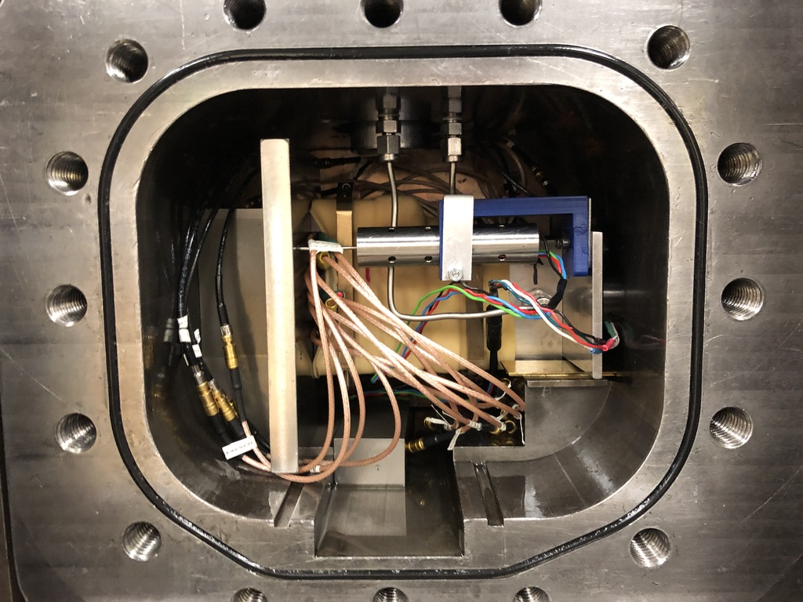
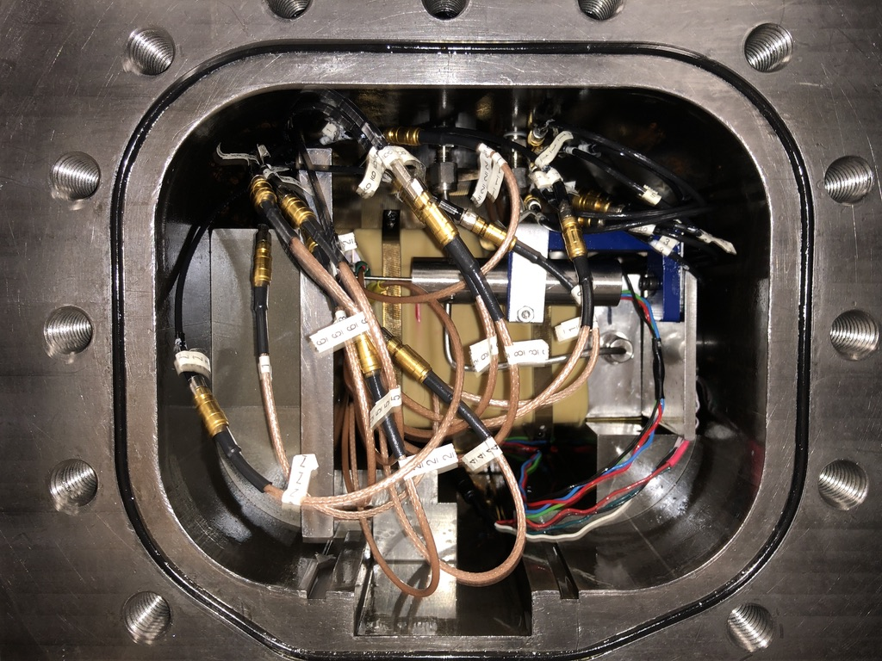
p5607/8 – sawcut fracture @ 600 grit

Slide 4
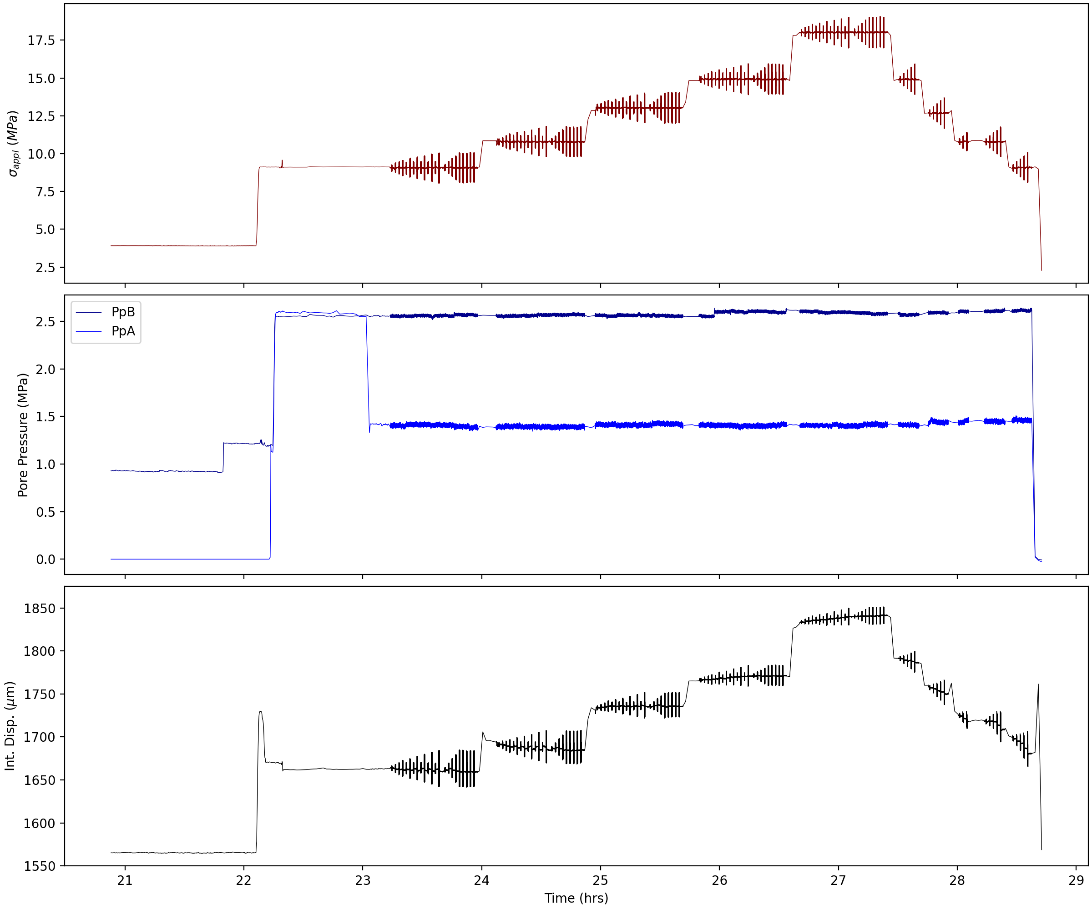
p5607

Slide 5
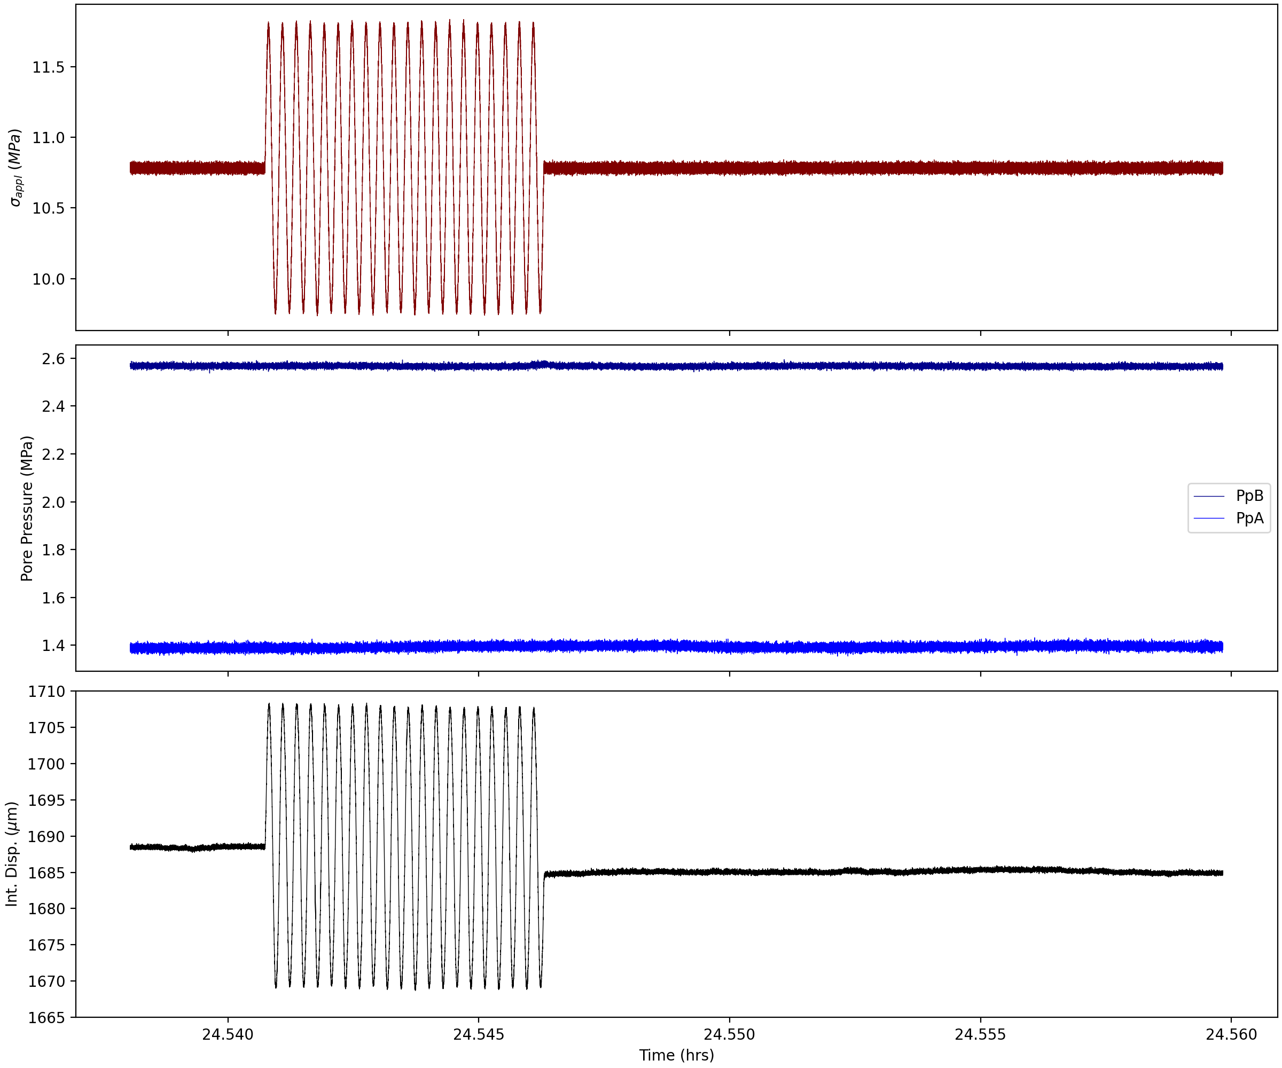
p5607

Slide 6
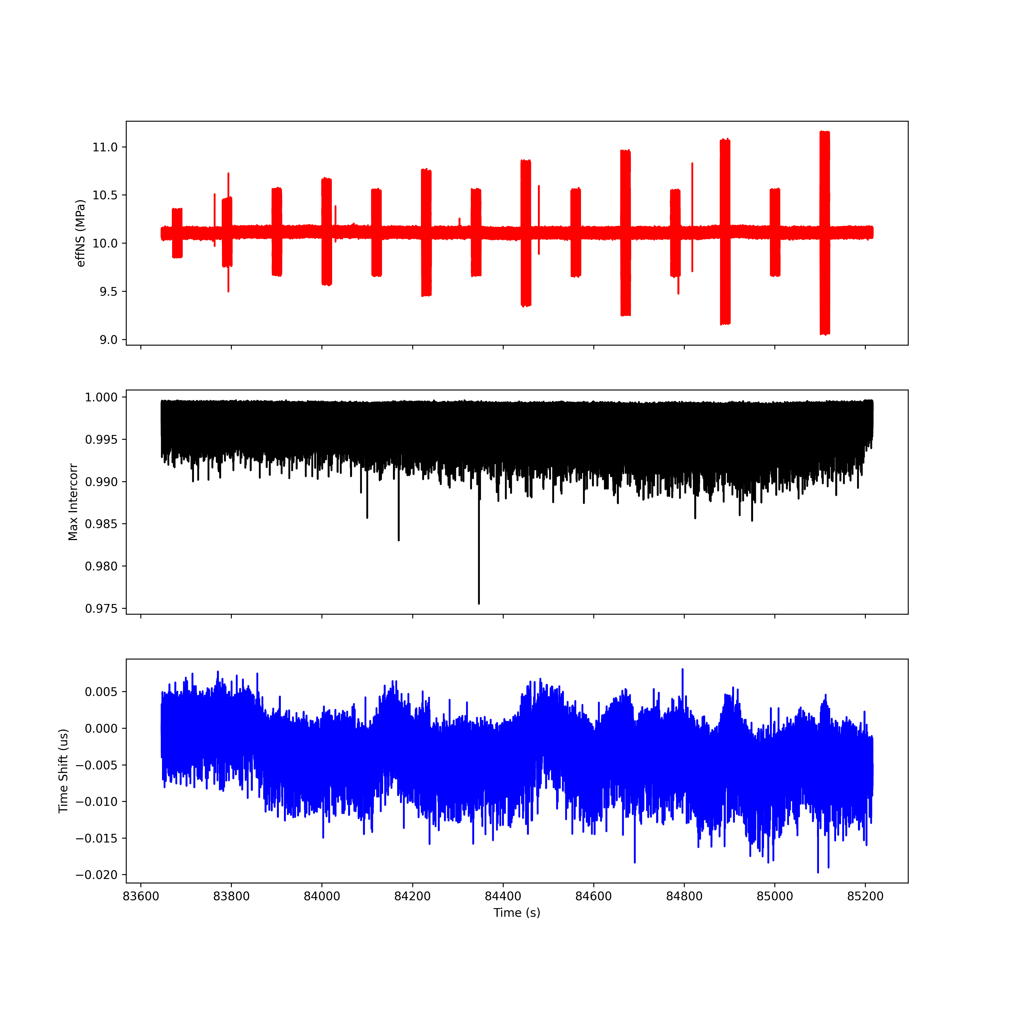
Run 1; T1 R1

Slide 7
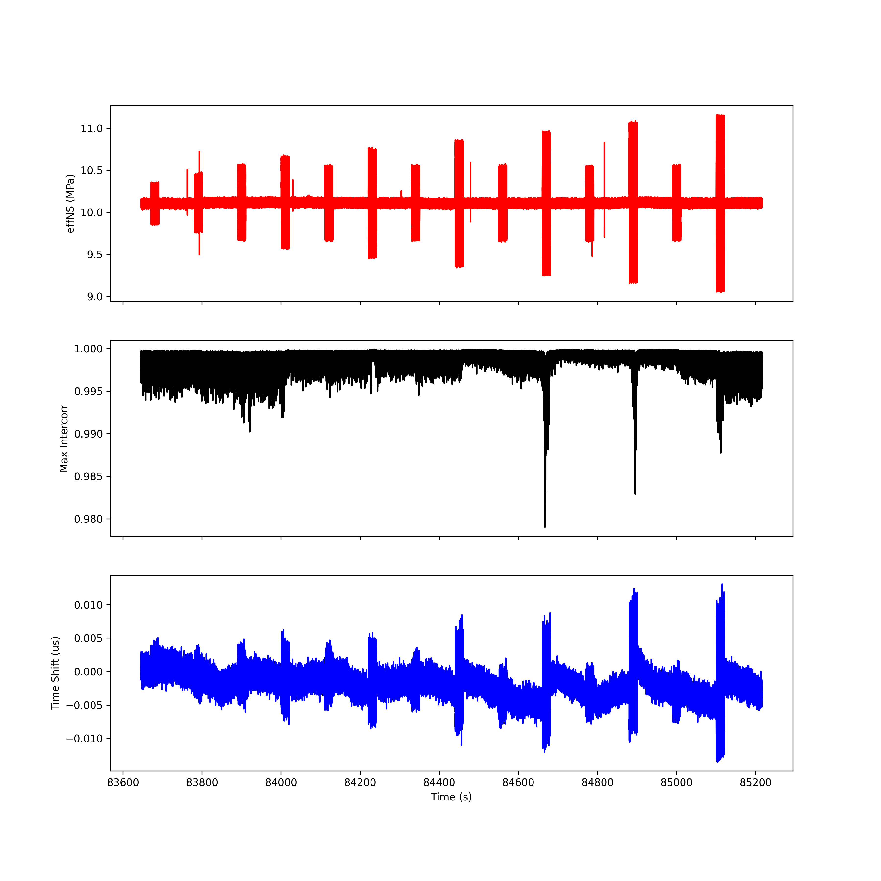
Run 1; T2 R2

Slide 8
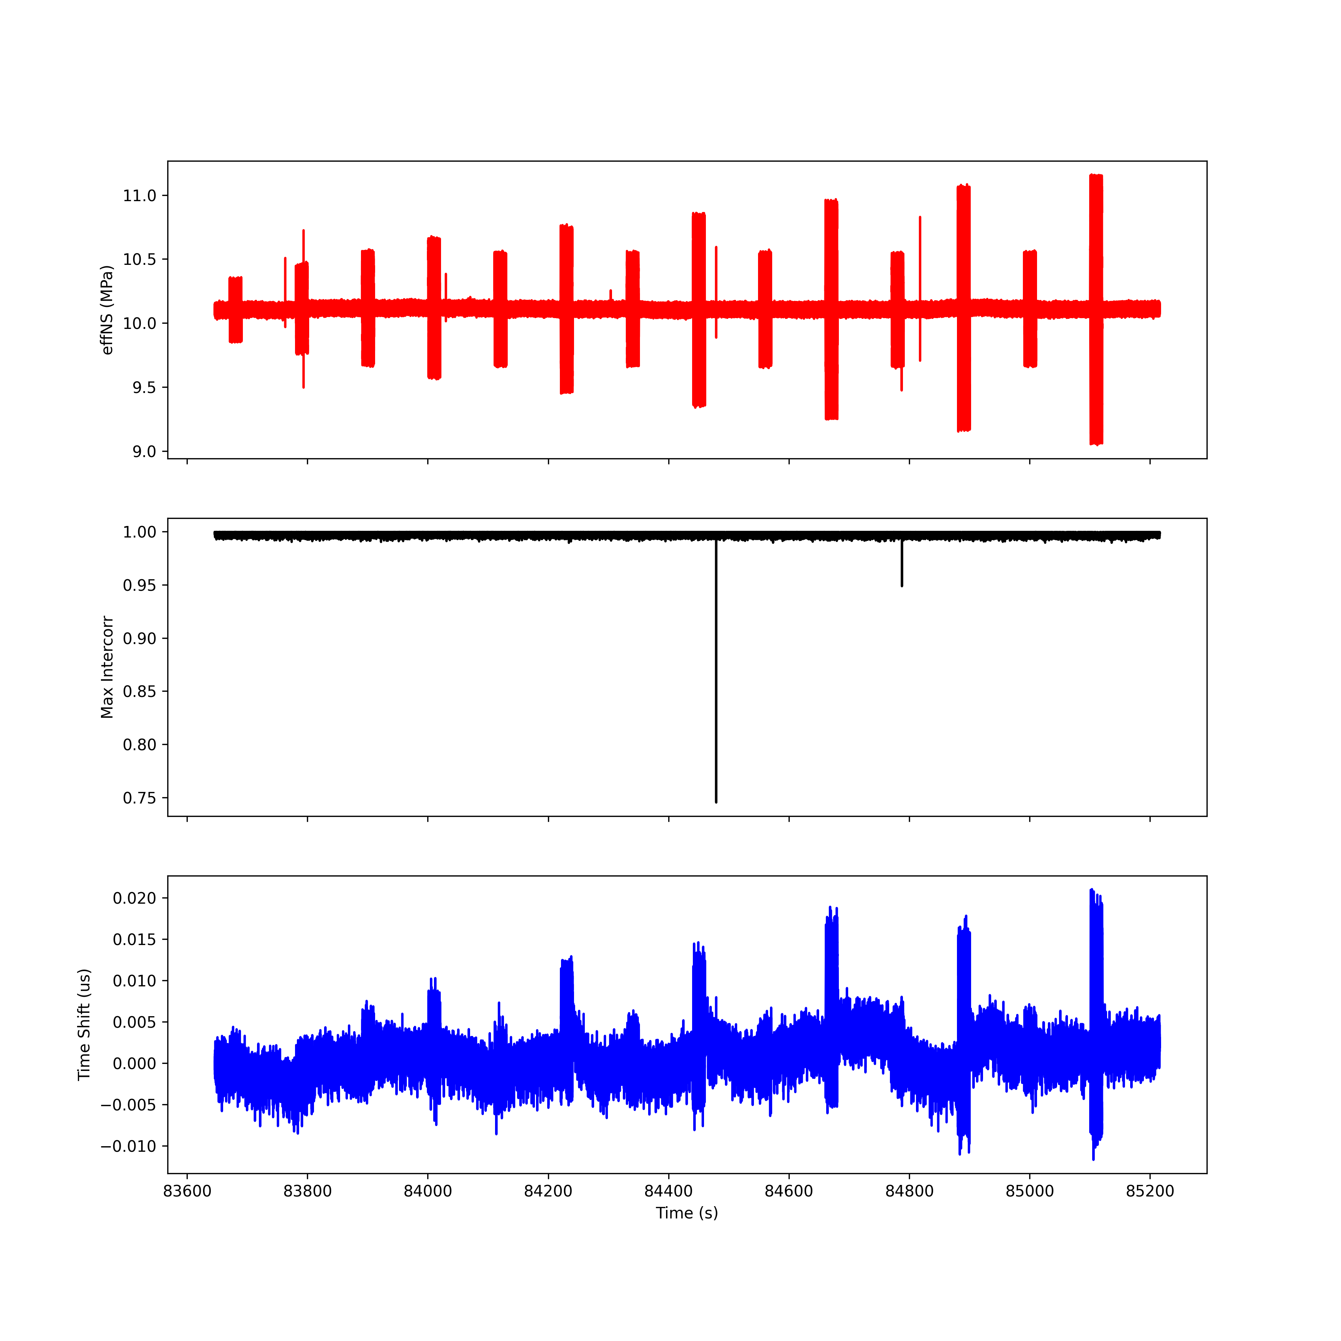
Run 1; T3 R3

Slide 9
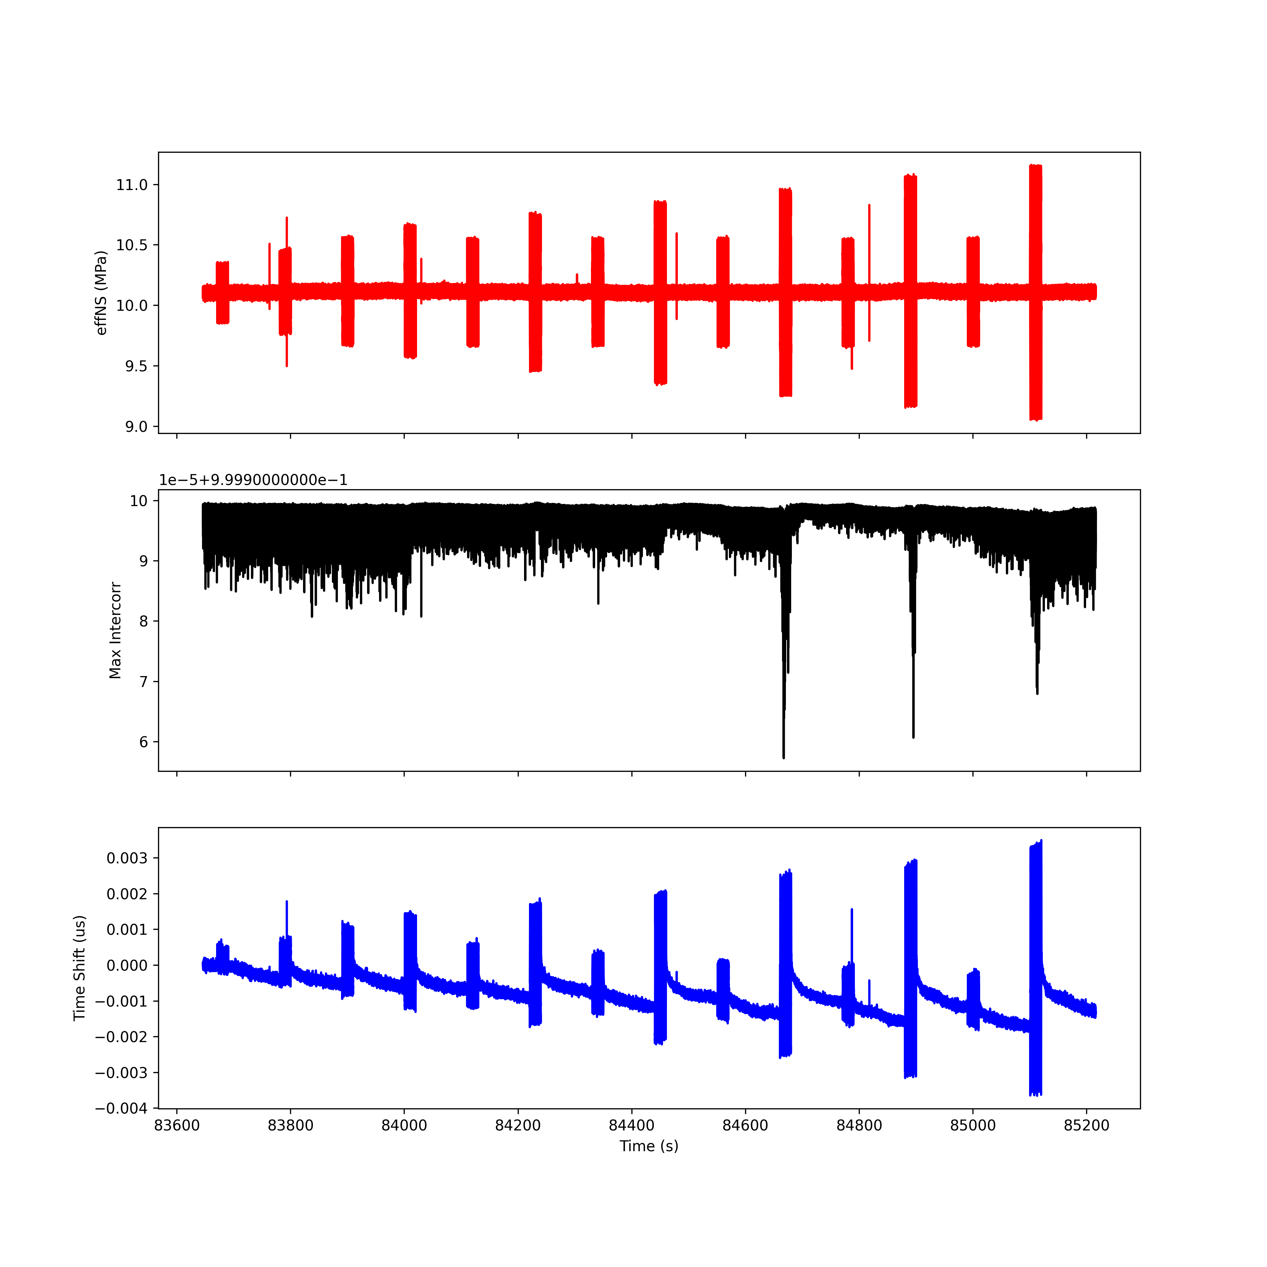
Run 1; T4 R4

Slide 10
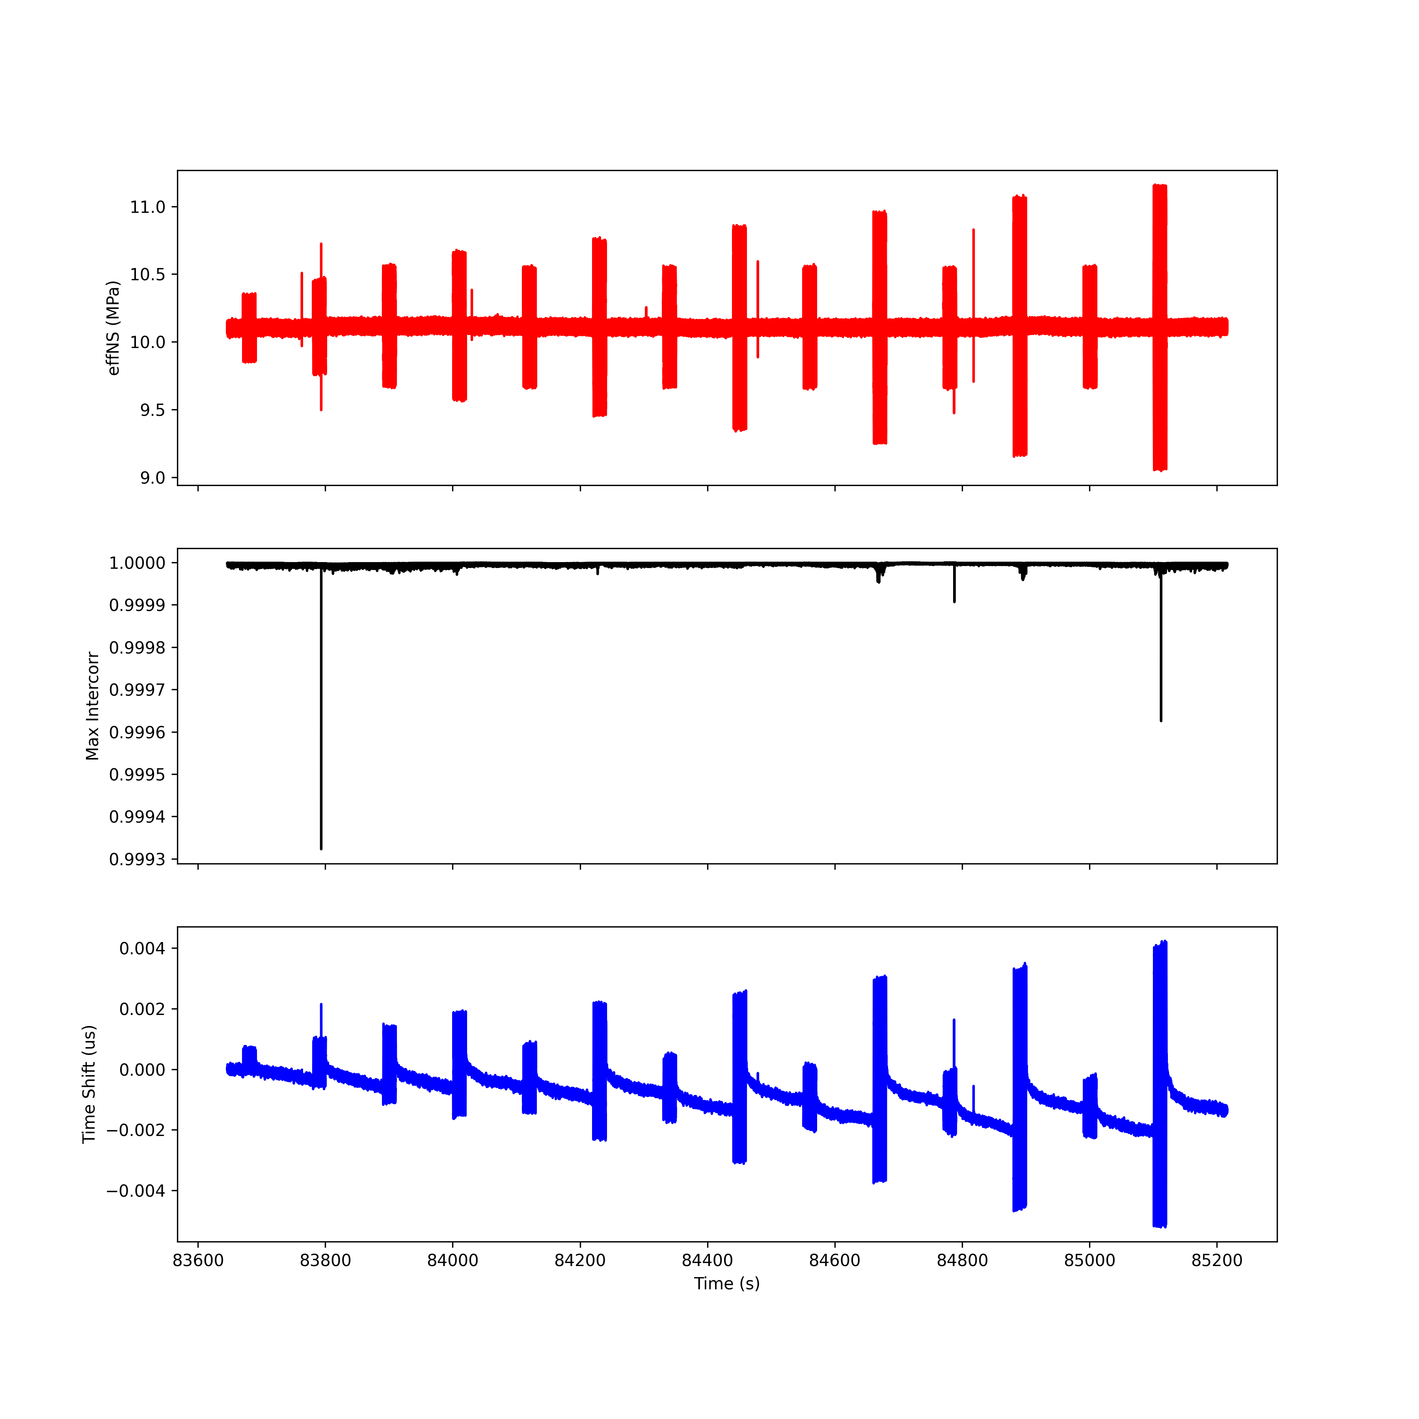
Run 1; T5 R5

Slide 11
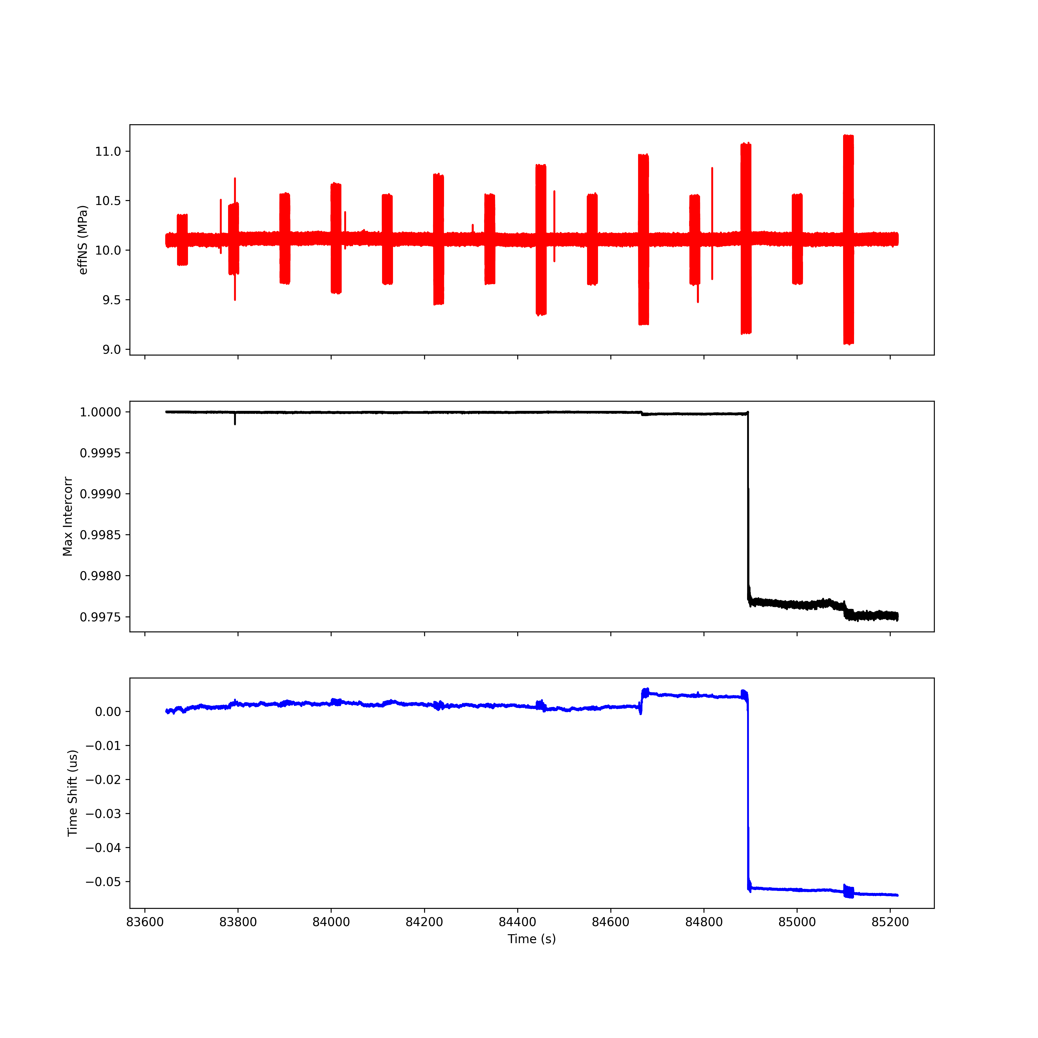
Run 1; T6 R6

Slide 12
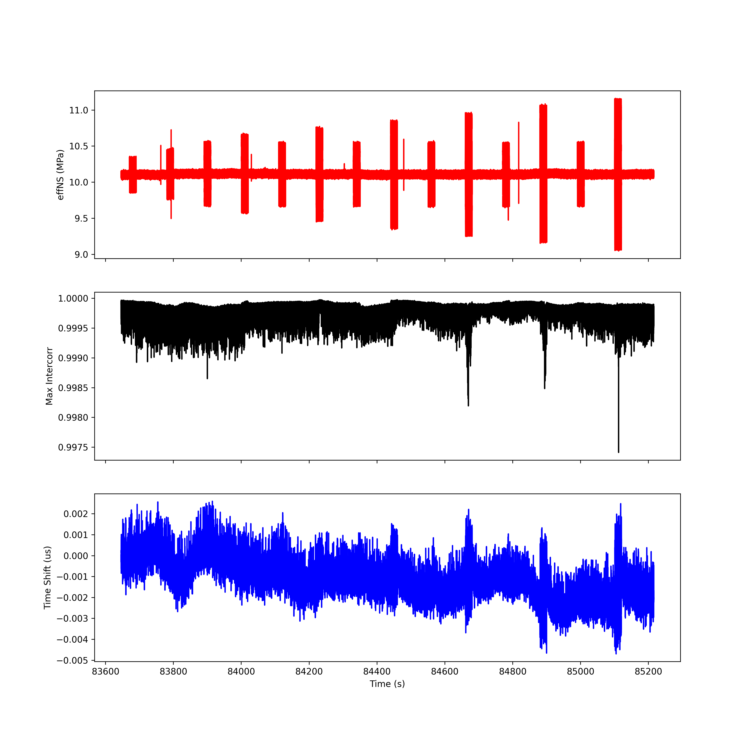
Run 1; T7 R7

Slide 13
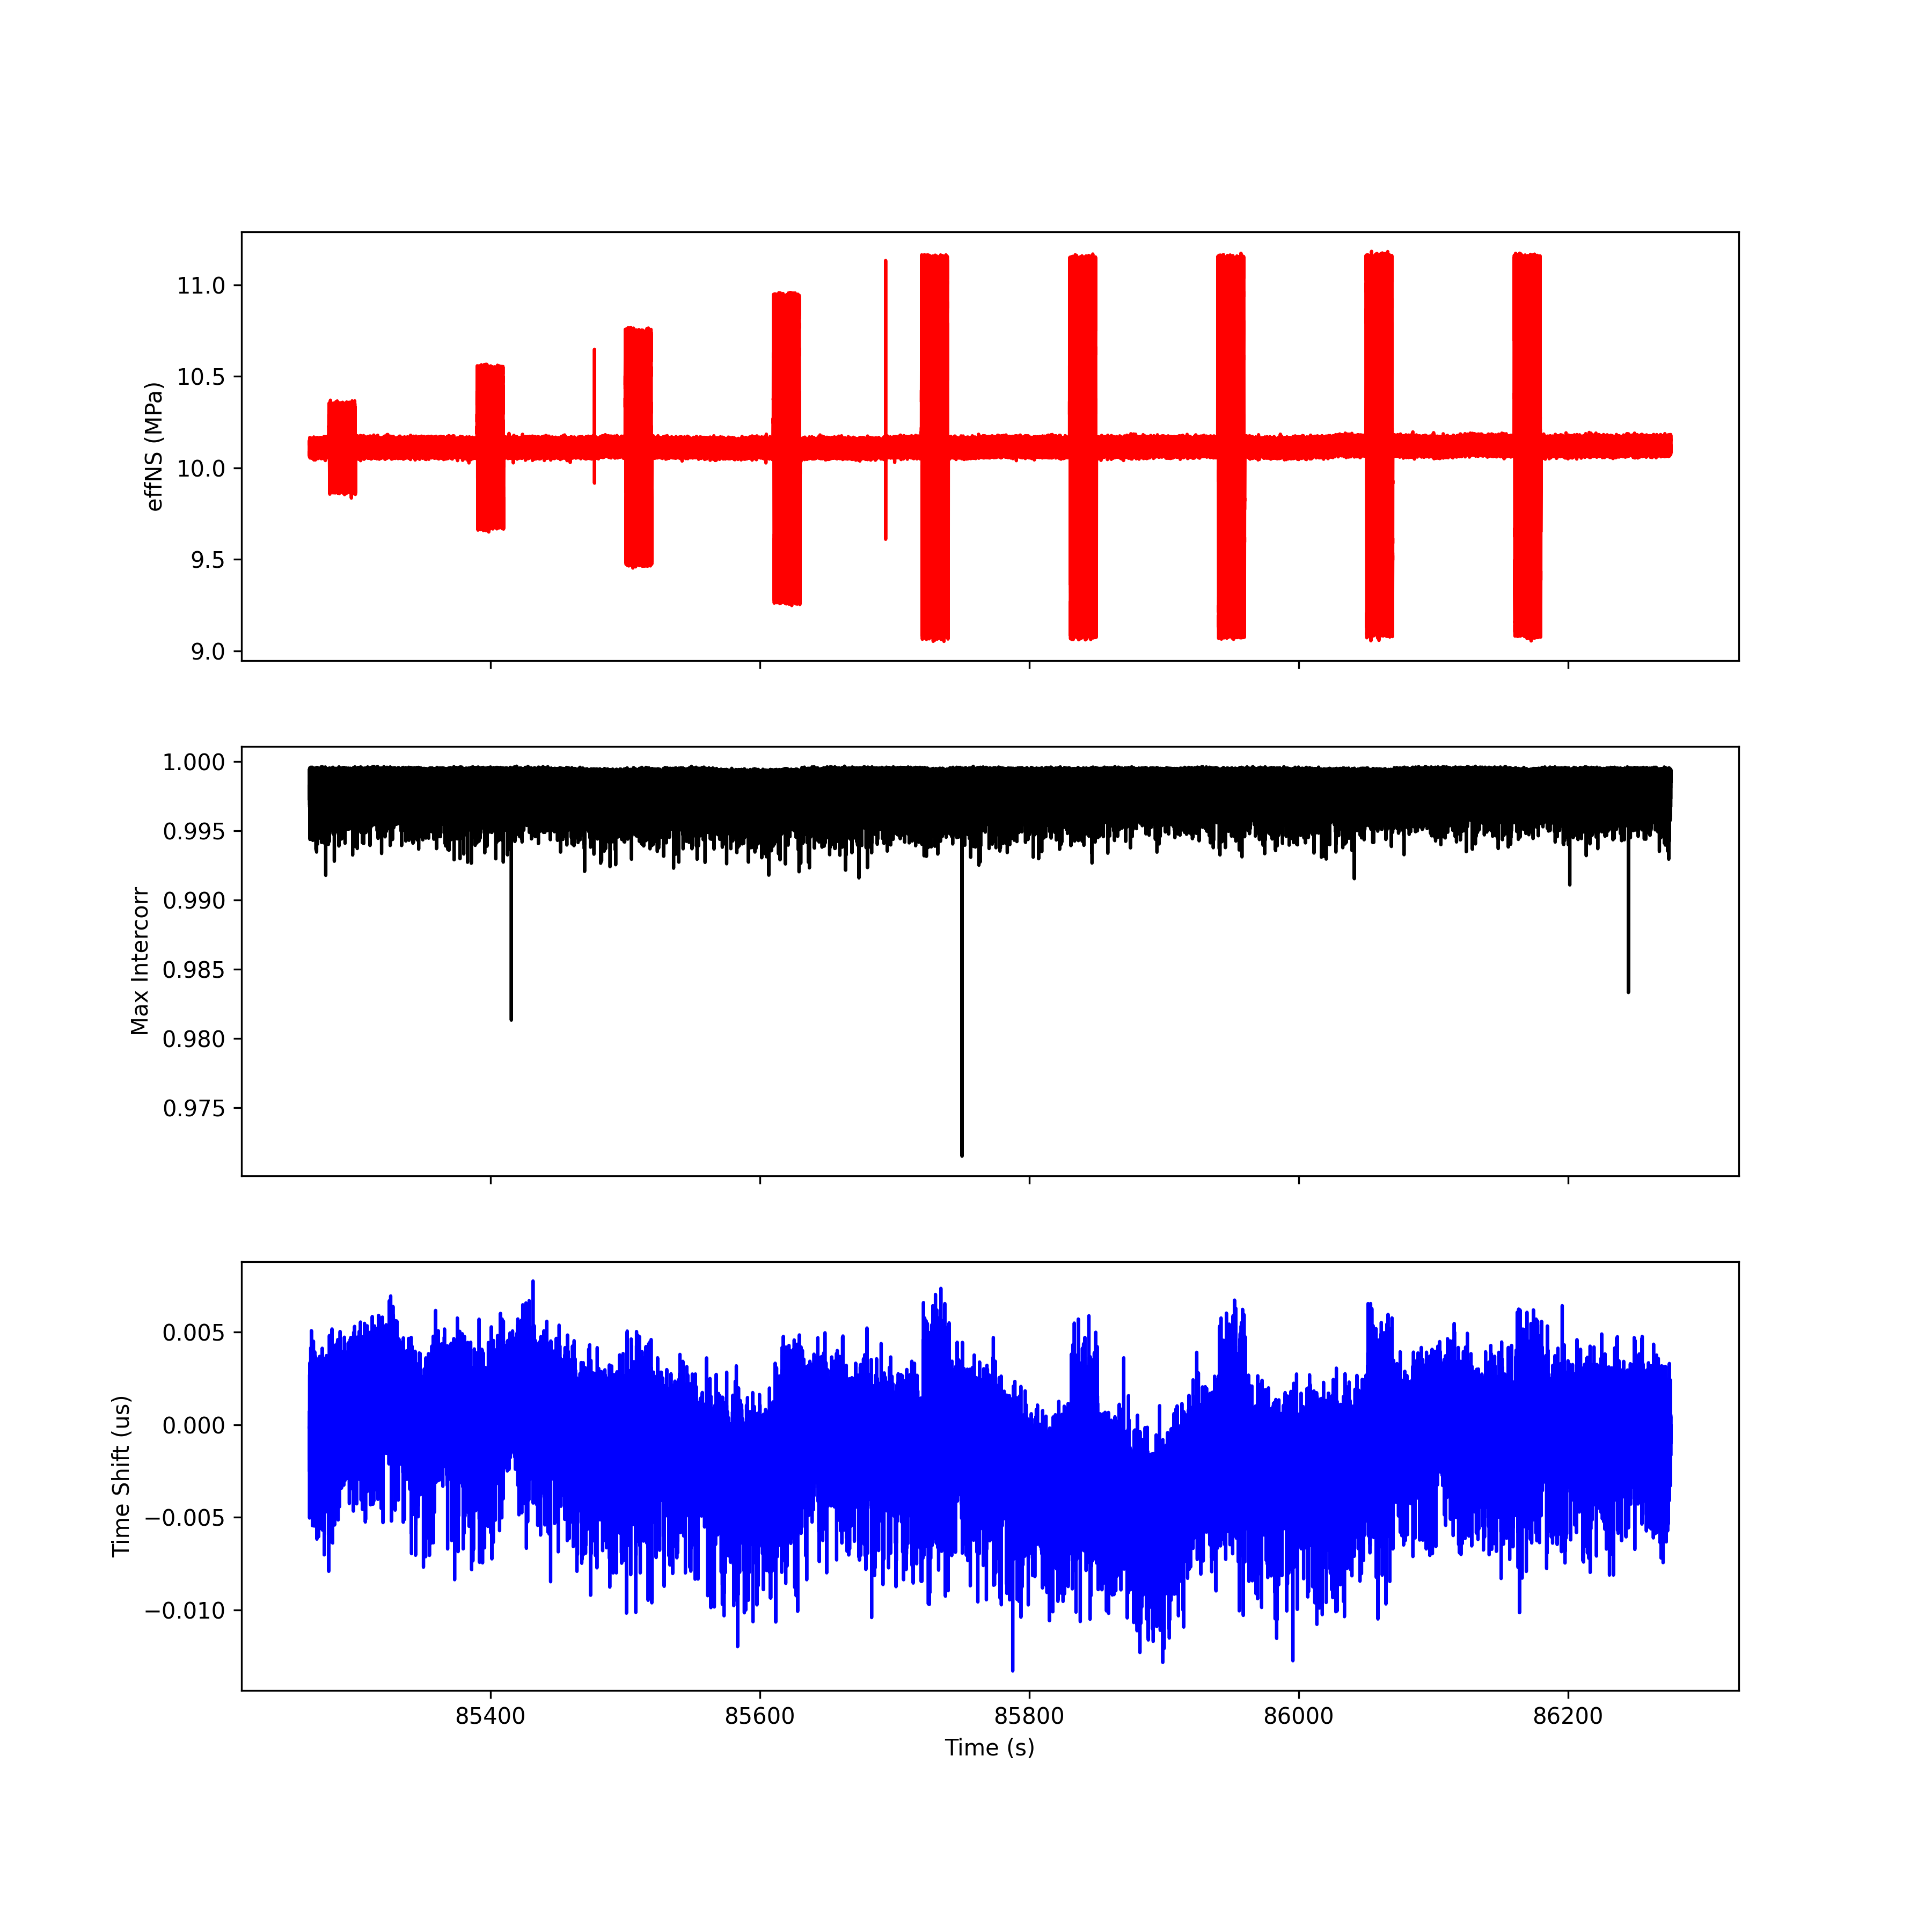
Run 2; T1 R1

Slide 14
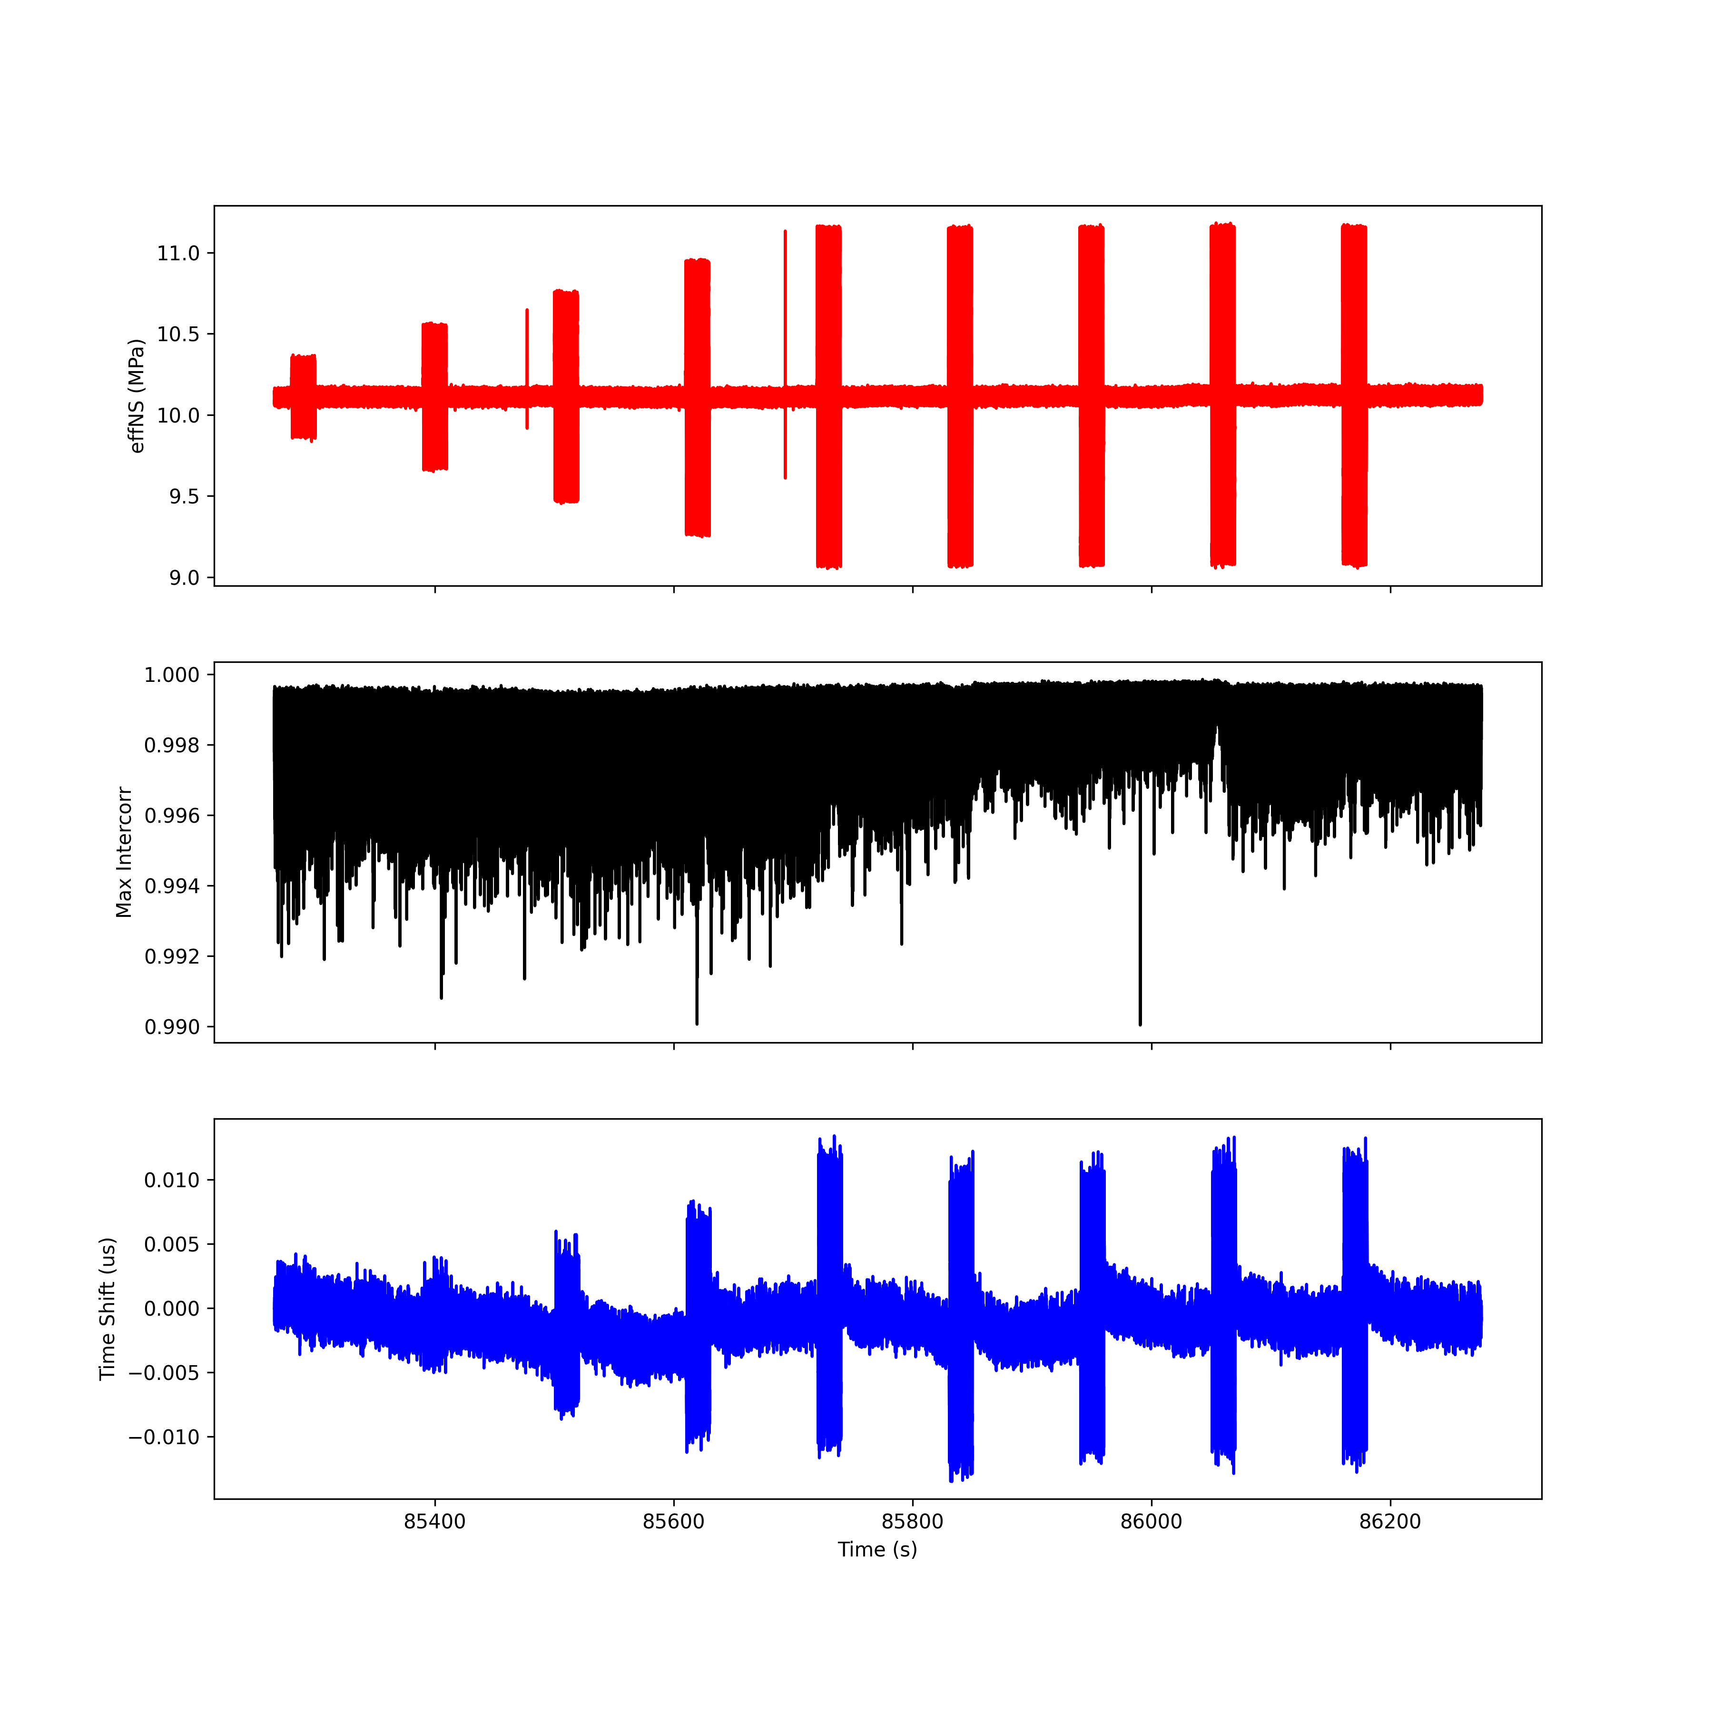
Run 2; T2 R2

Slide 15
Run 2; T3 R3

Slide 16
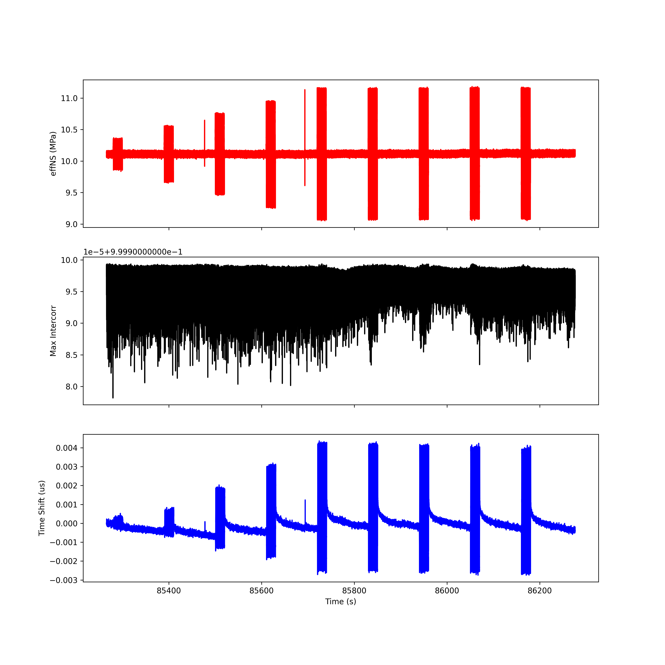
Run 2; T4 R4

Slide 17
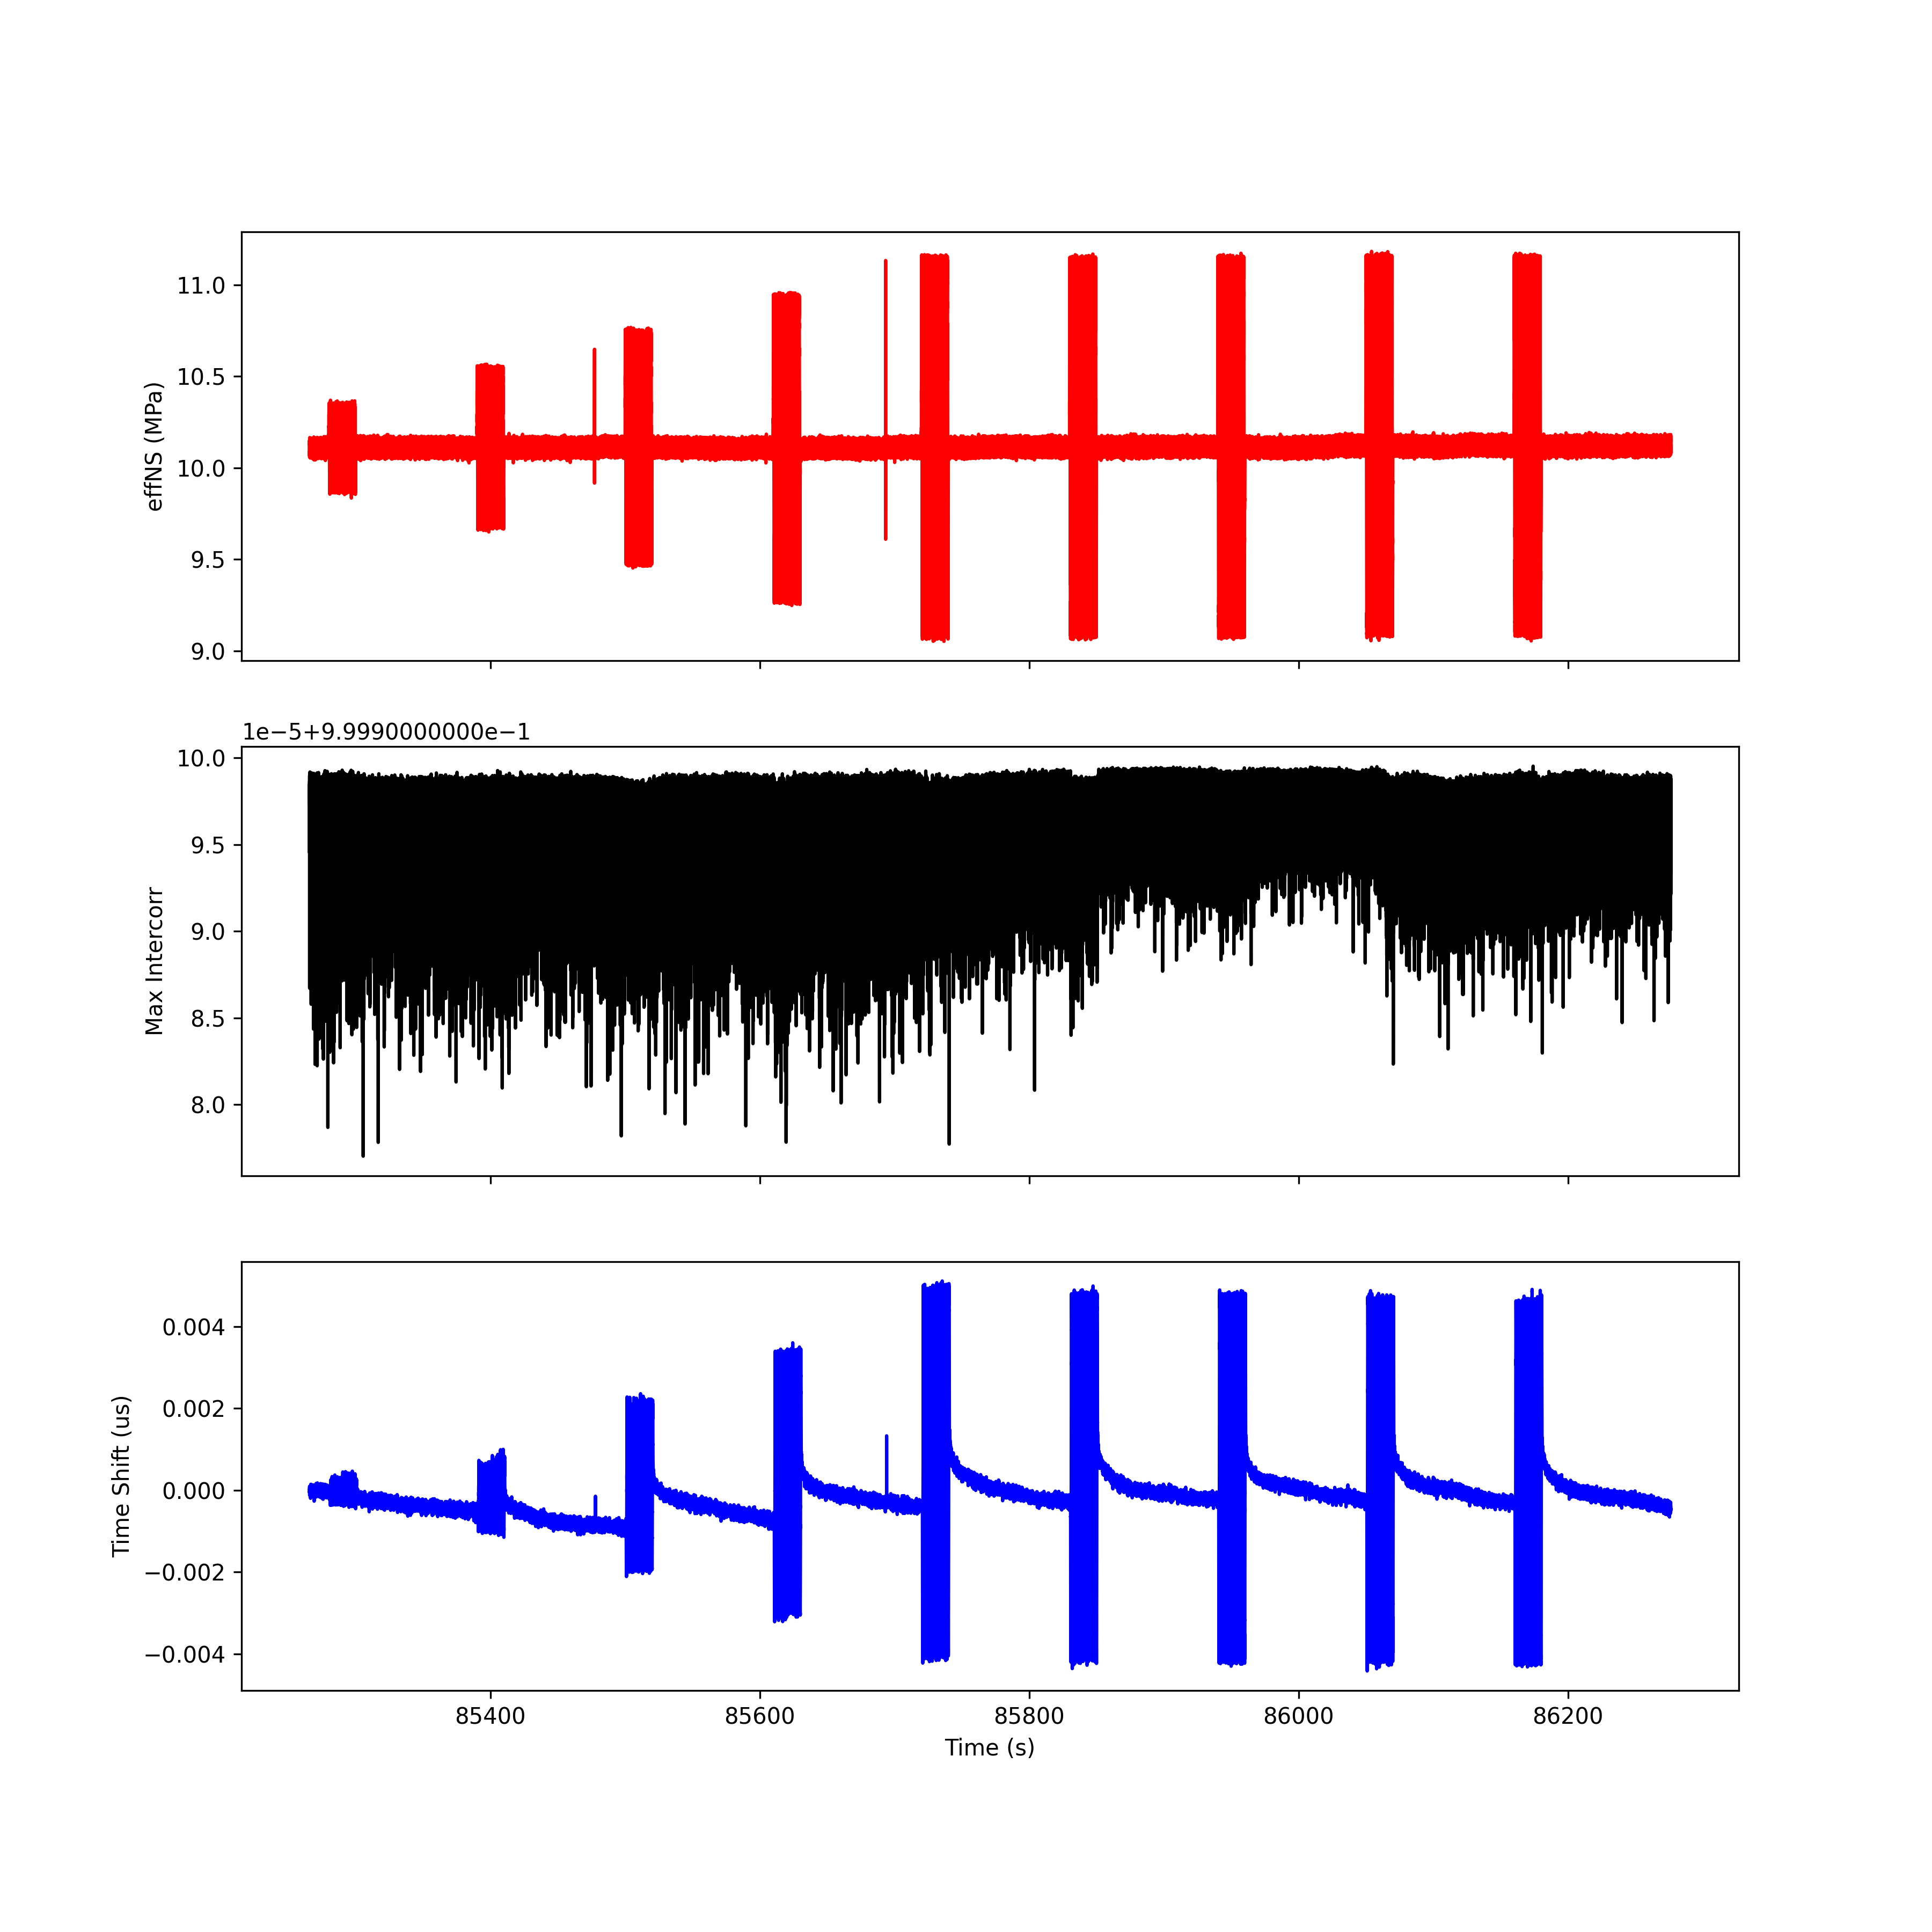
Run 2; T5 R5

Slide 18
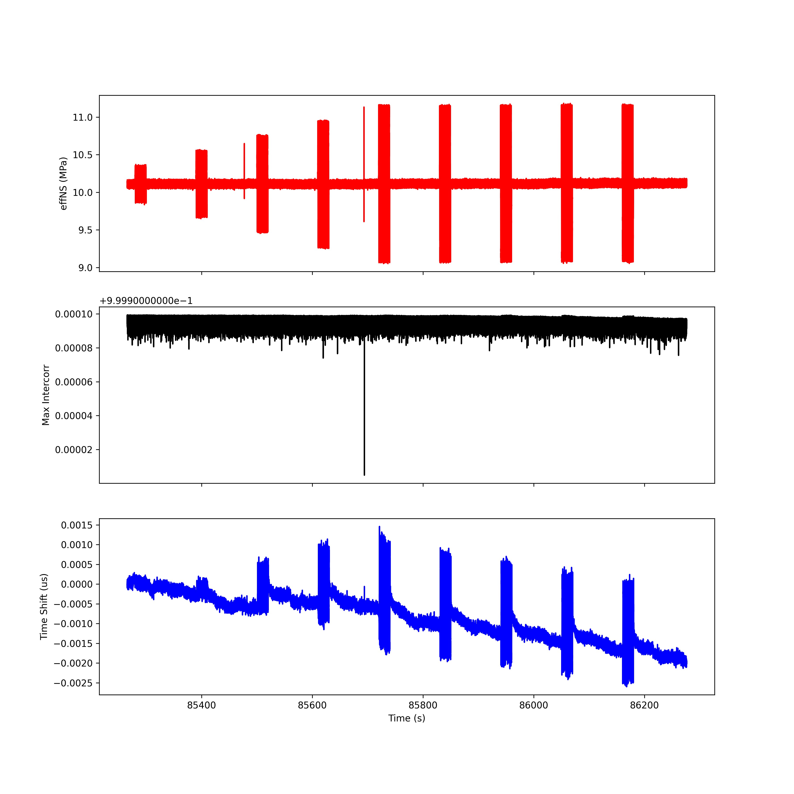
Run 2; T6 R6

Slide 19
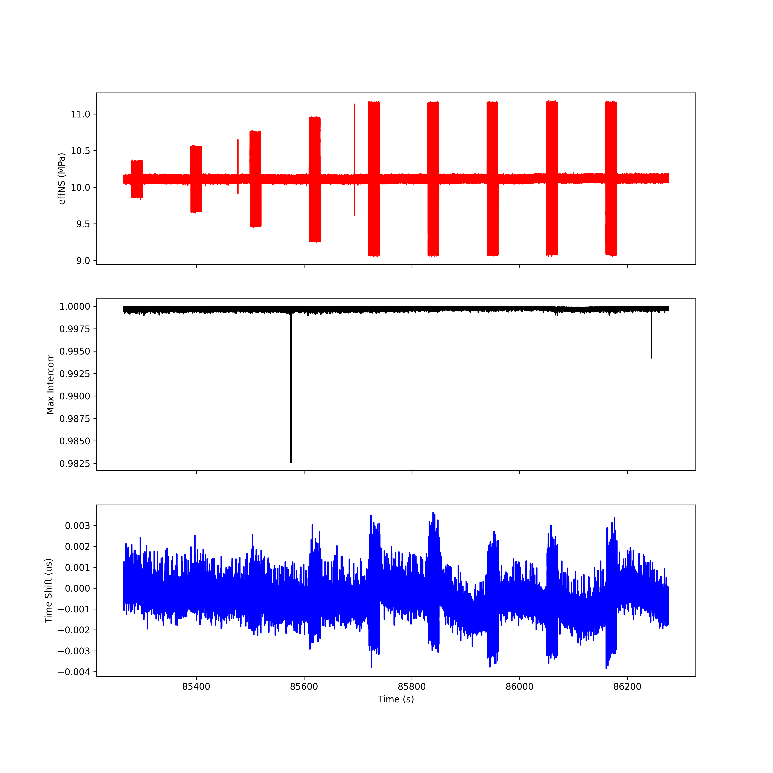
Run 2; T7 R7

Slide 20
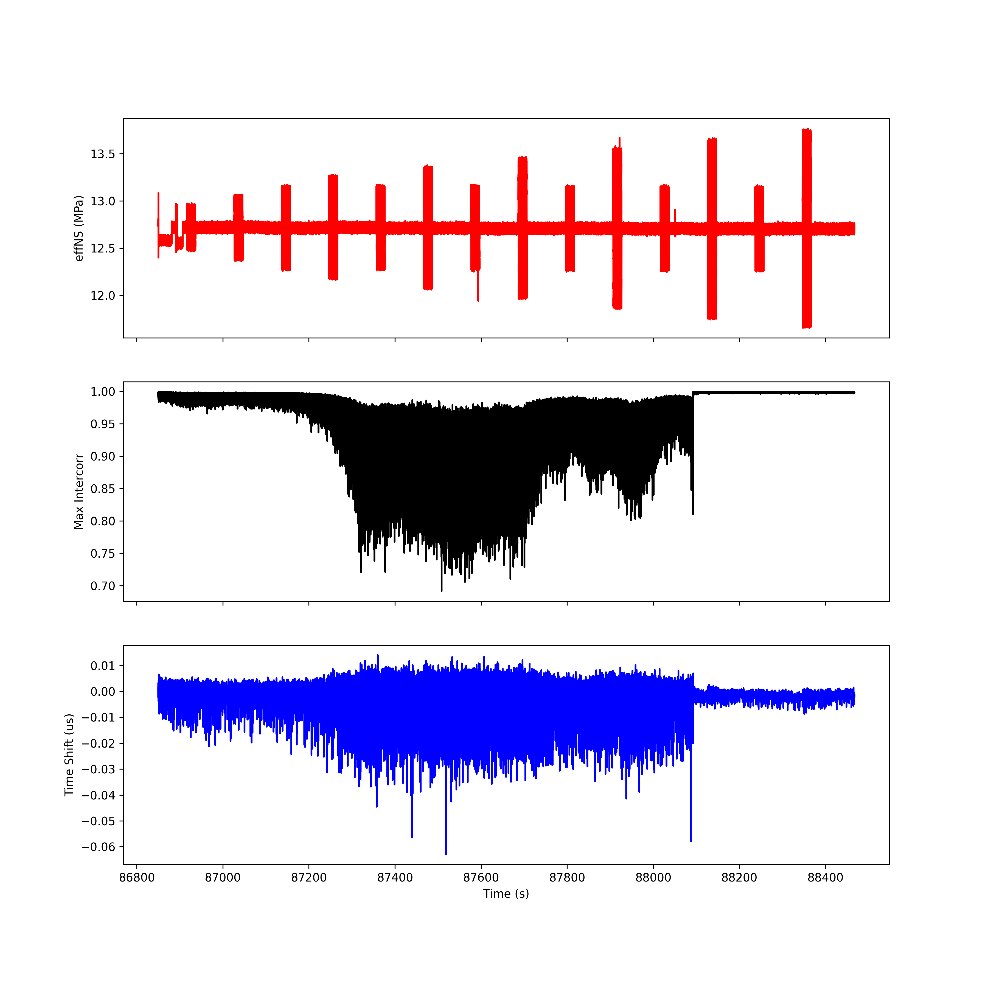
Run 3; T1 R1

Slide 21
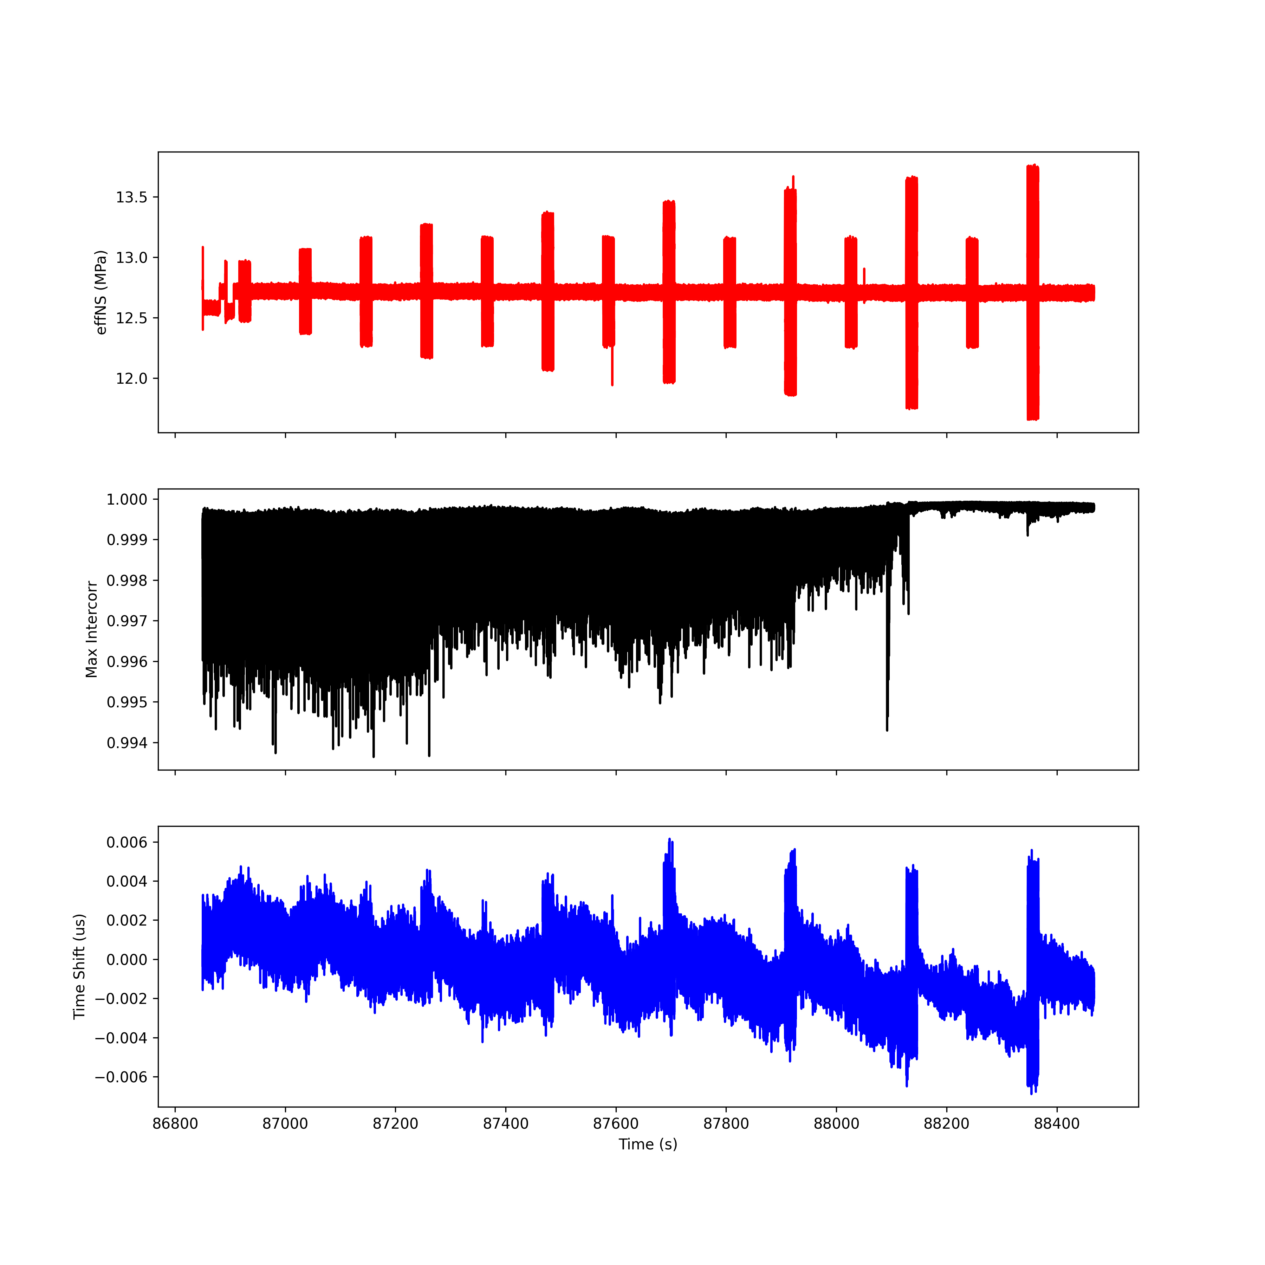
Run 3; T2 R2

Slide 22
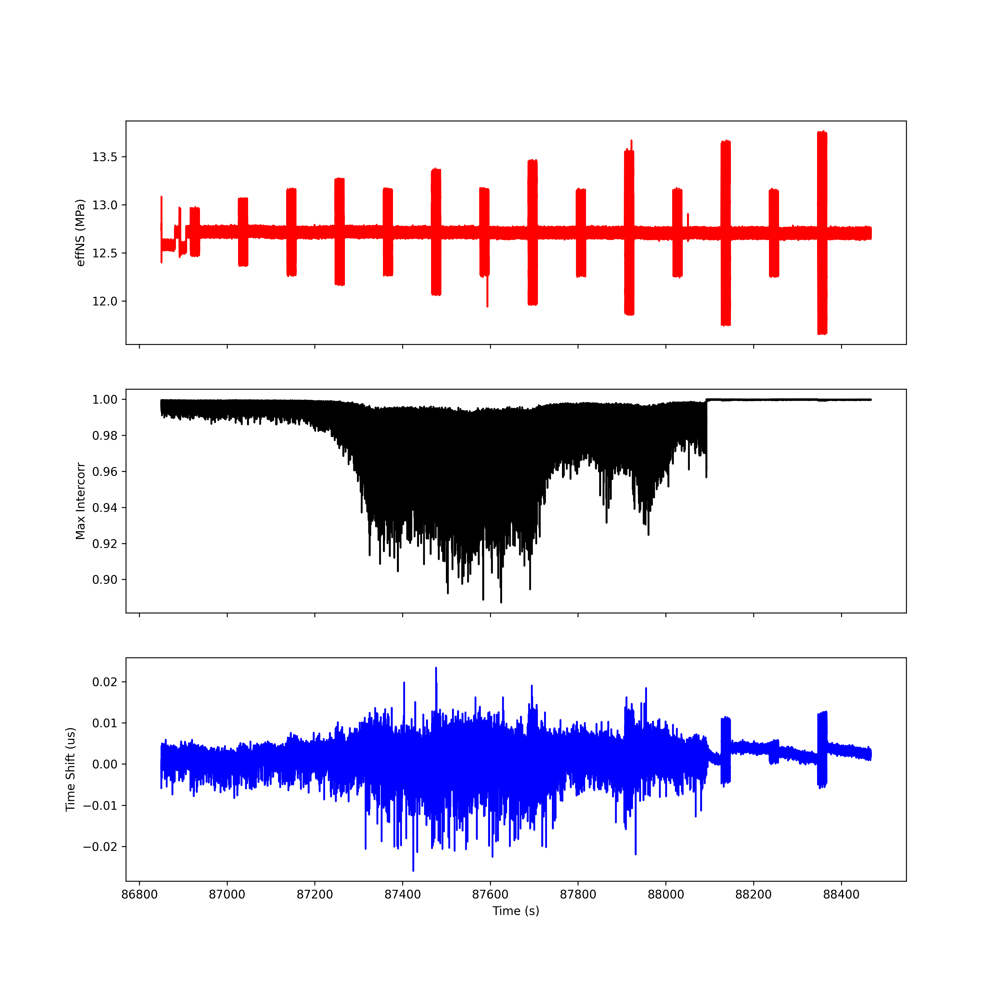
Run 3; T3 R3

Slide 23
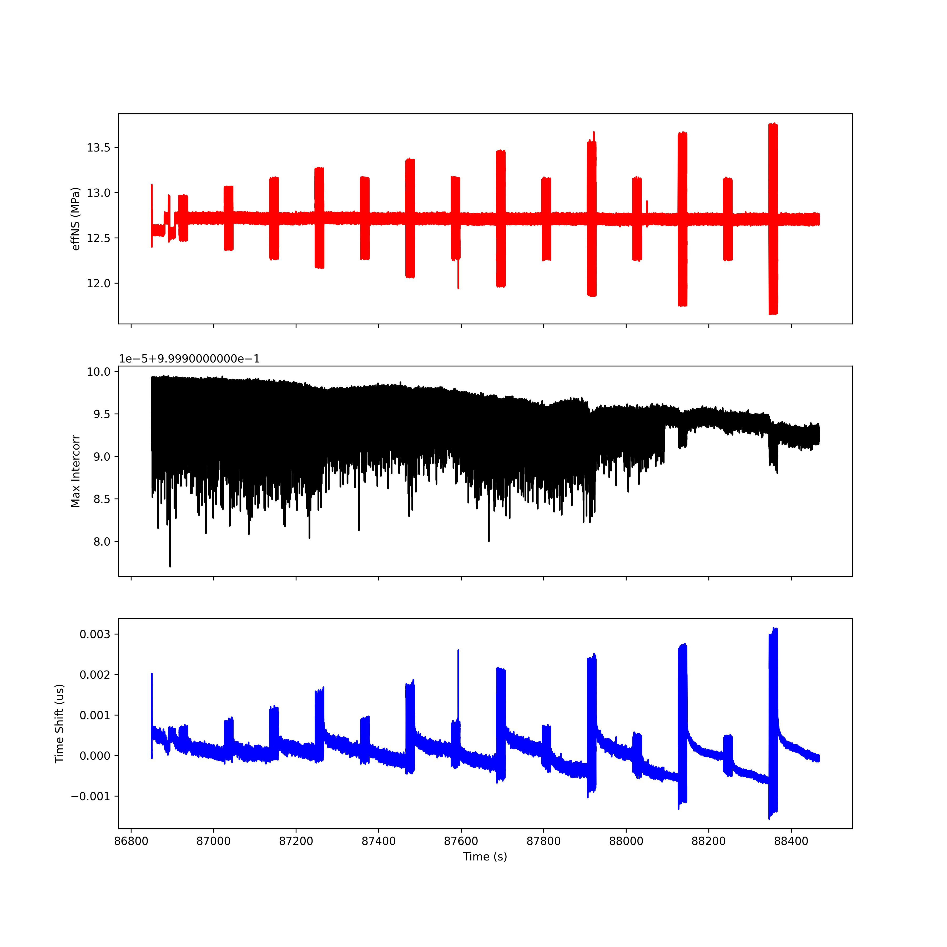
Run 3; T4 R4

Slide 24
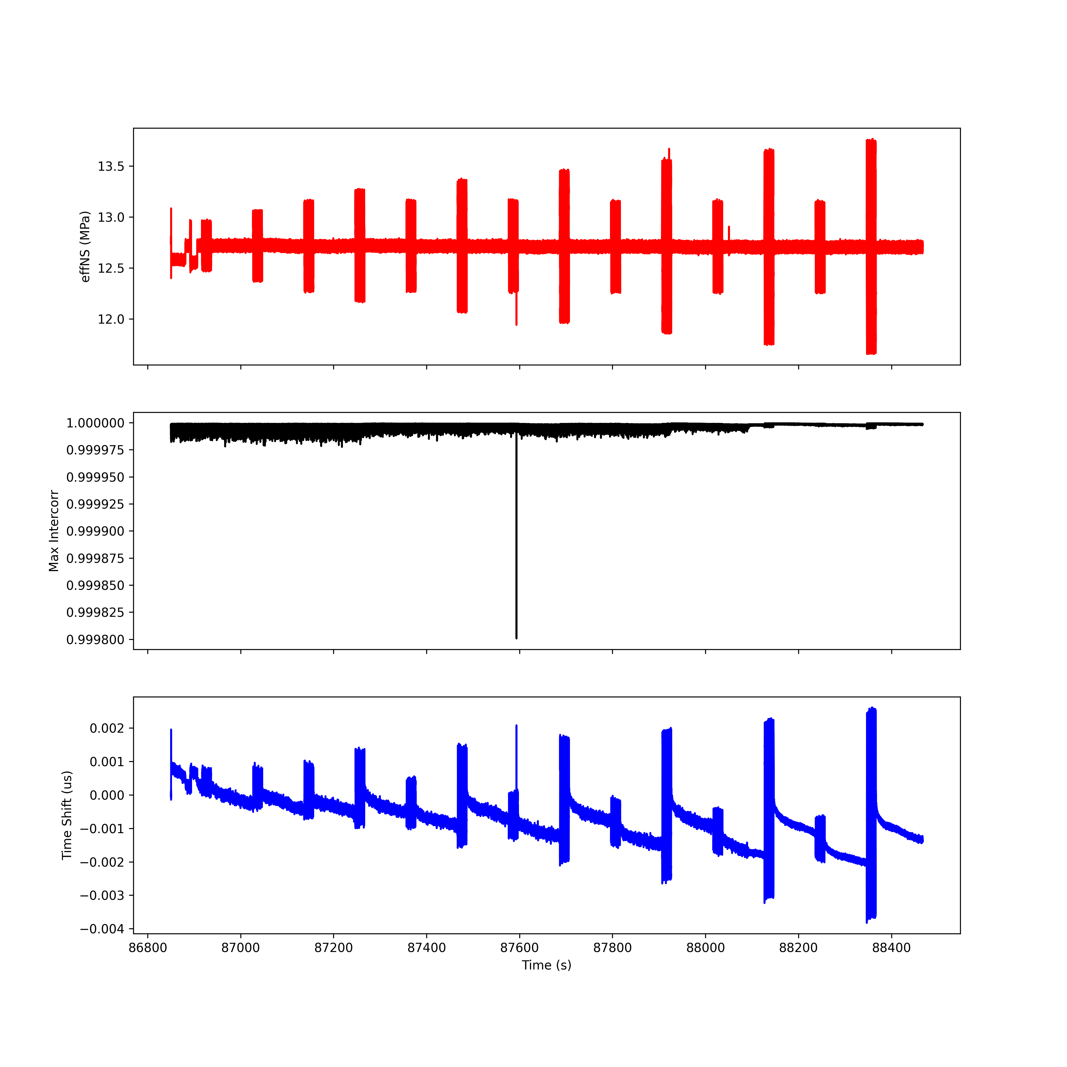
Run 3; T5 R5

Slide 25
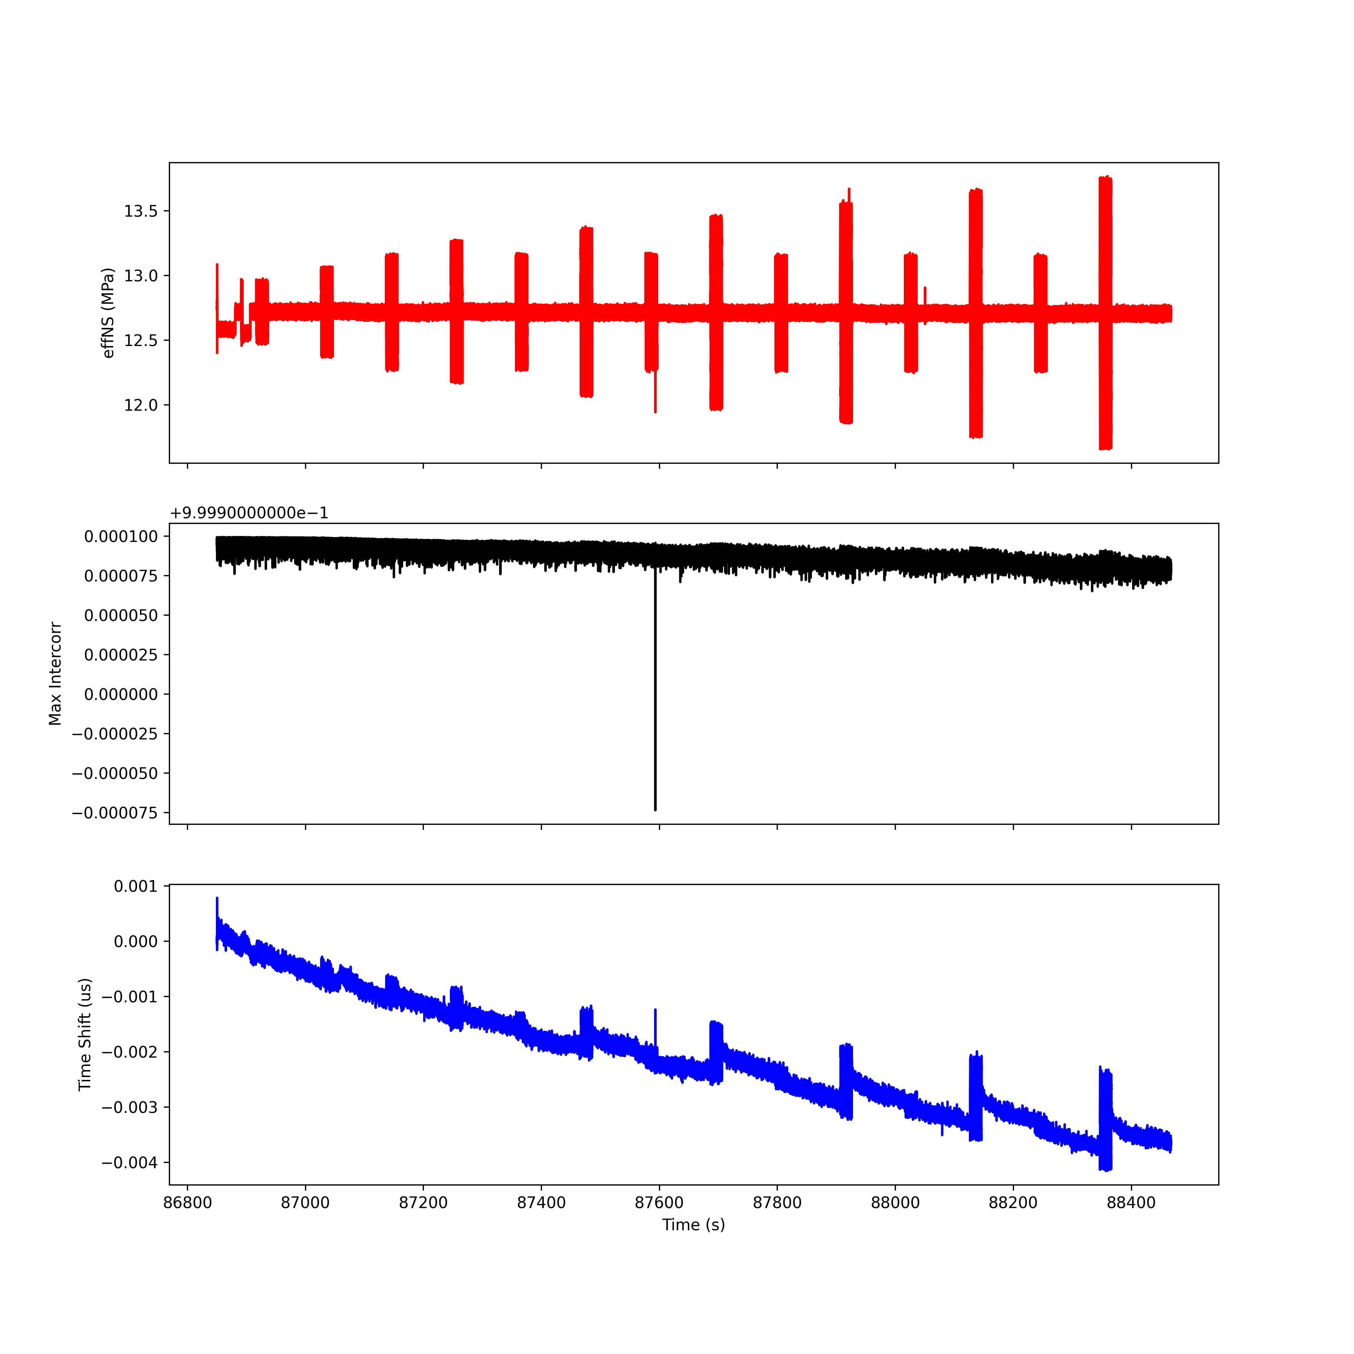
Run 3; T6 R6

Slide 26
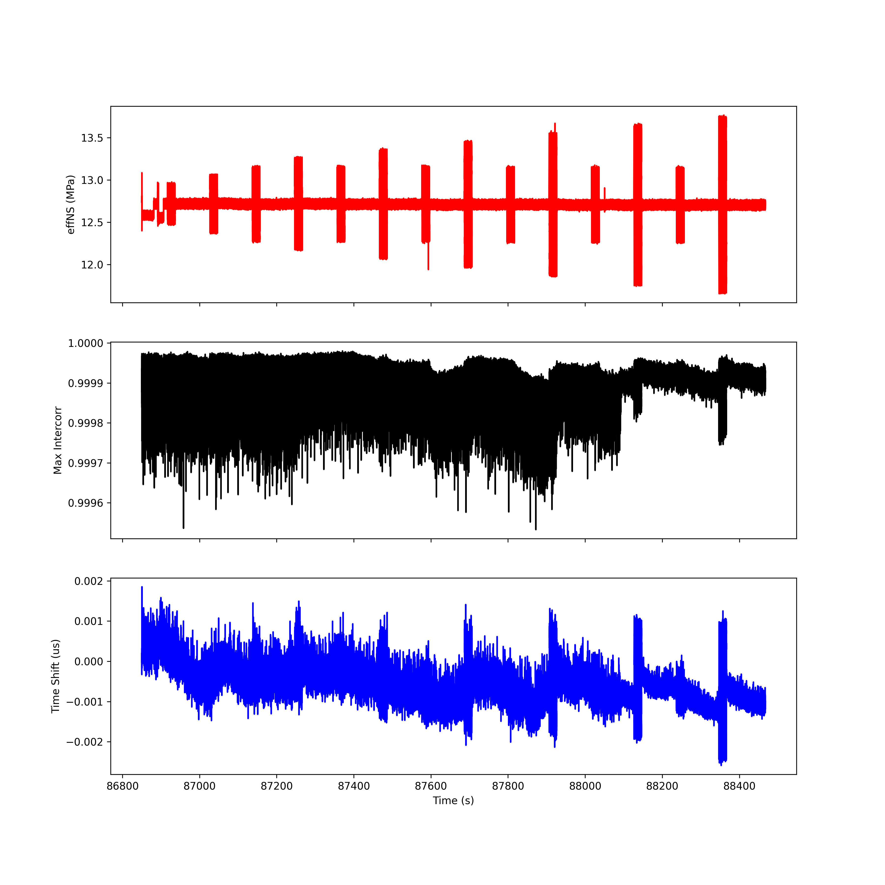
Run 3; T7 R7

Slide 27
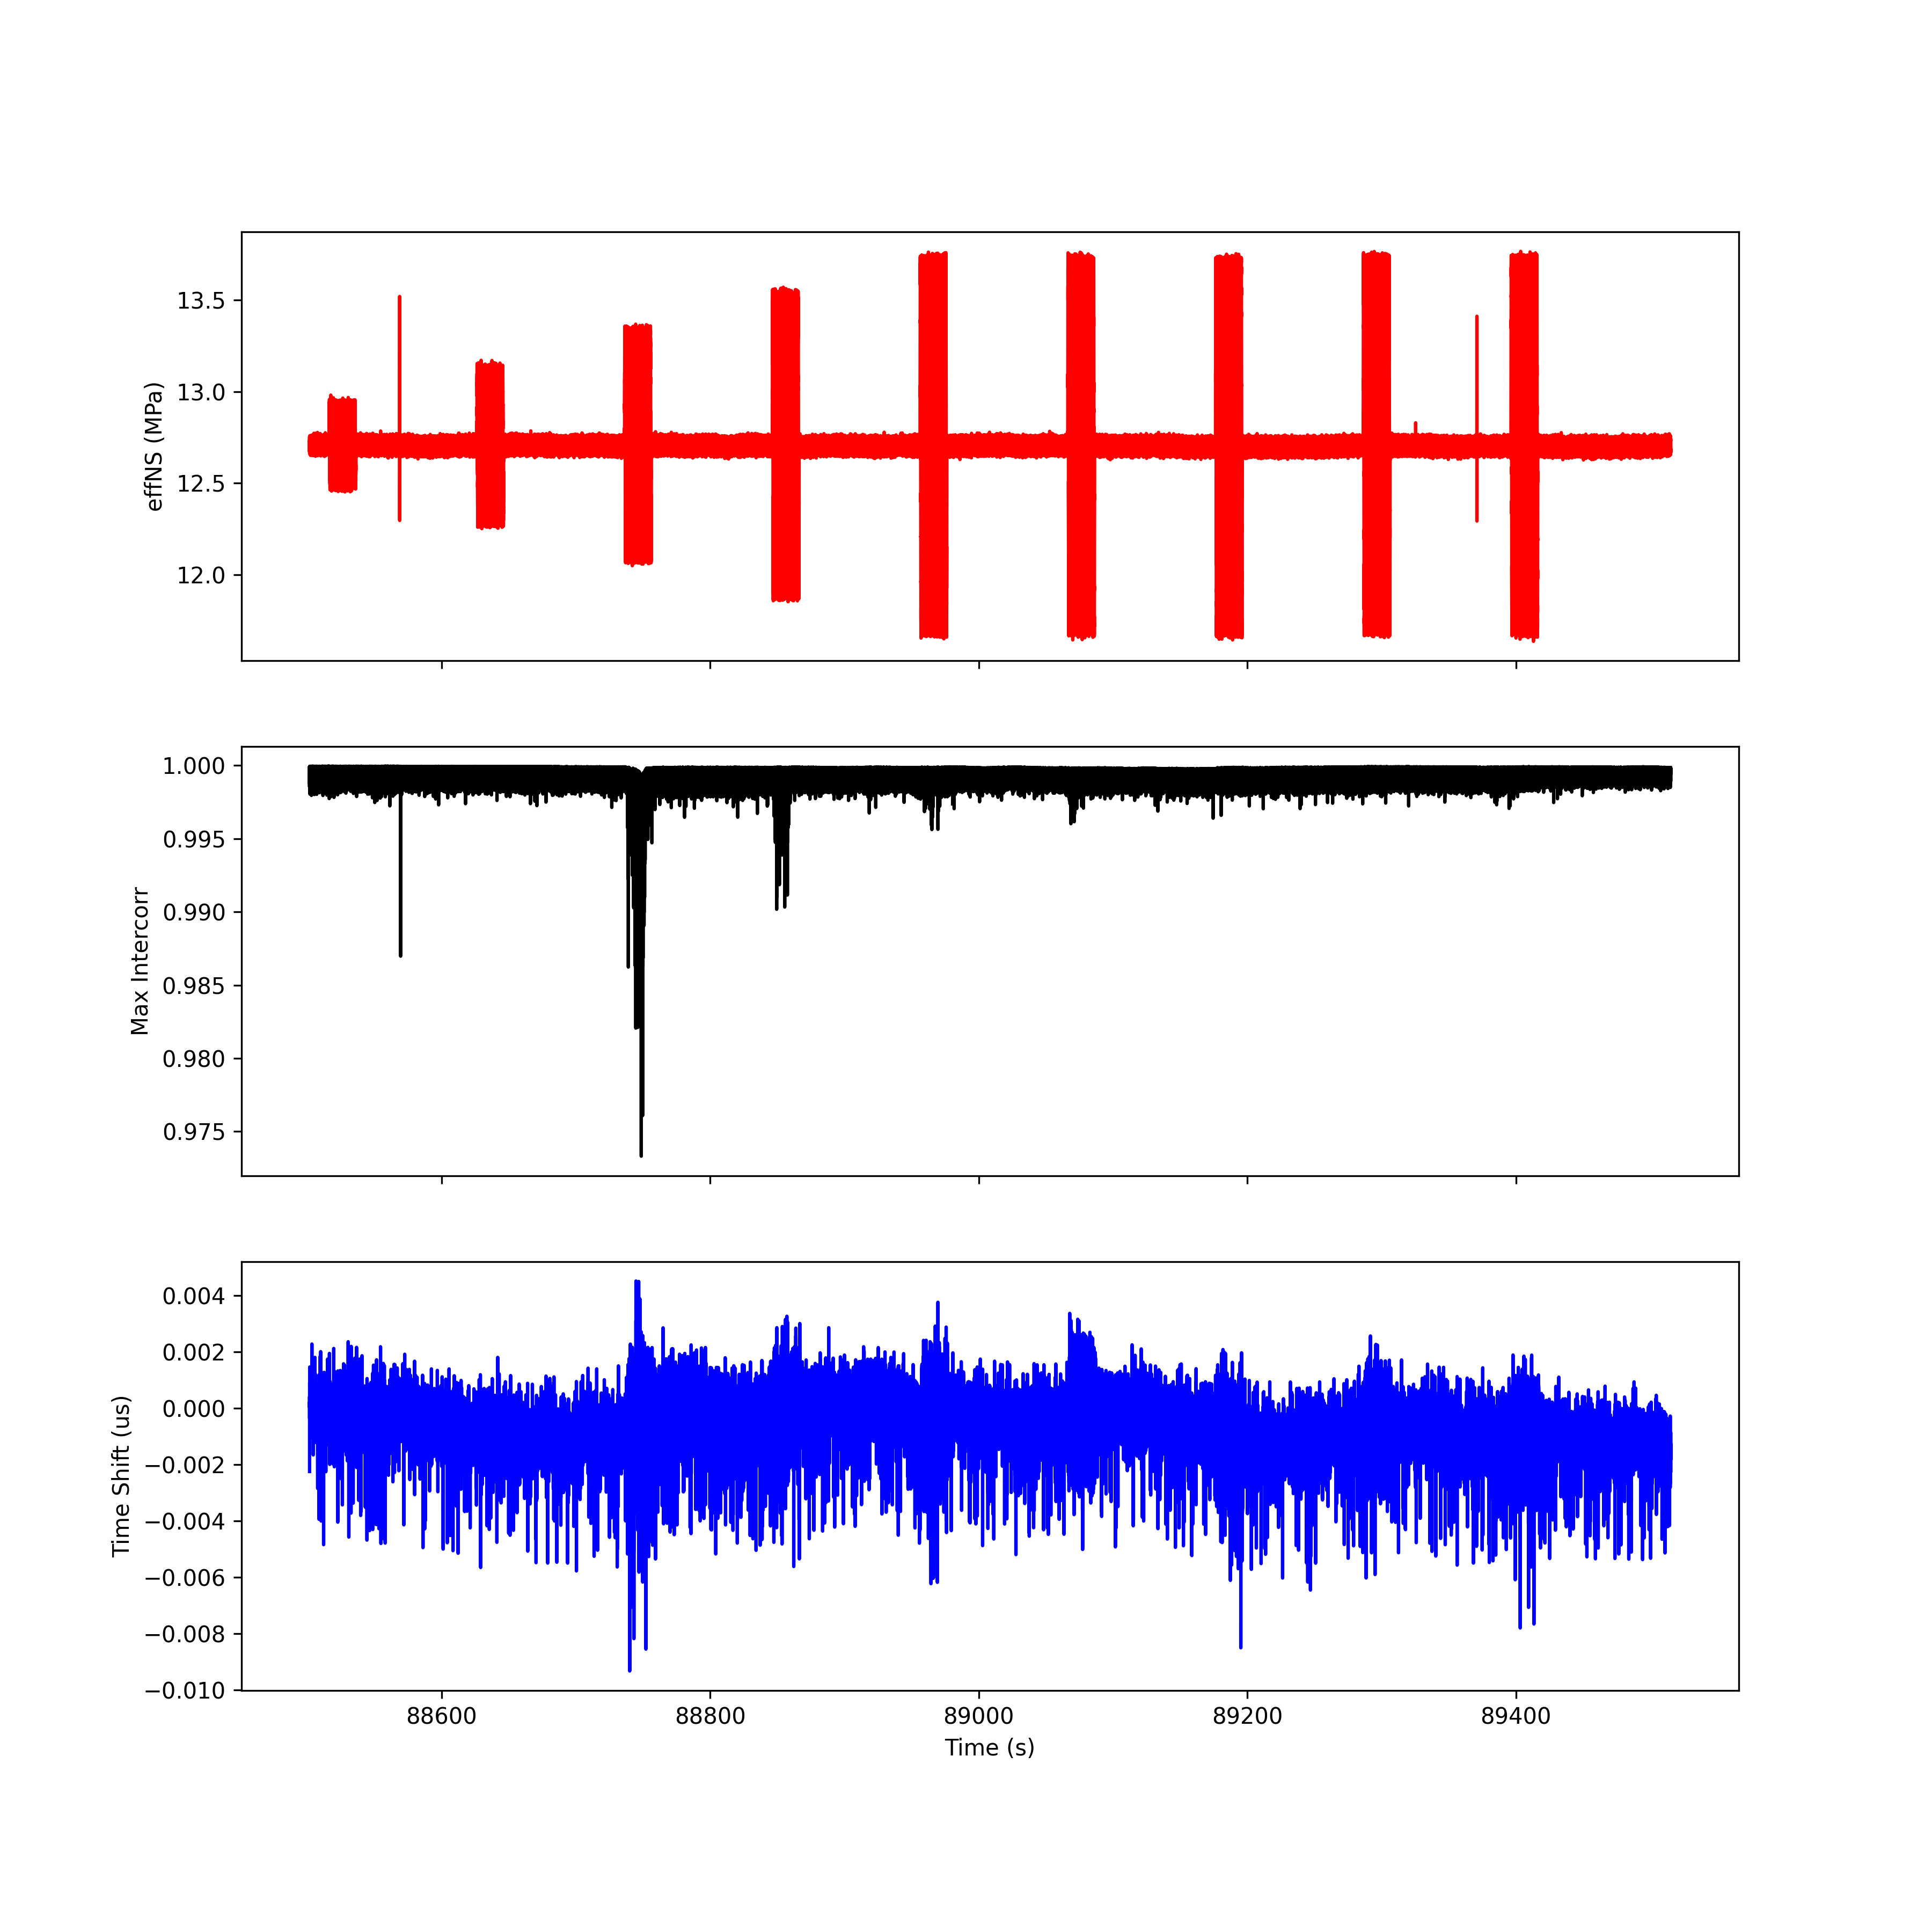
Run 4; T1 R1

Slide 28
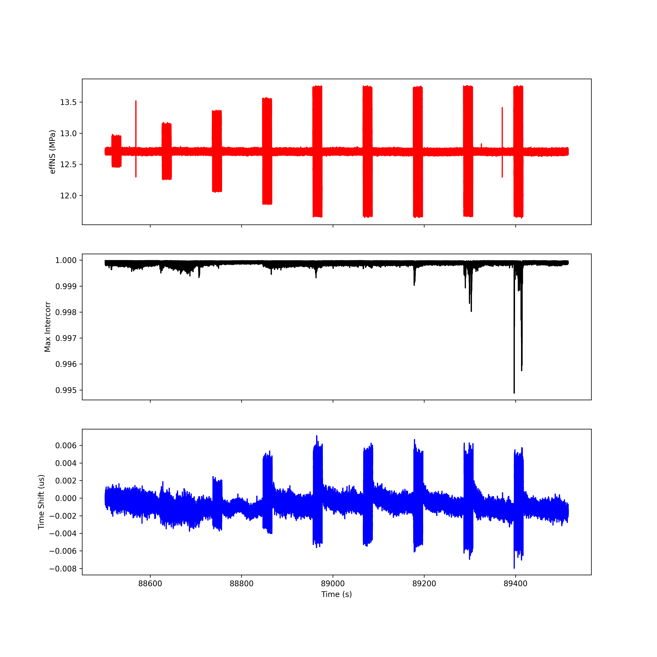
Run 4; T2 R2

Slide 29
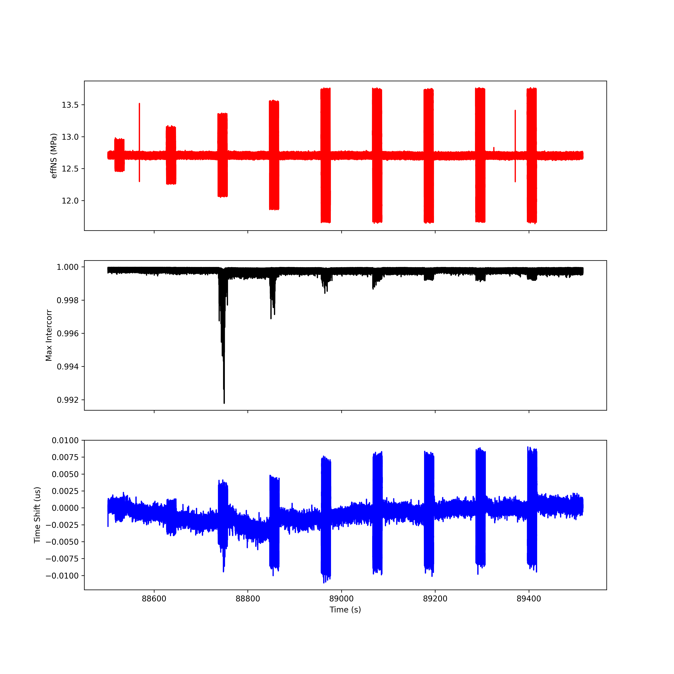
Run 4; T3 R3

Slide 30
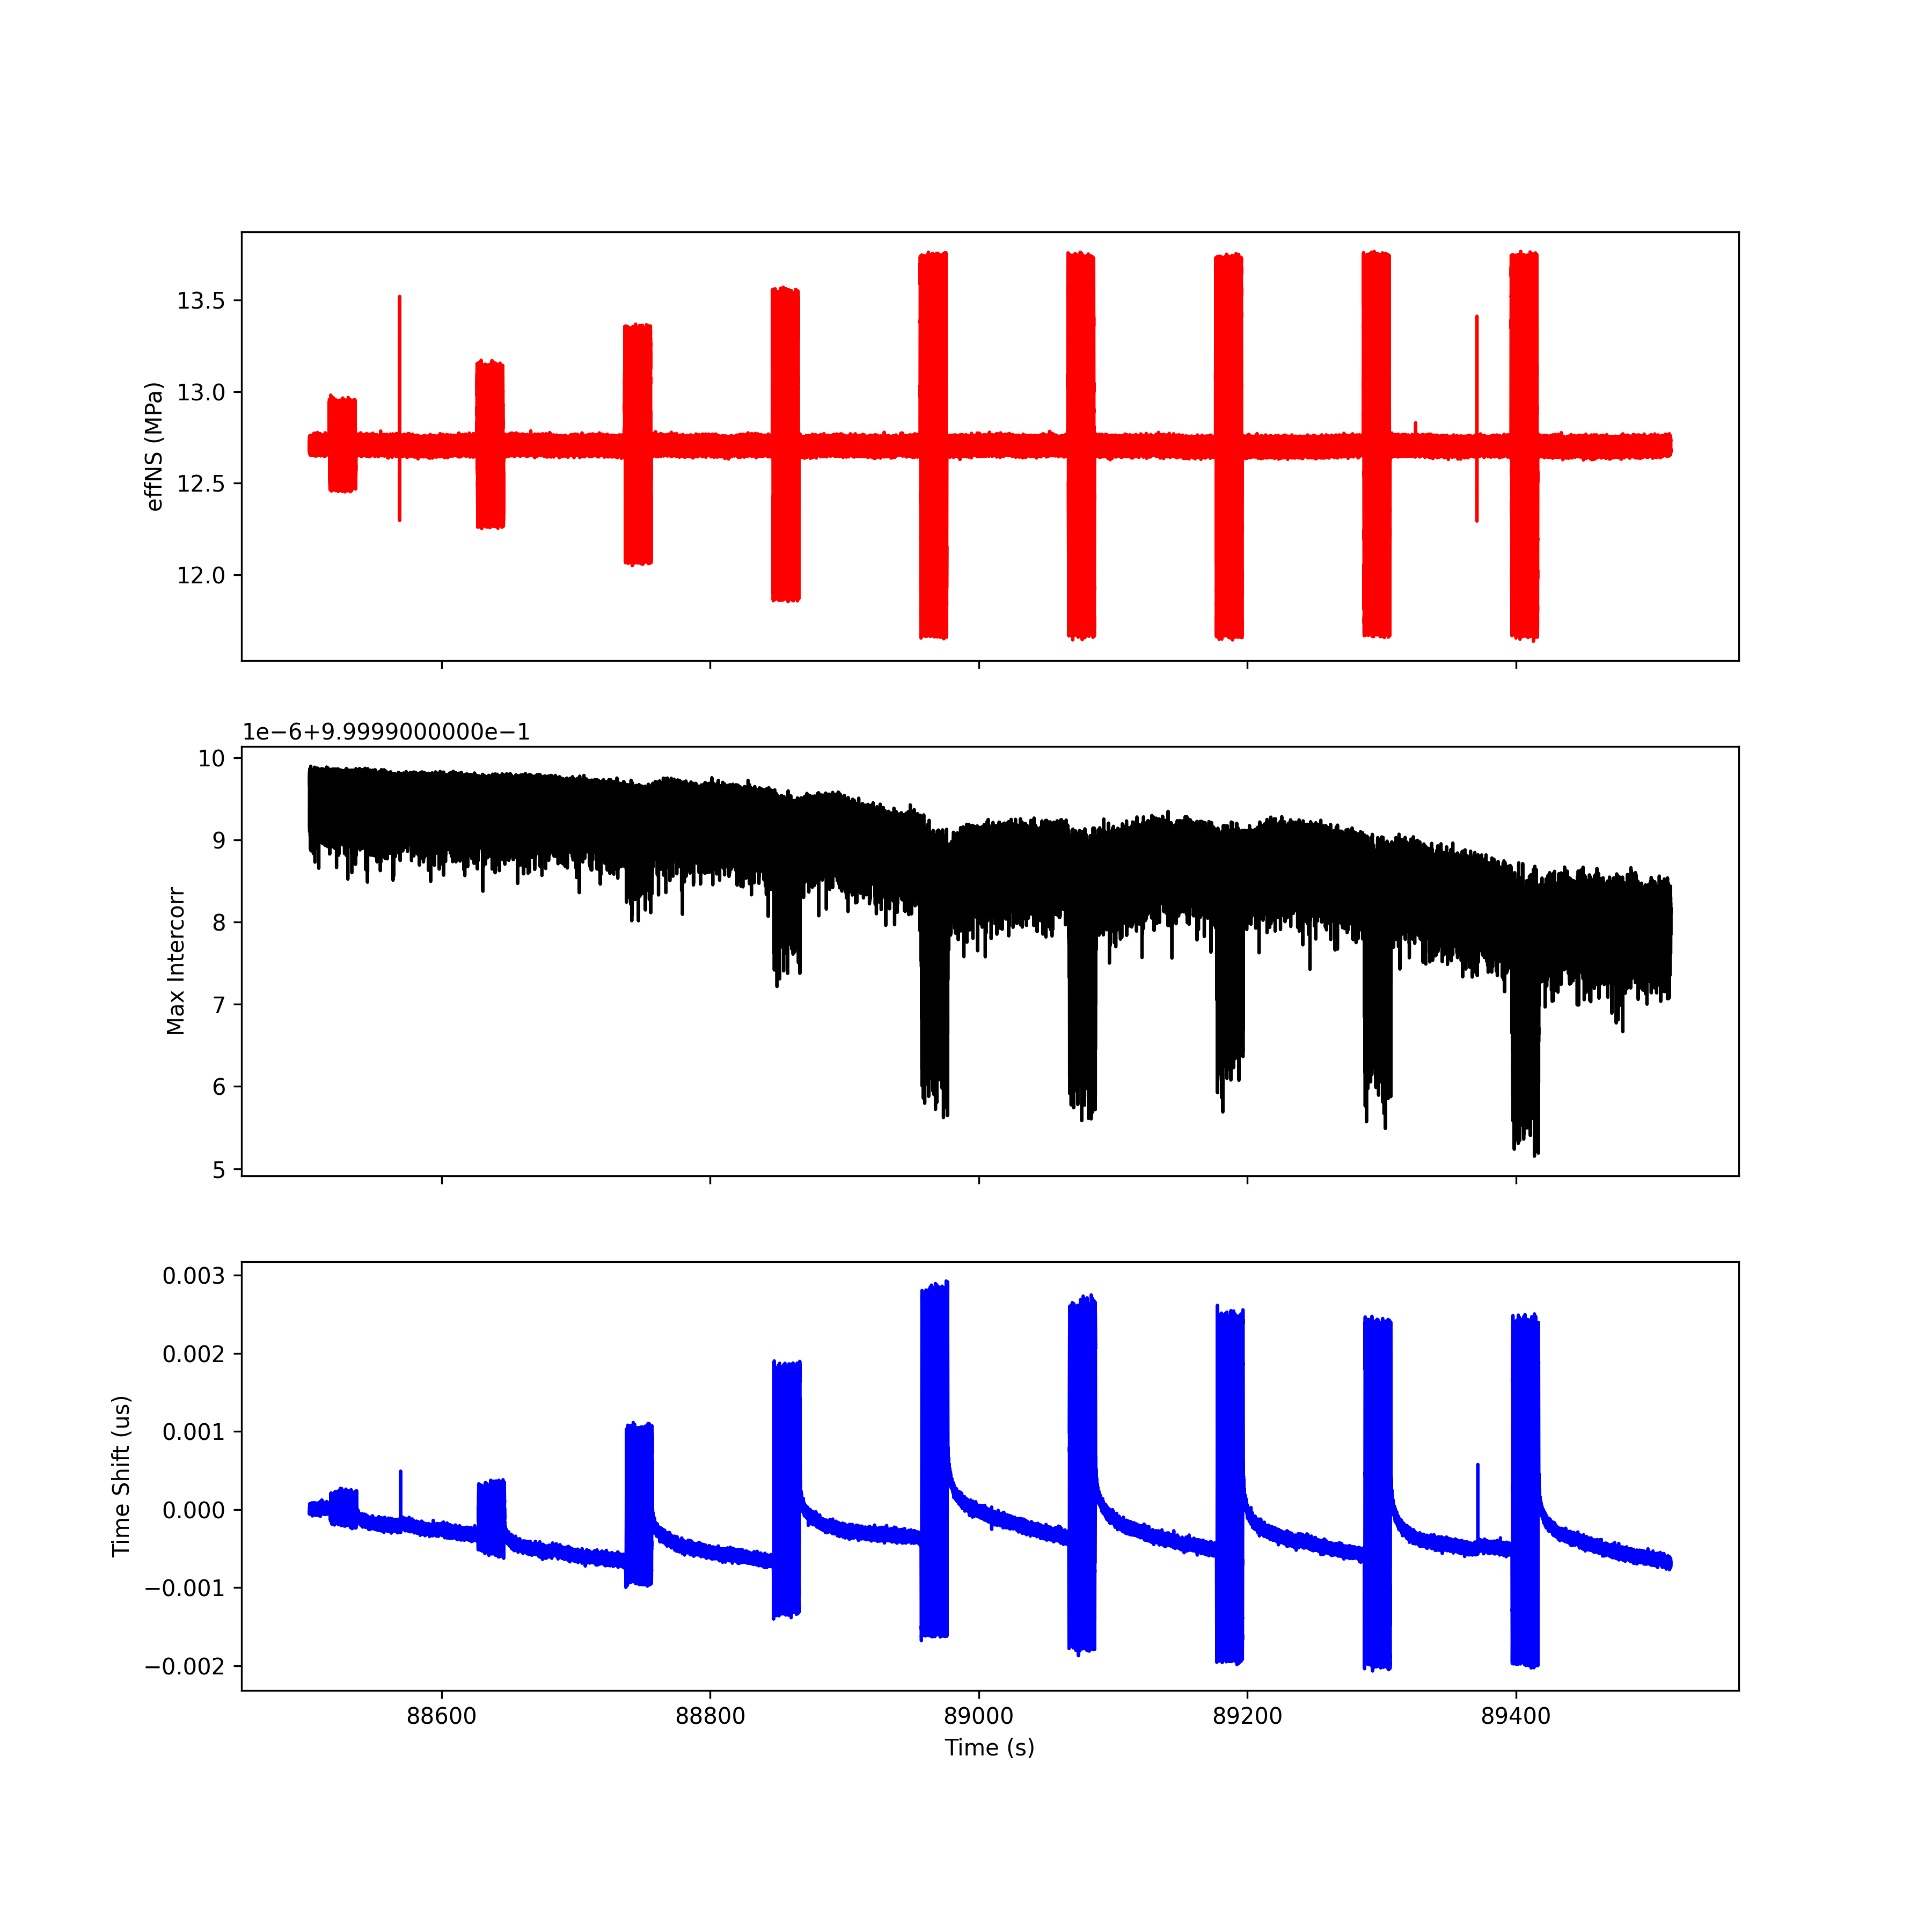
Run 4; T4 R4

Slide 31
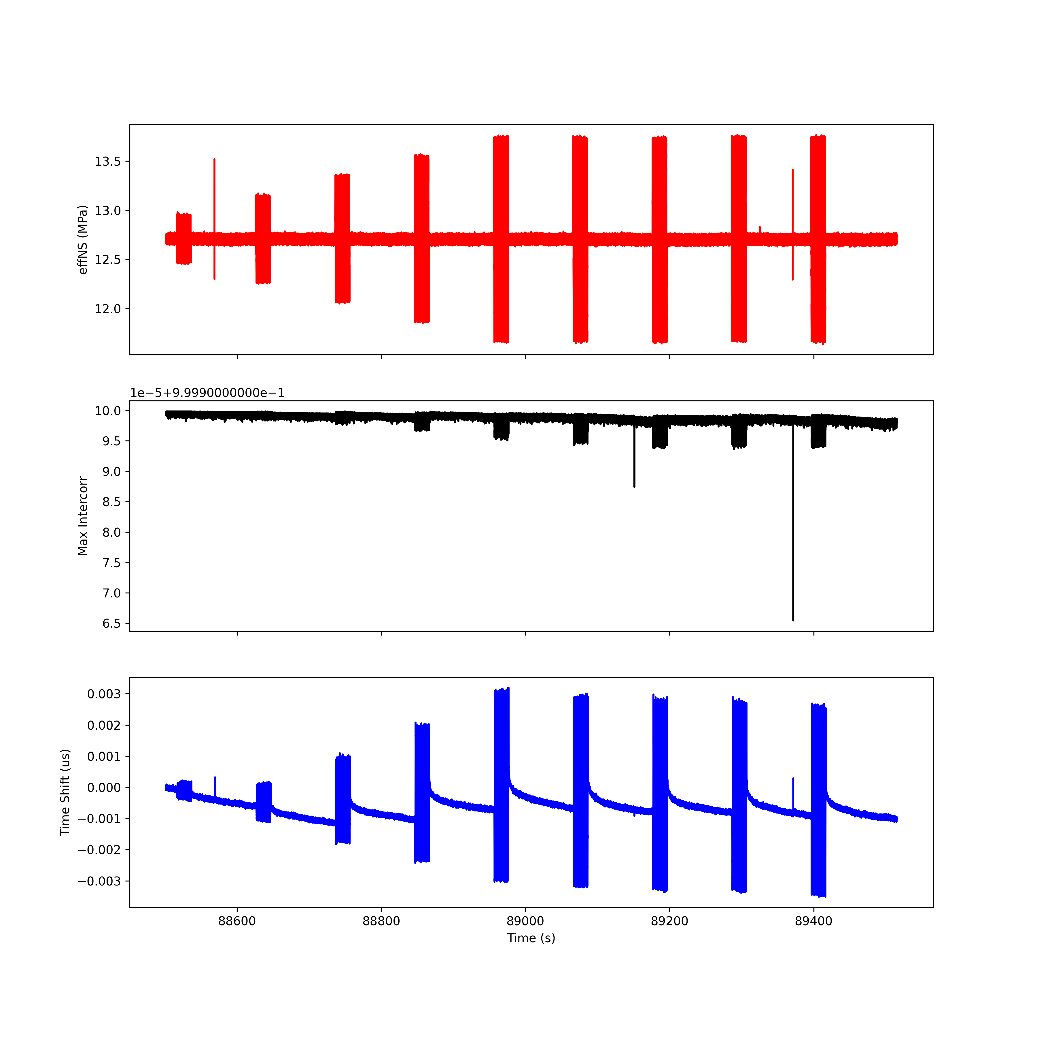
Run 4; T5 R5

Slide 32
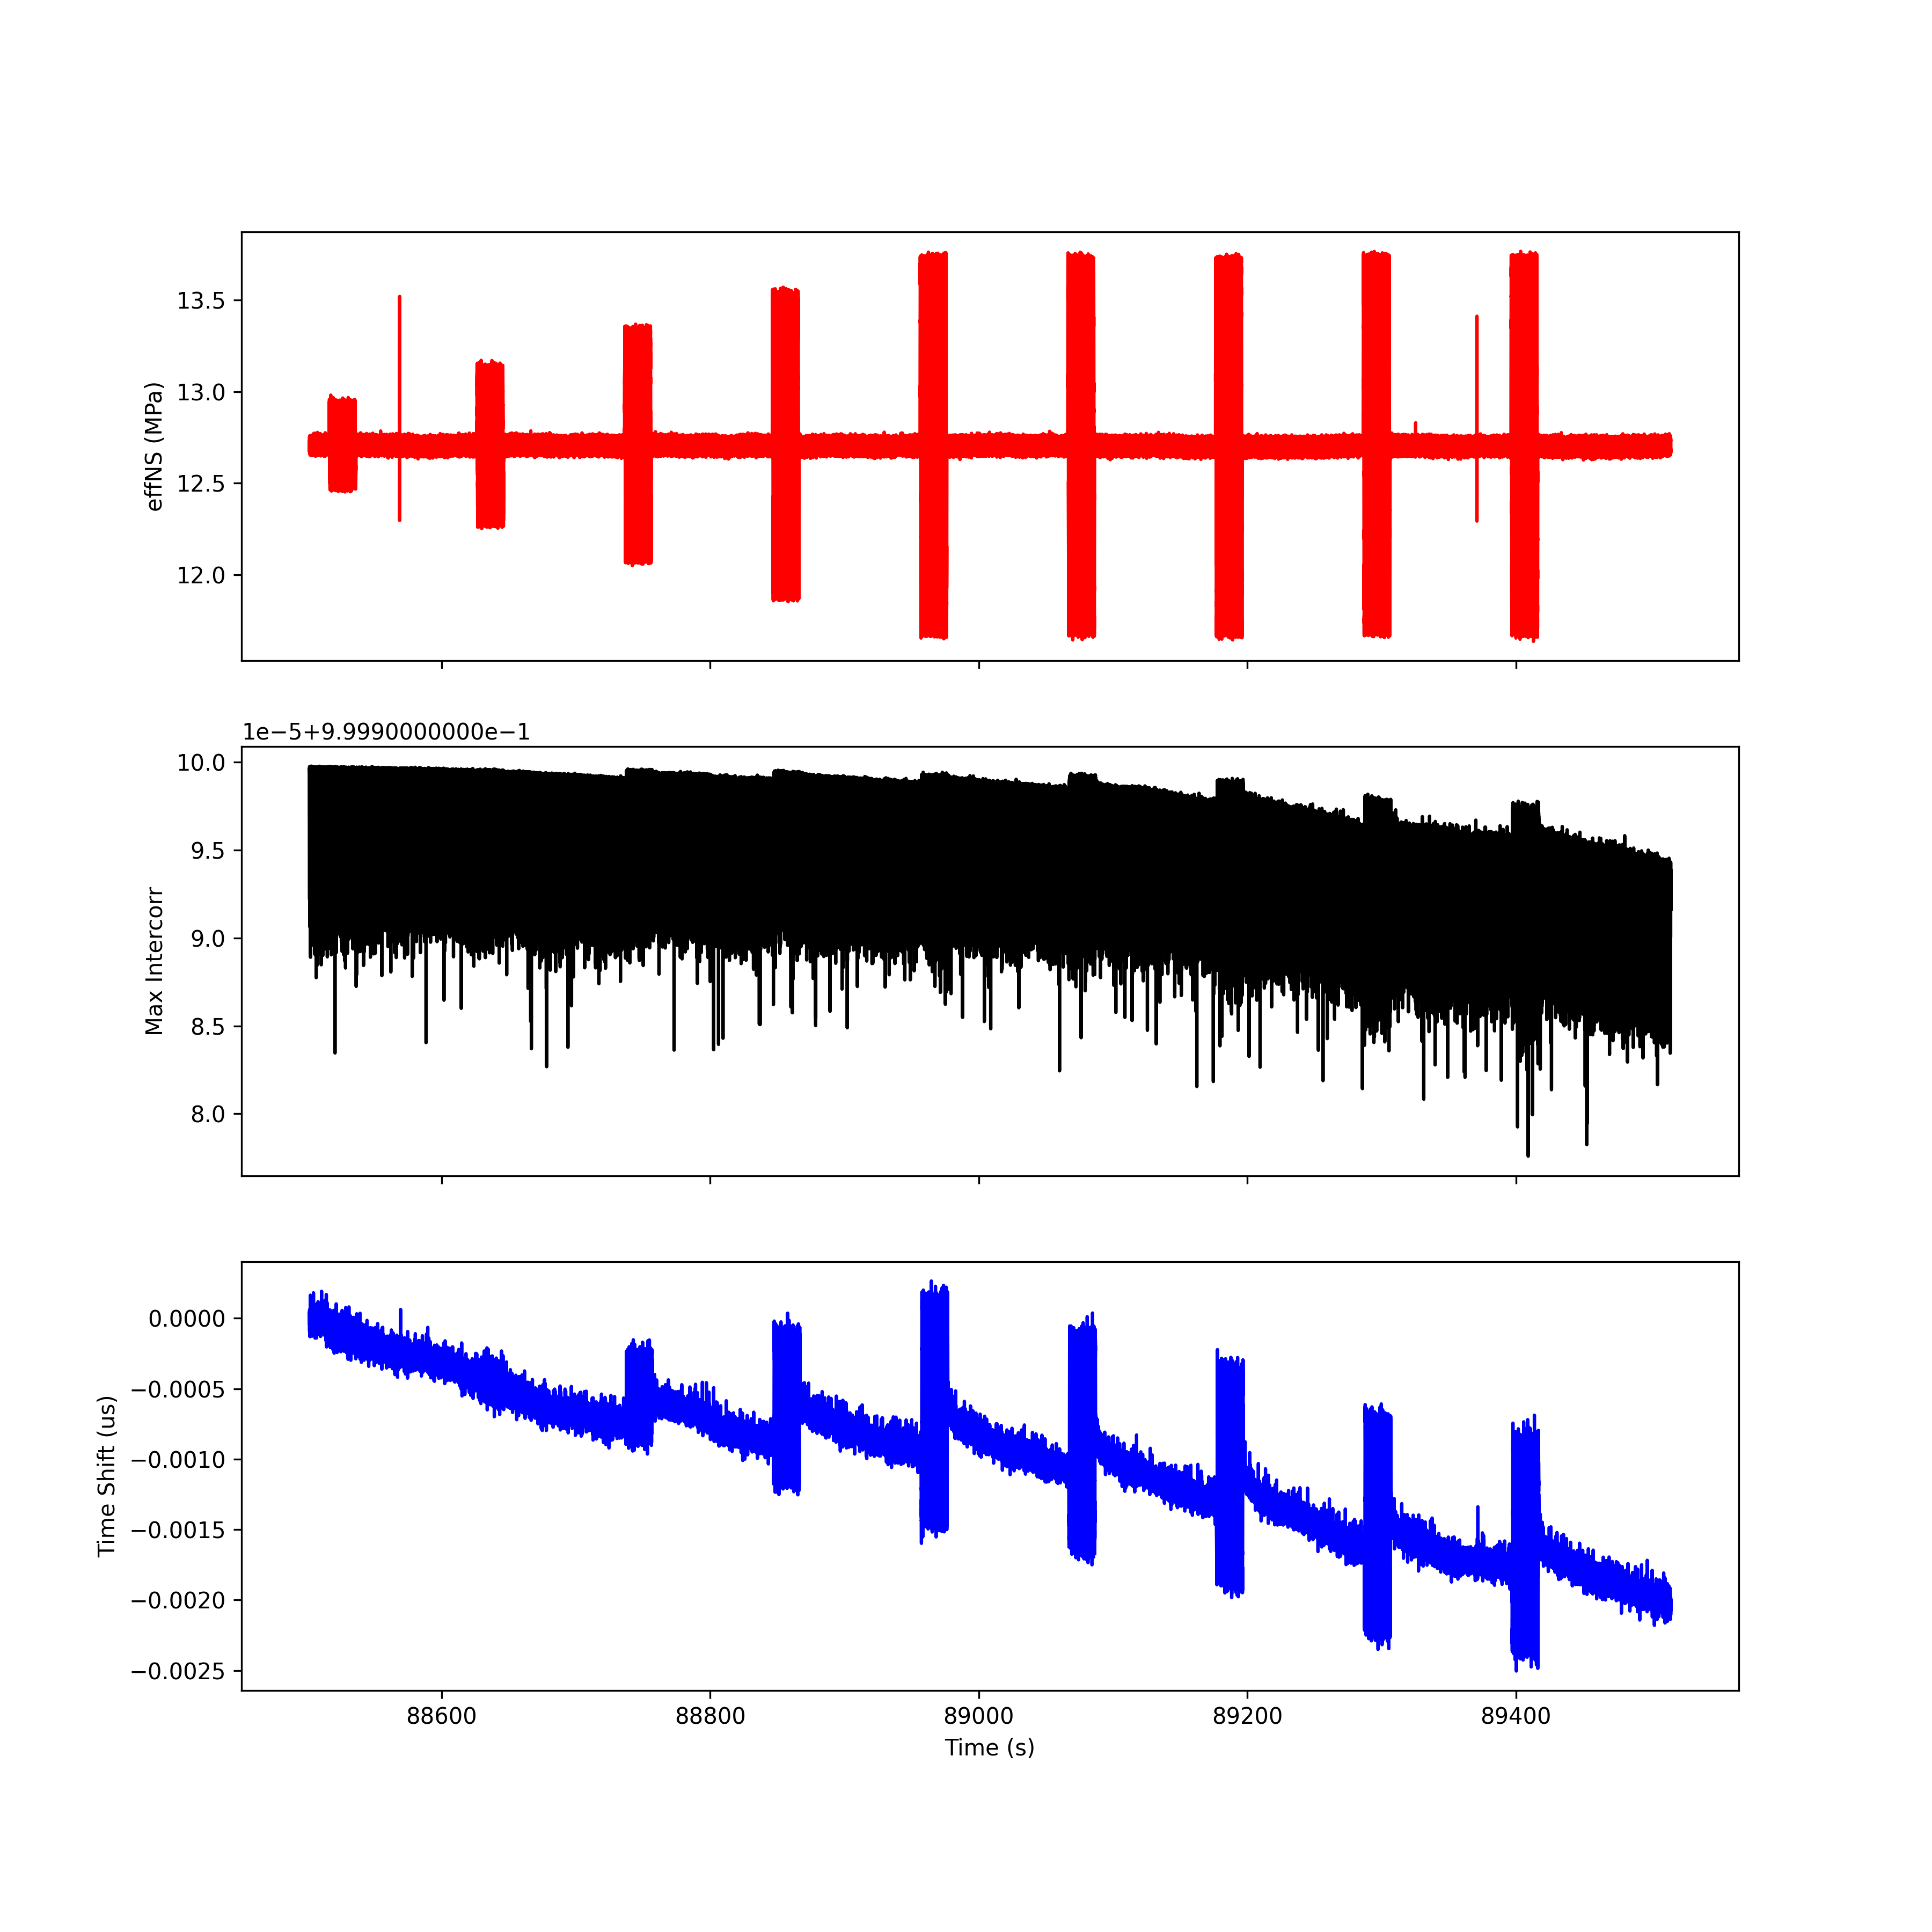
Run 4; T6 R6

Slide 33
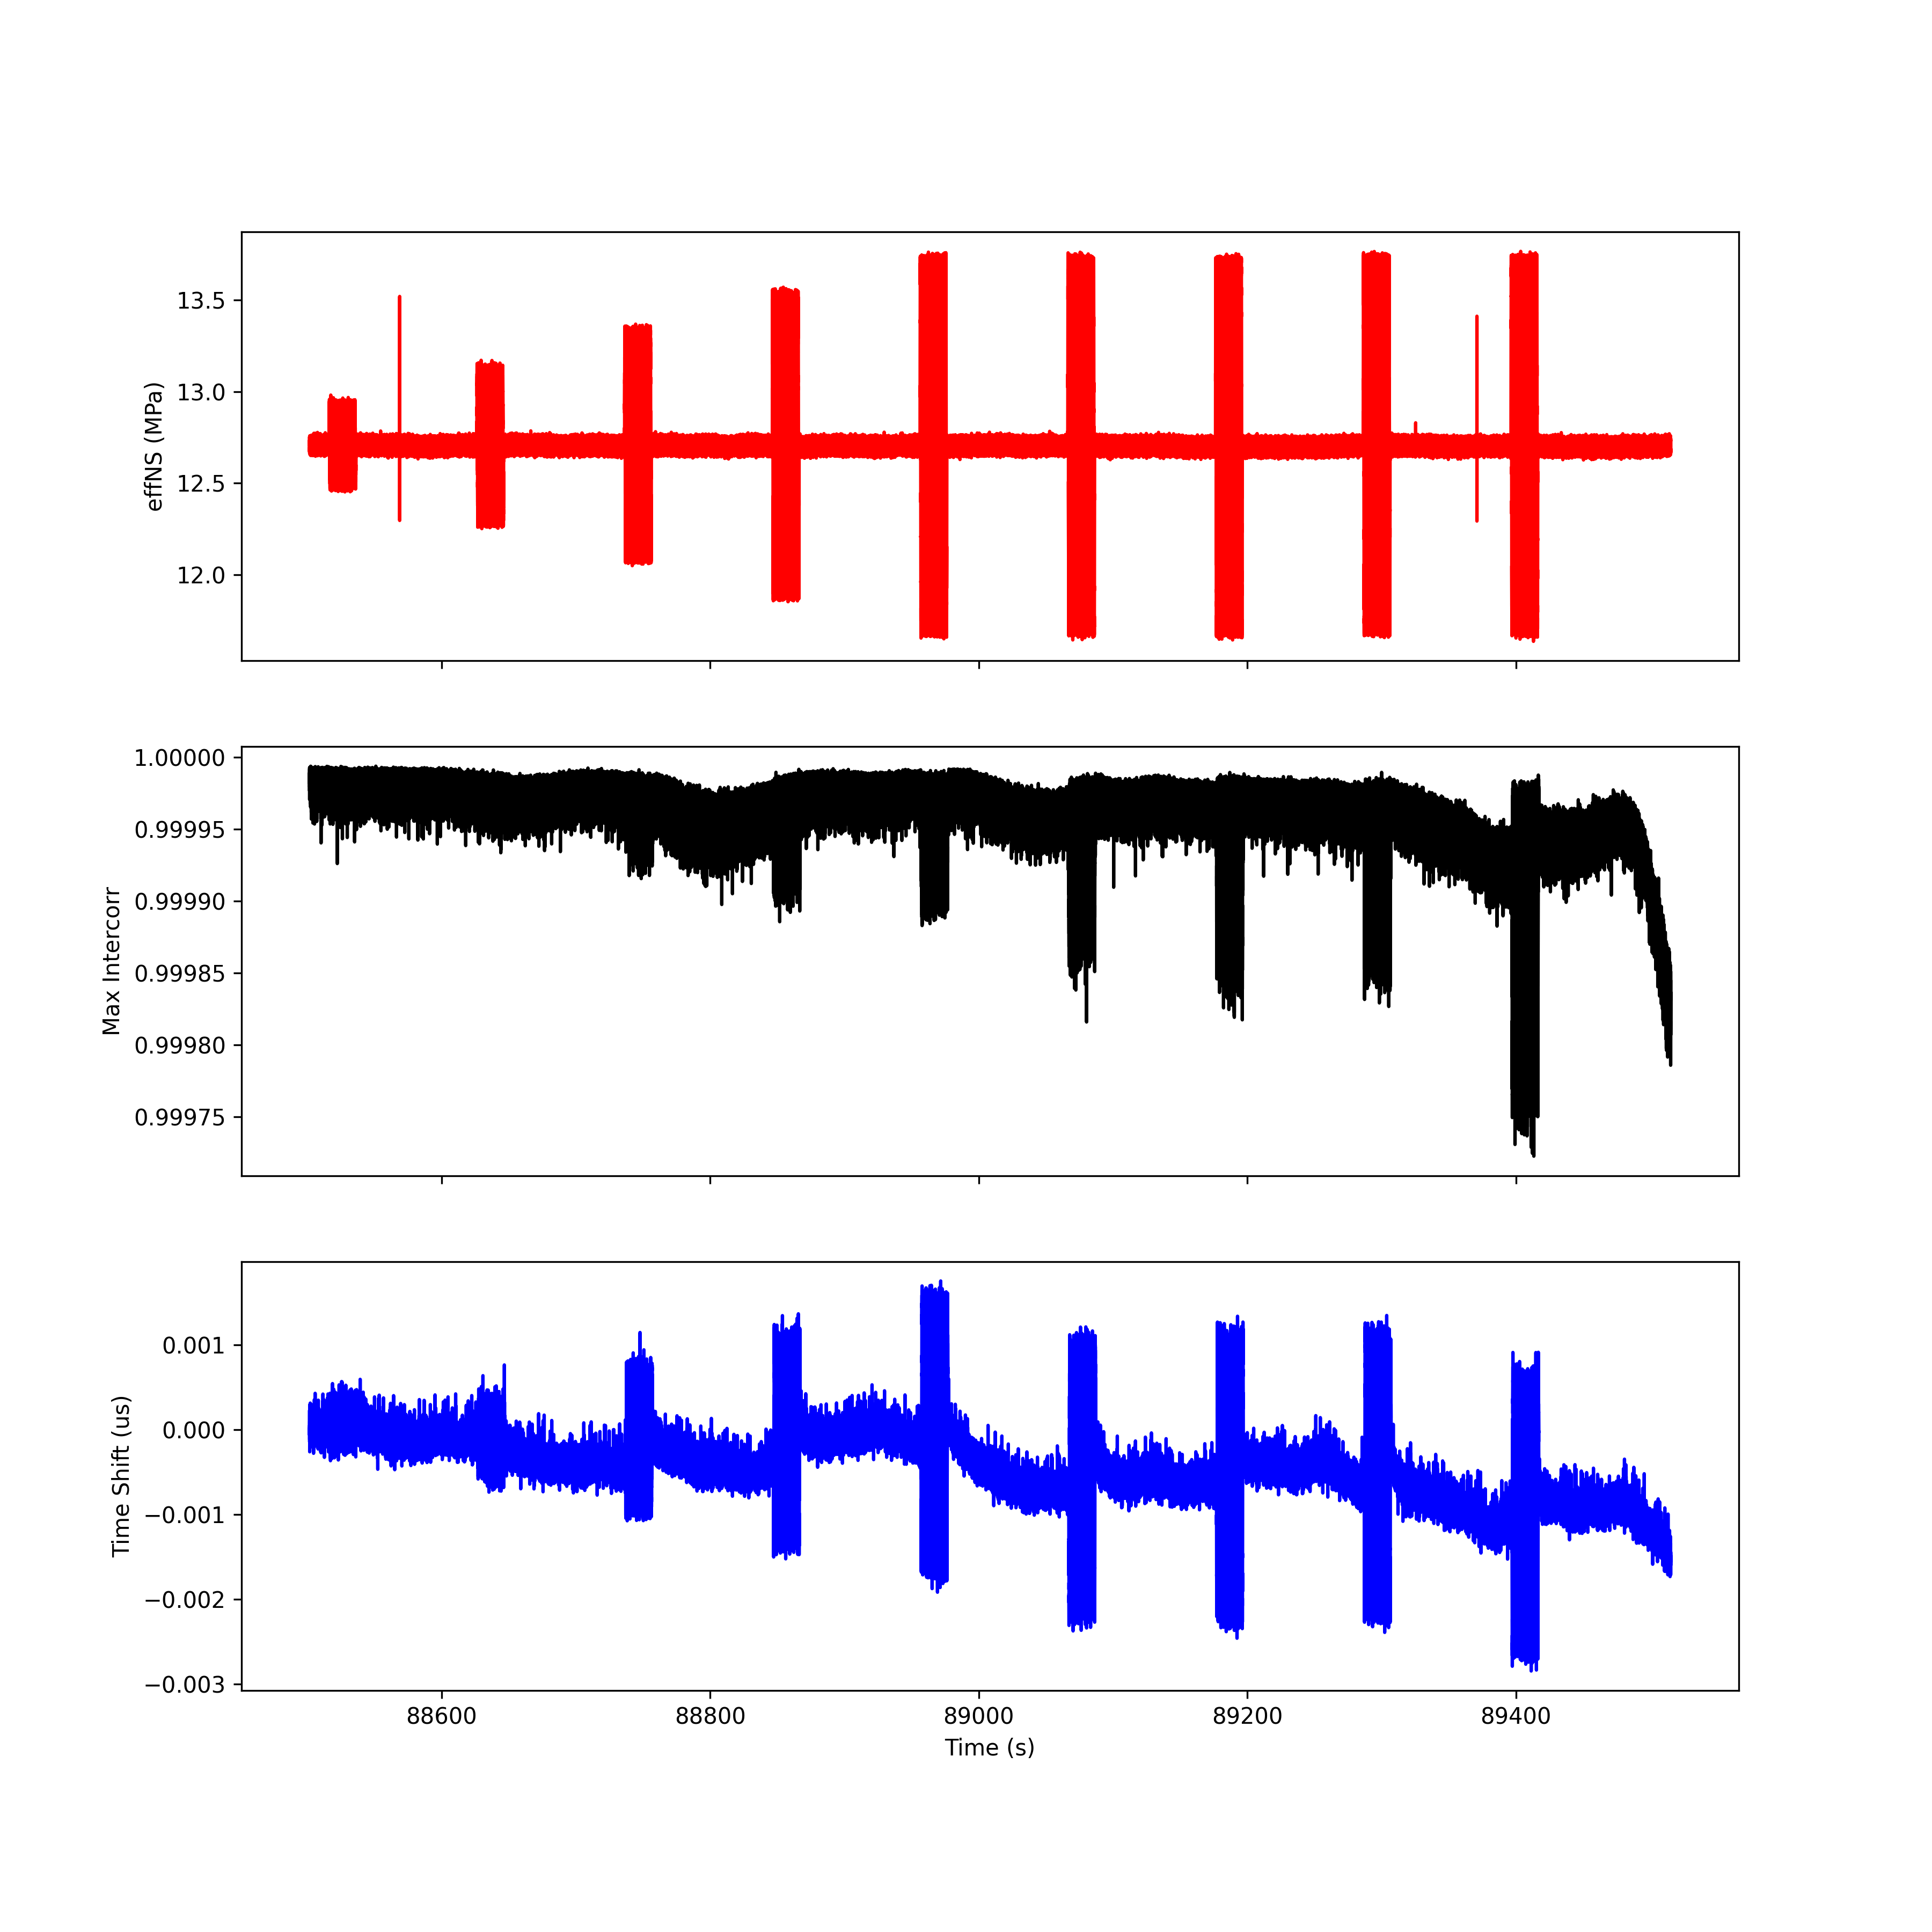
Run 4; T7 R7

Slide 34
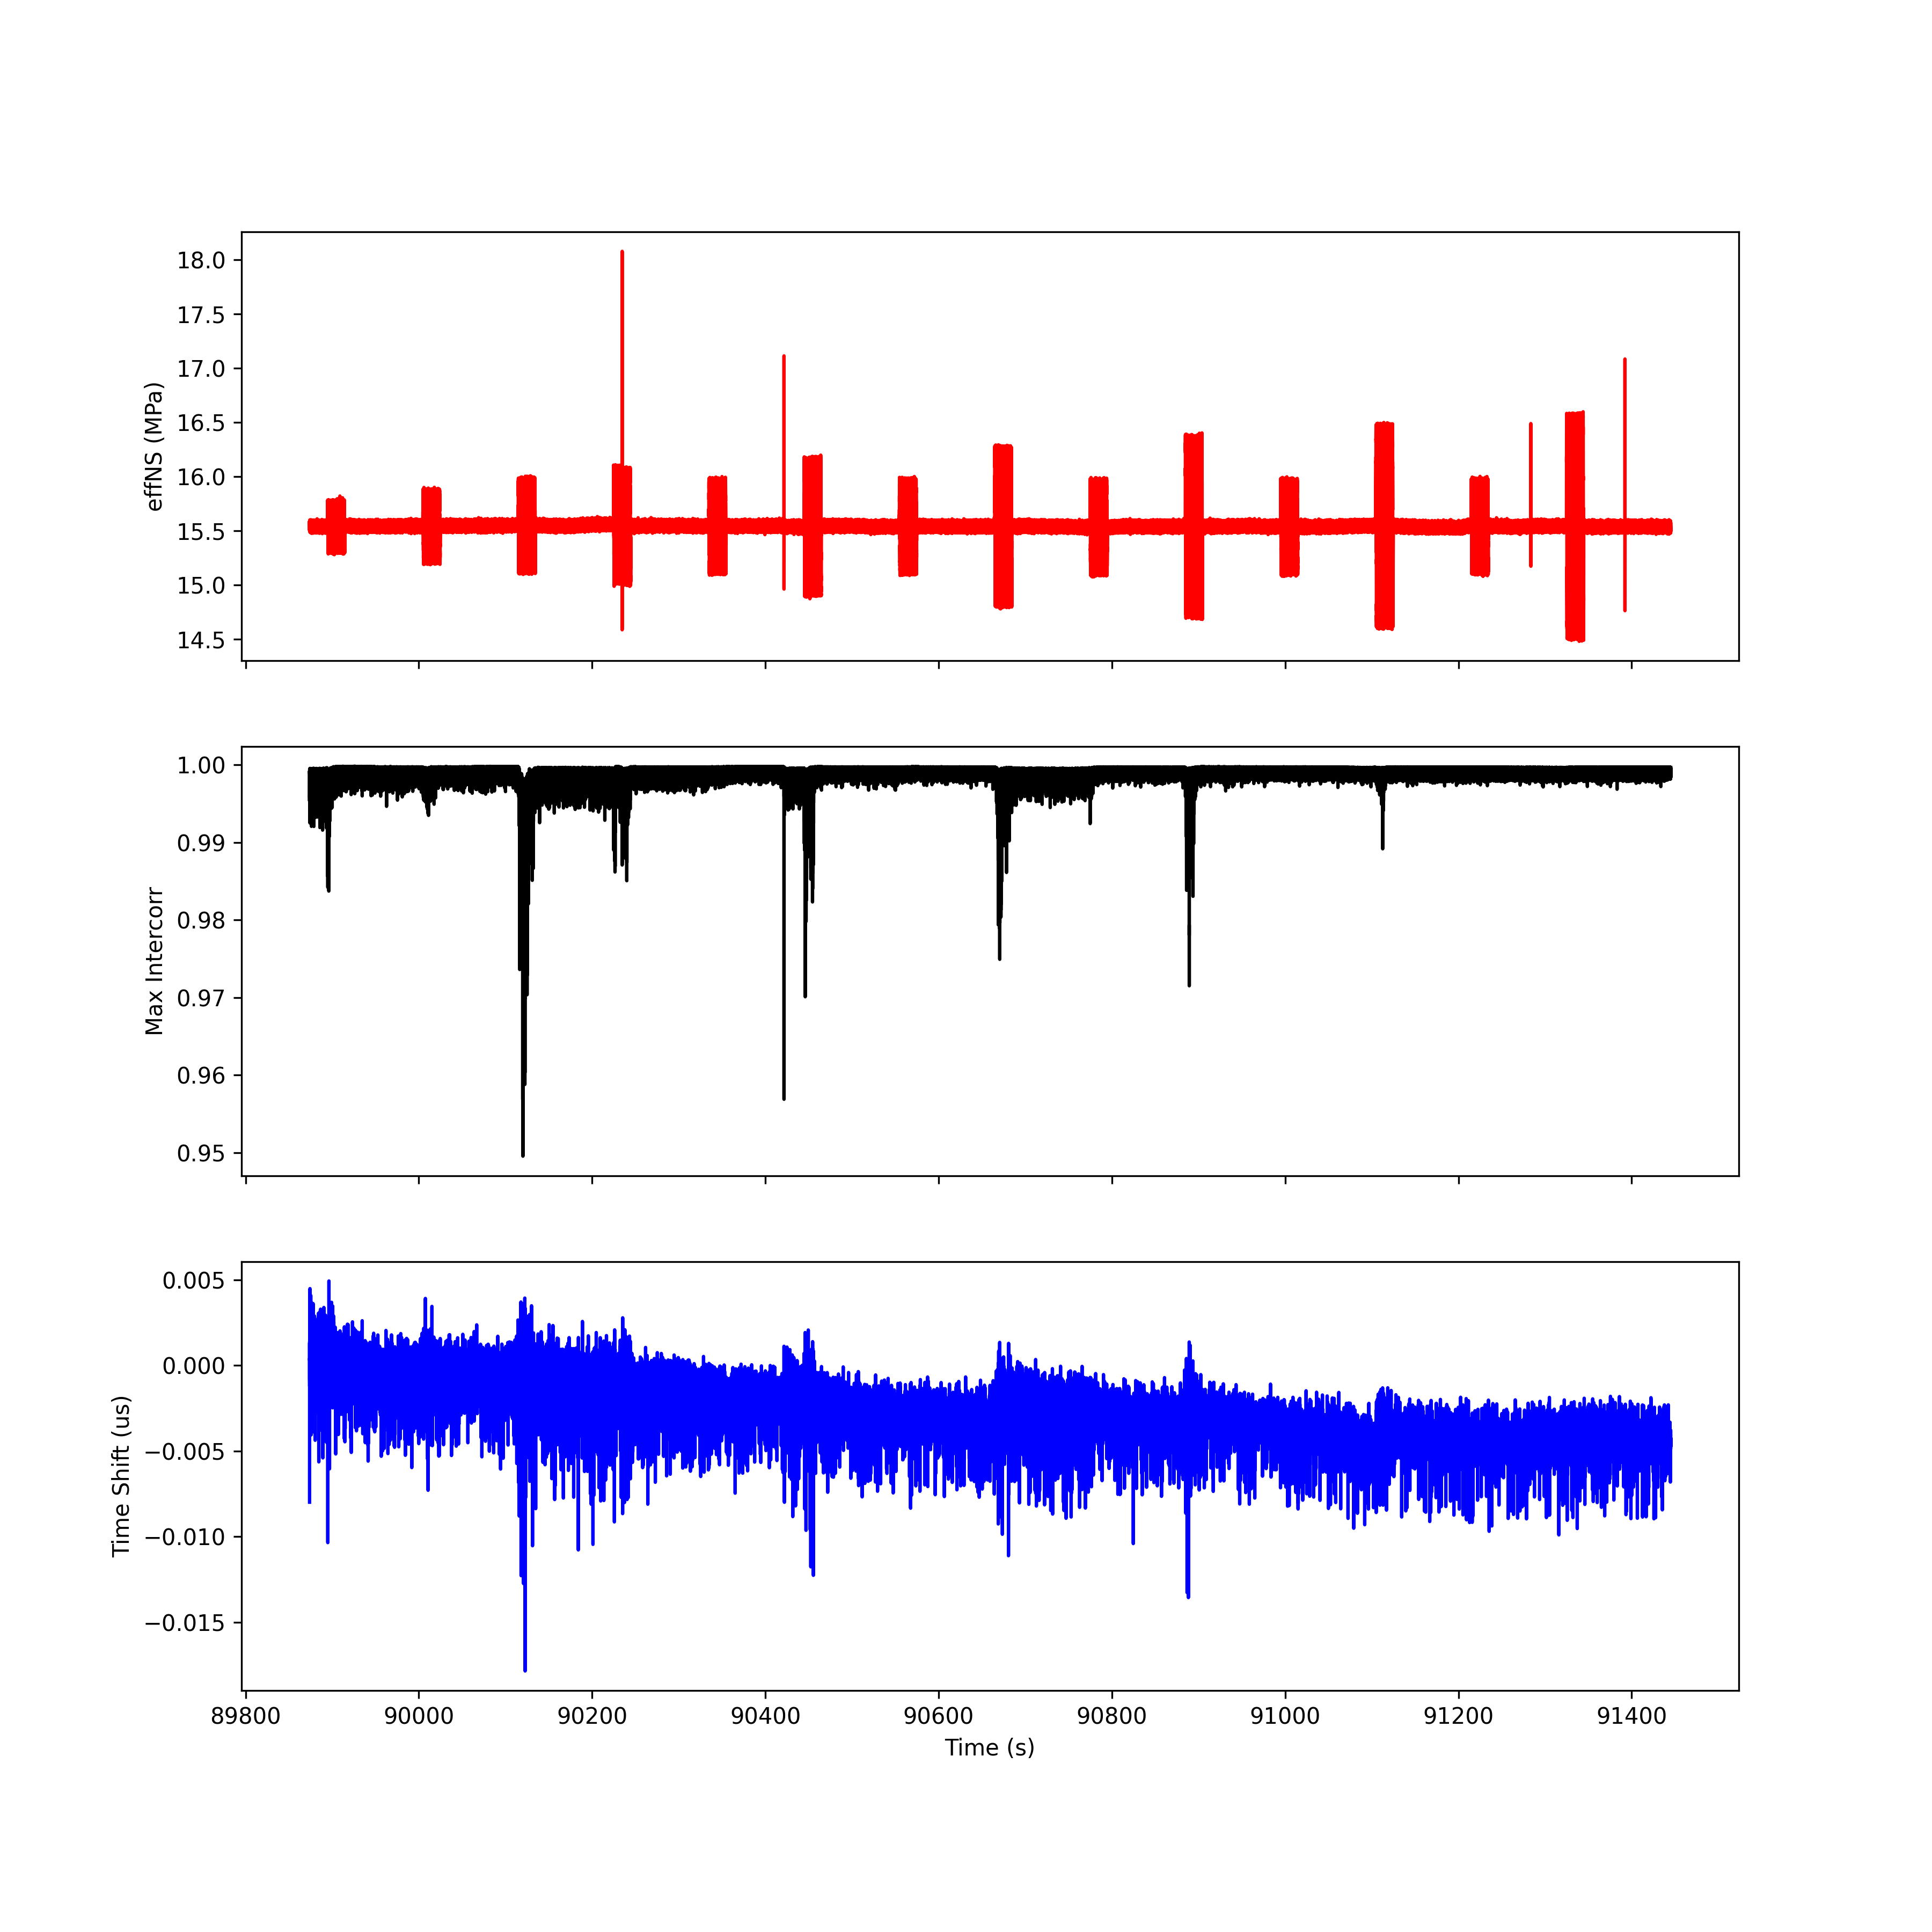
Run 5; T1 R1

Slide 35
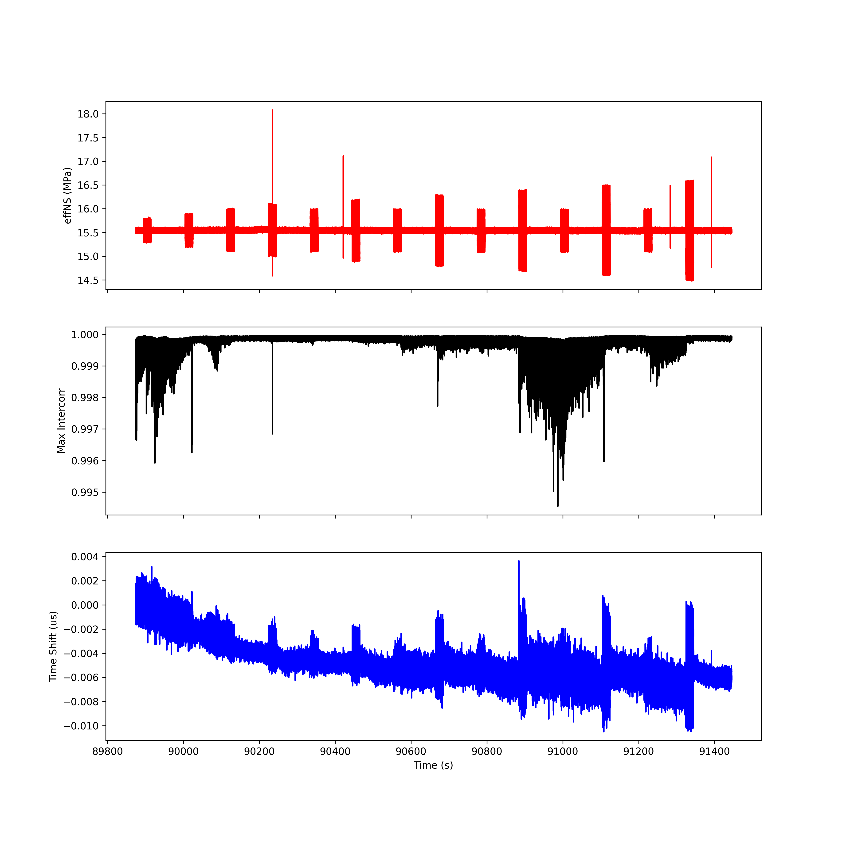
Run 5; T2 R2

Slide 36
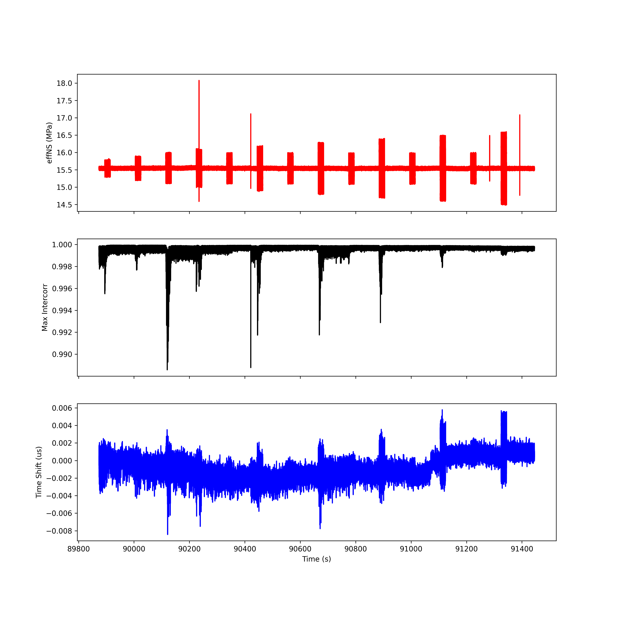
Run 5; T3 R3

Slide 37
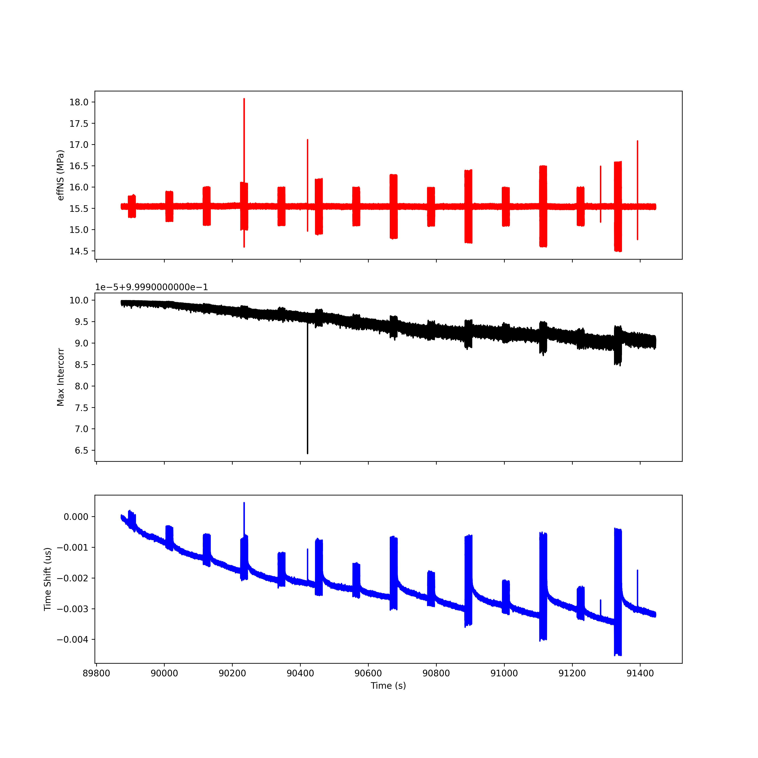
Run 5; T4 R4

Slide 38
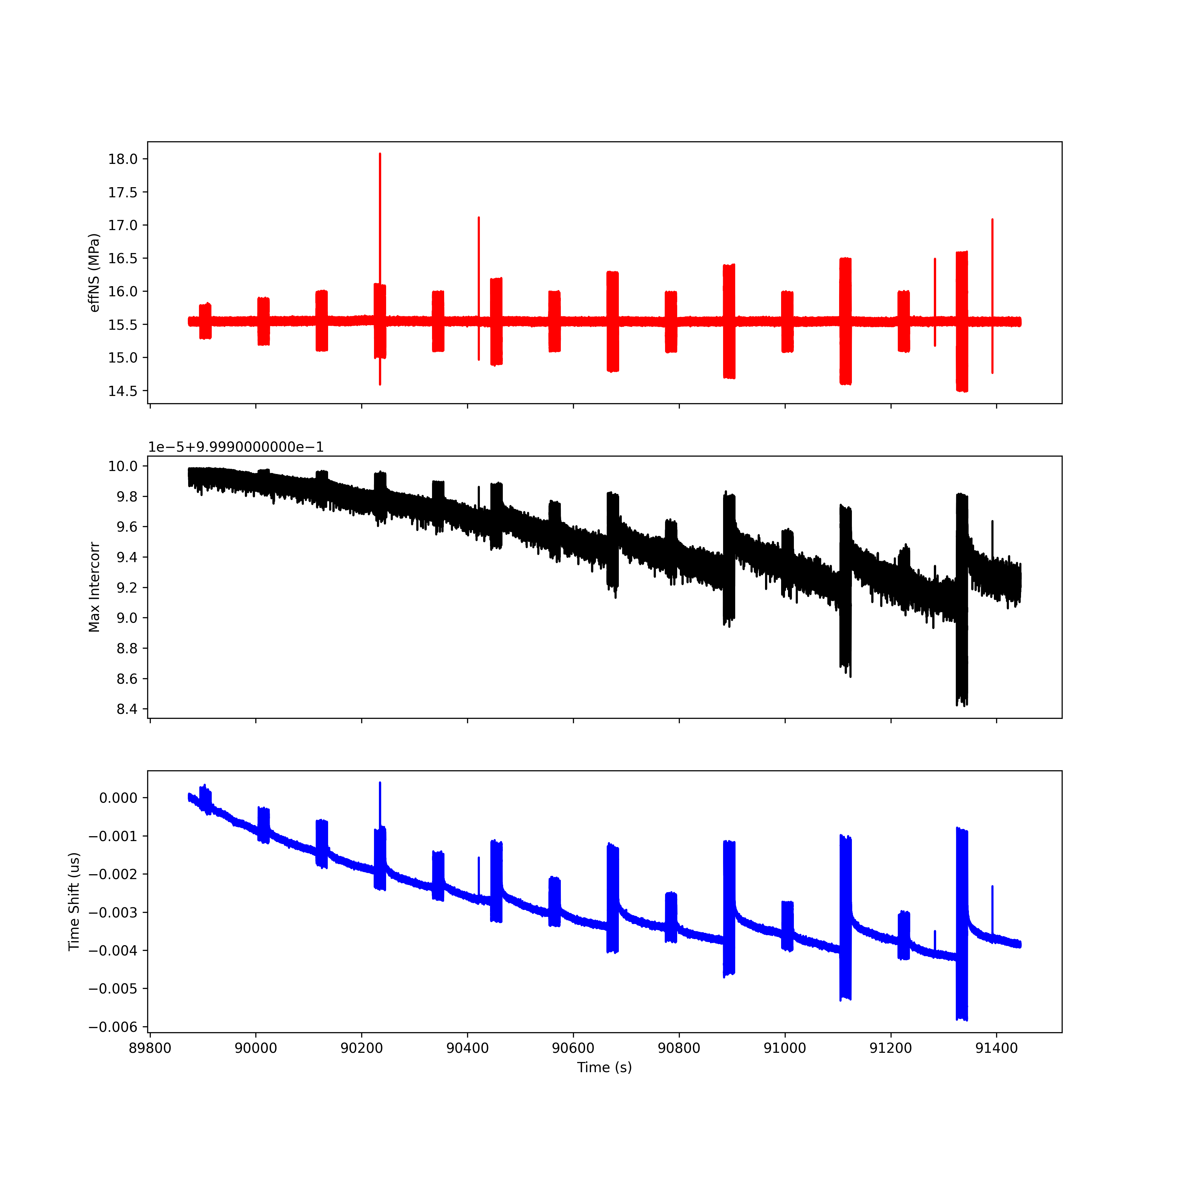
Run 5; T5 R5

Slide 39
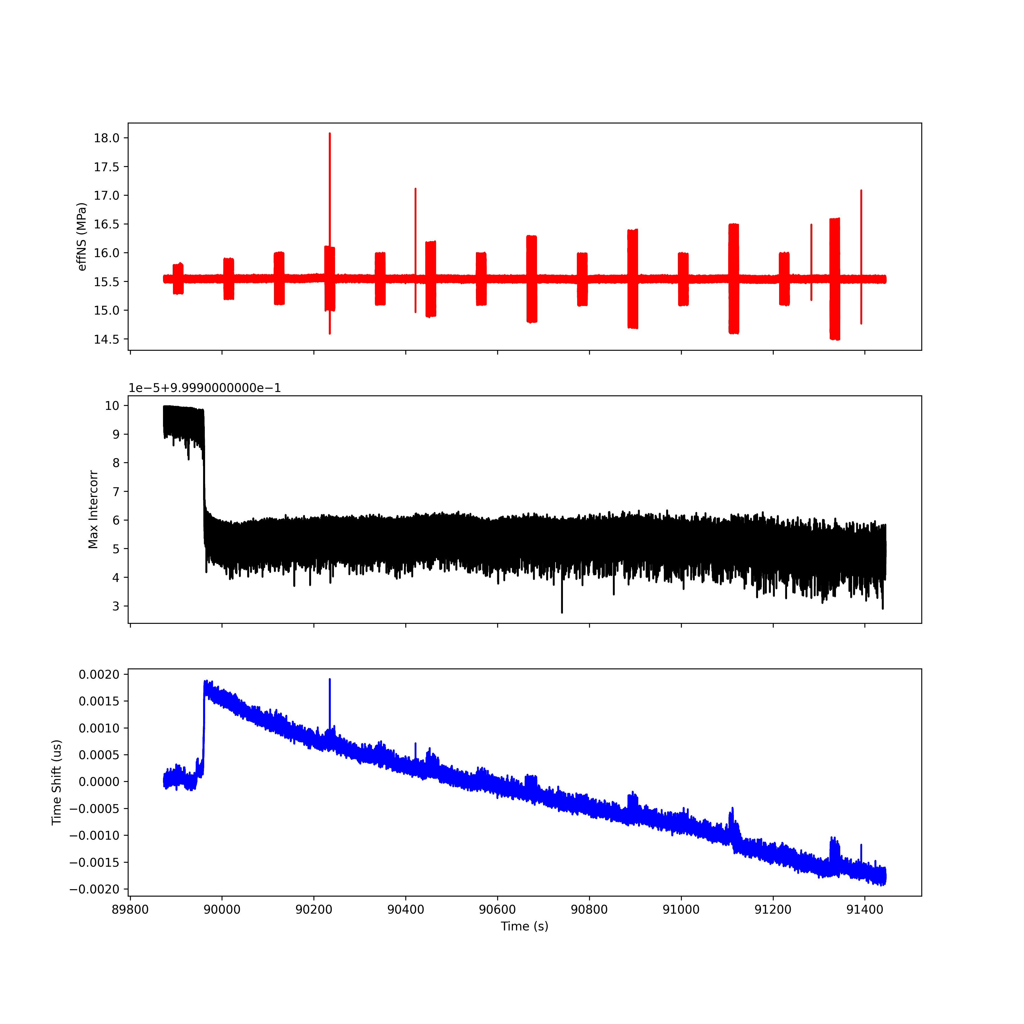
Run 5; T6 R6

Slide 40
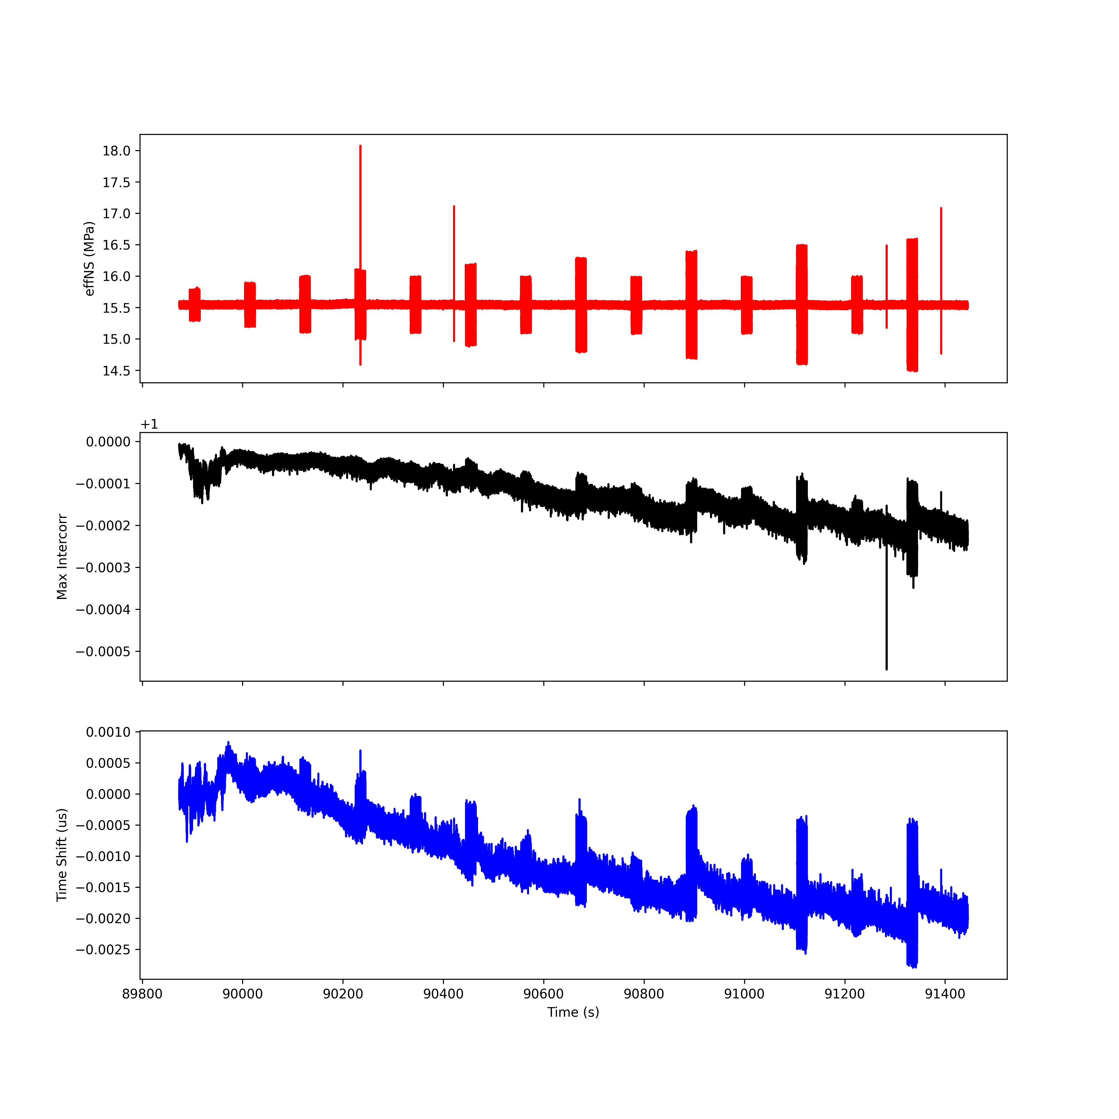
Run 5; T7 R7

Slide 41
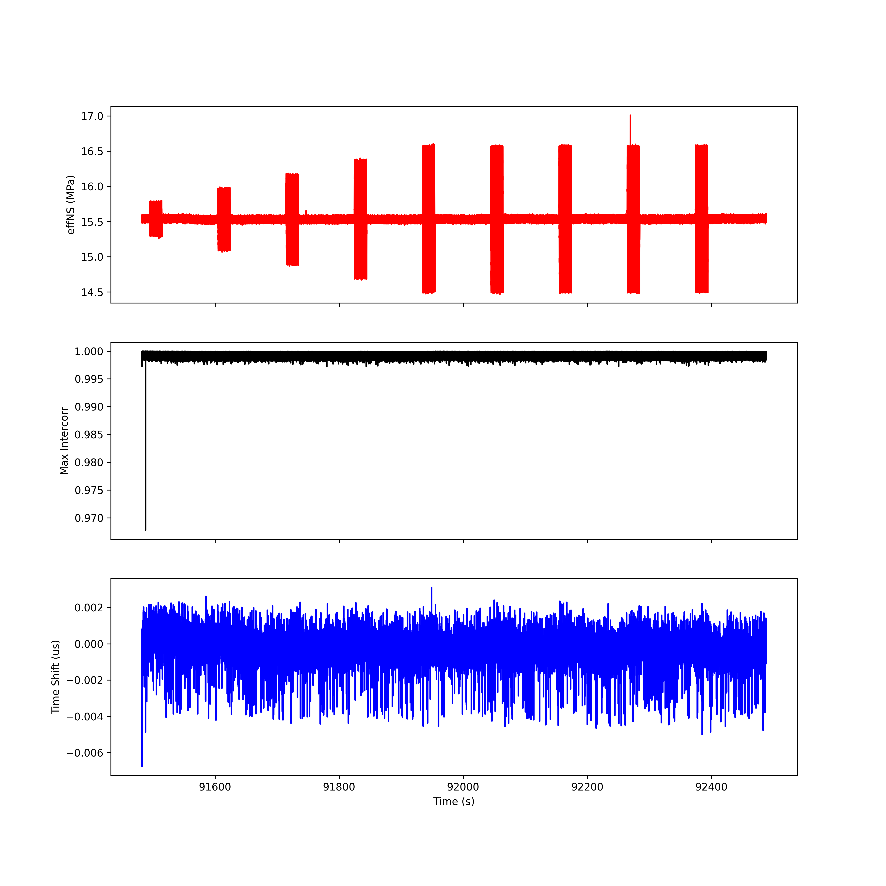
Run 6; T1 R1

Slide 42
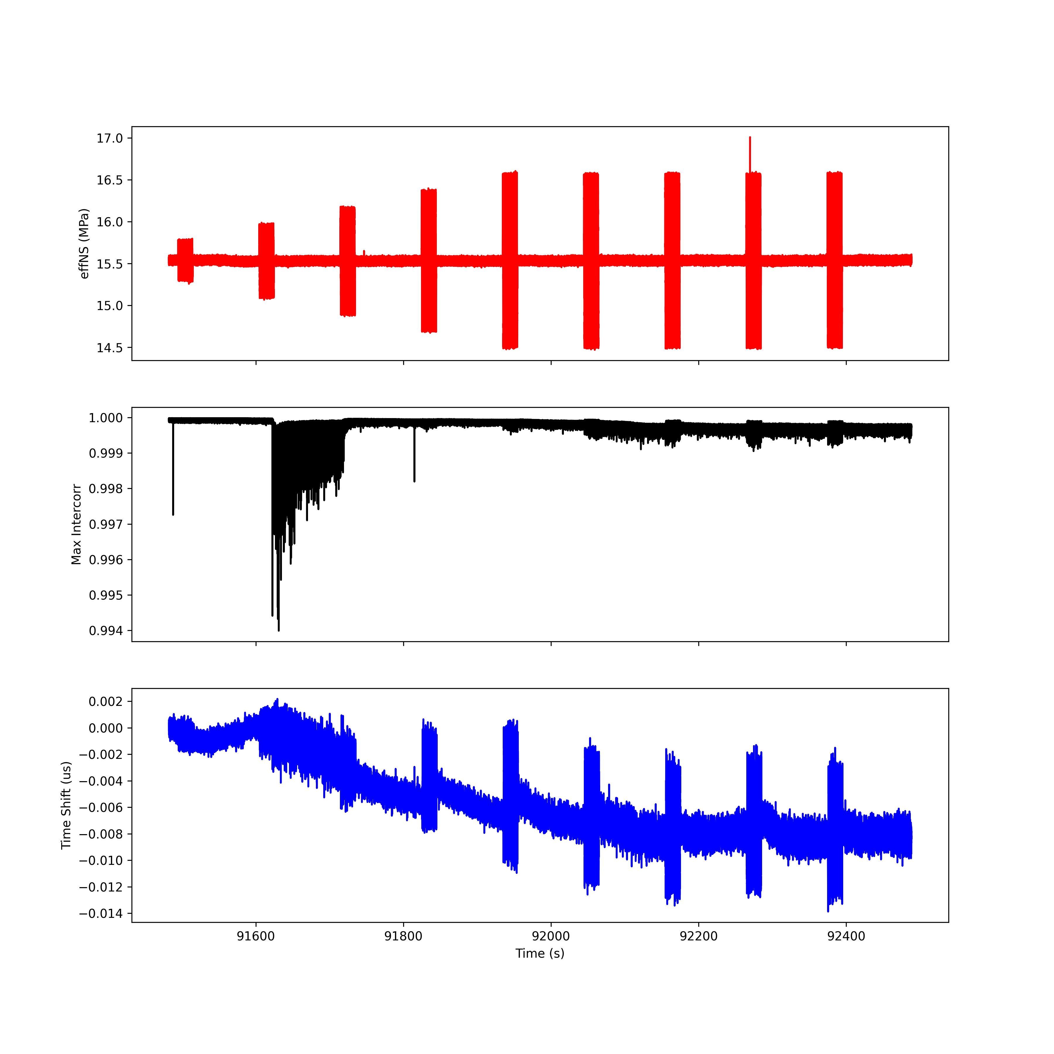
Run 6; T2 R2

Slide 43
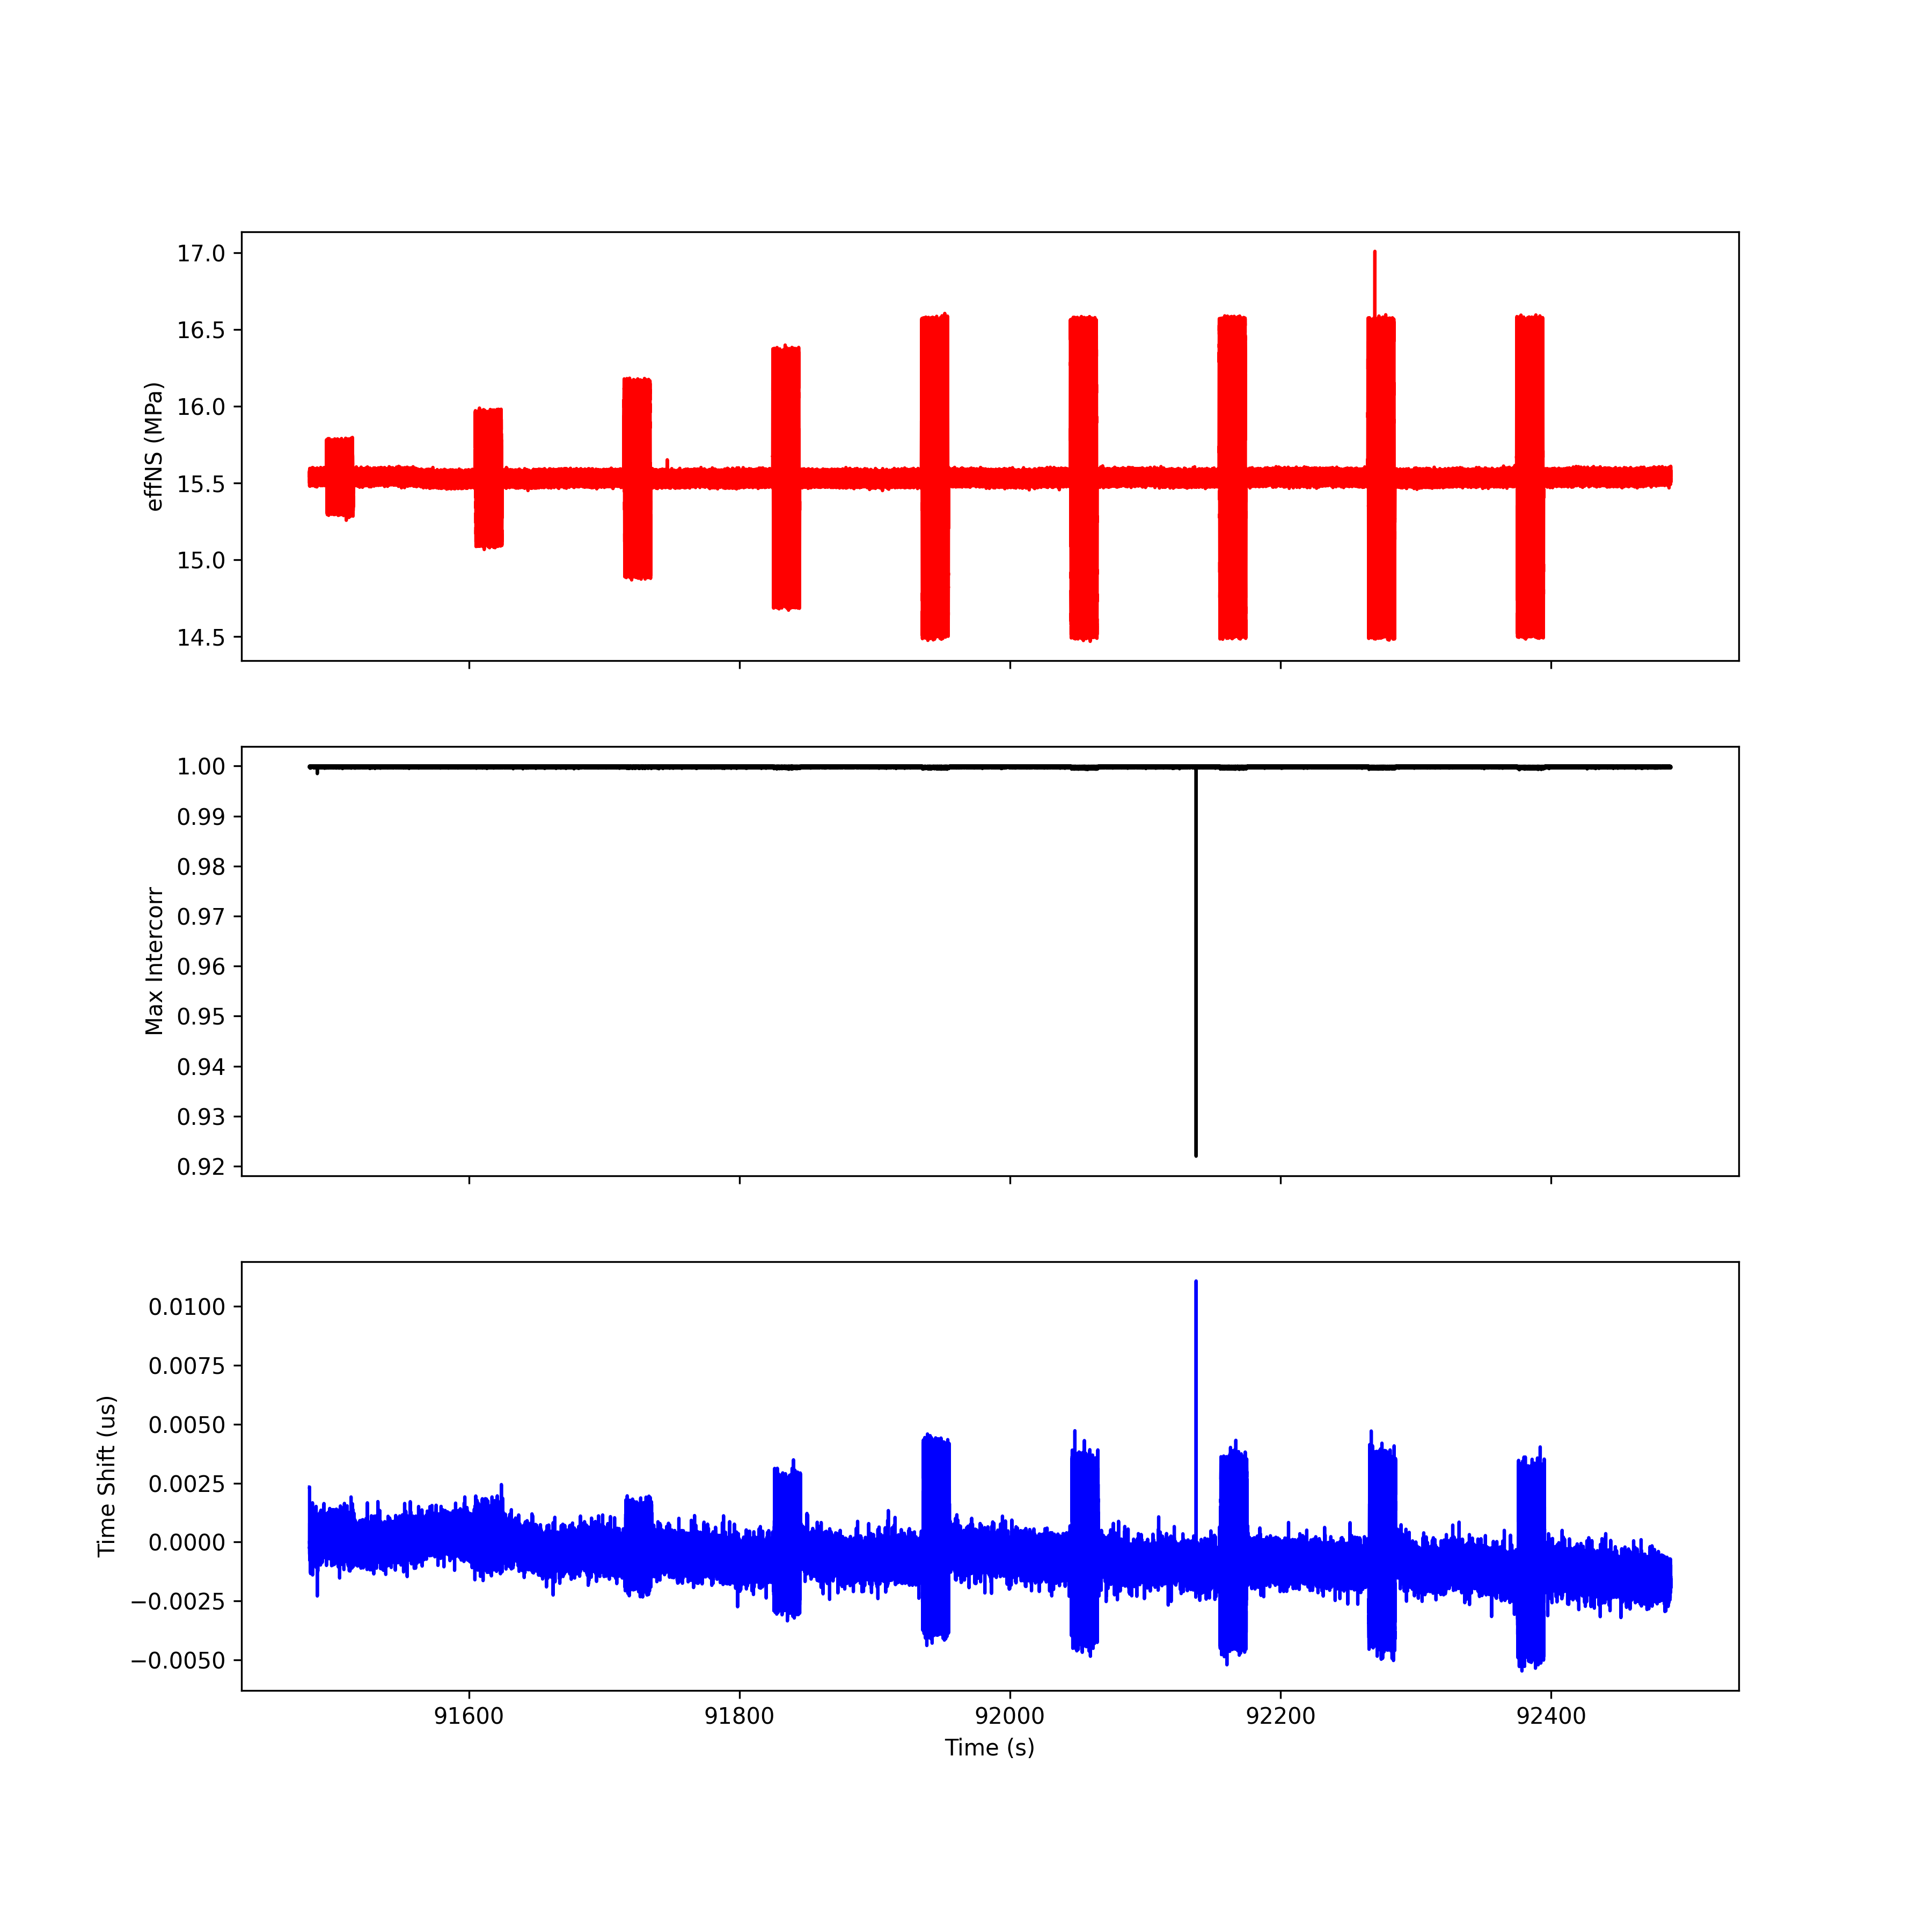
Run 6; T3 R3

Slide 44
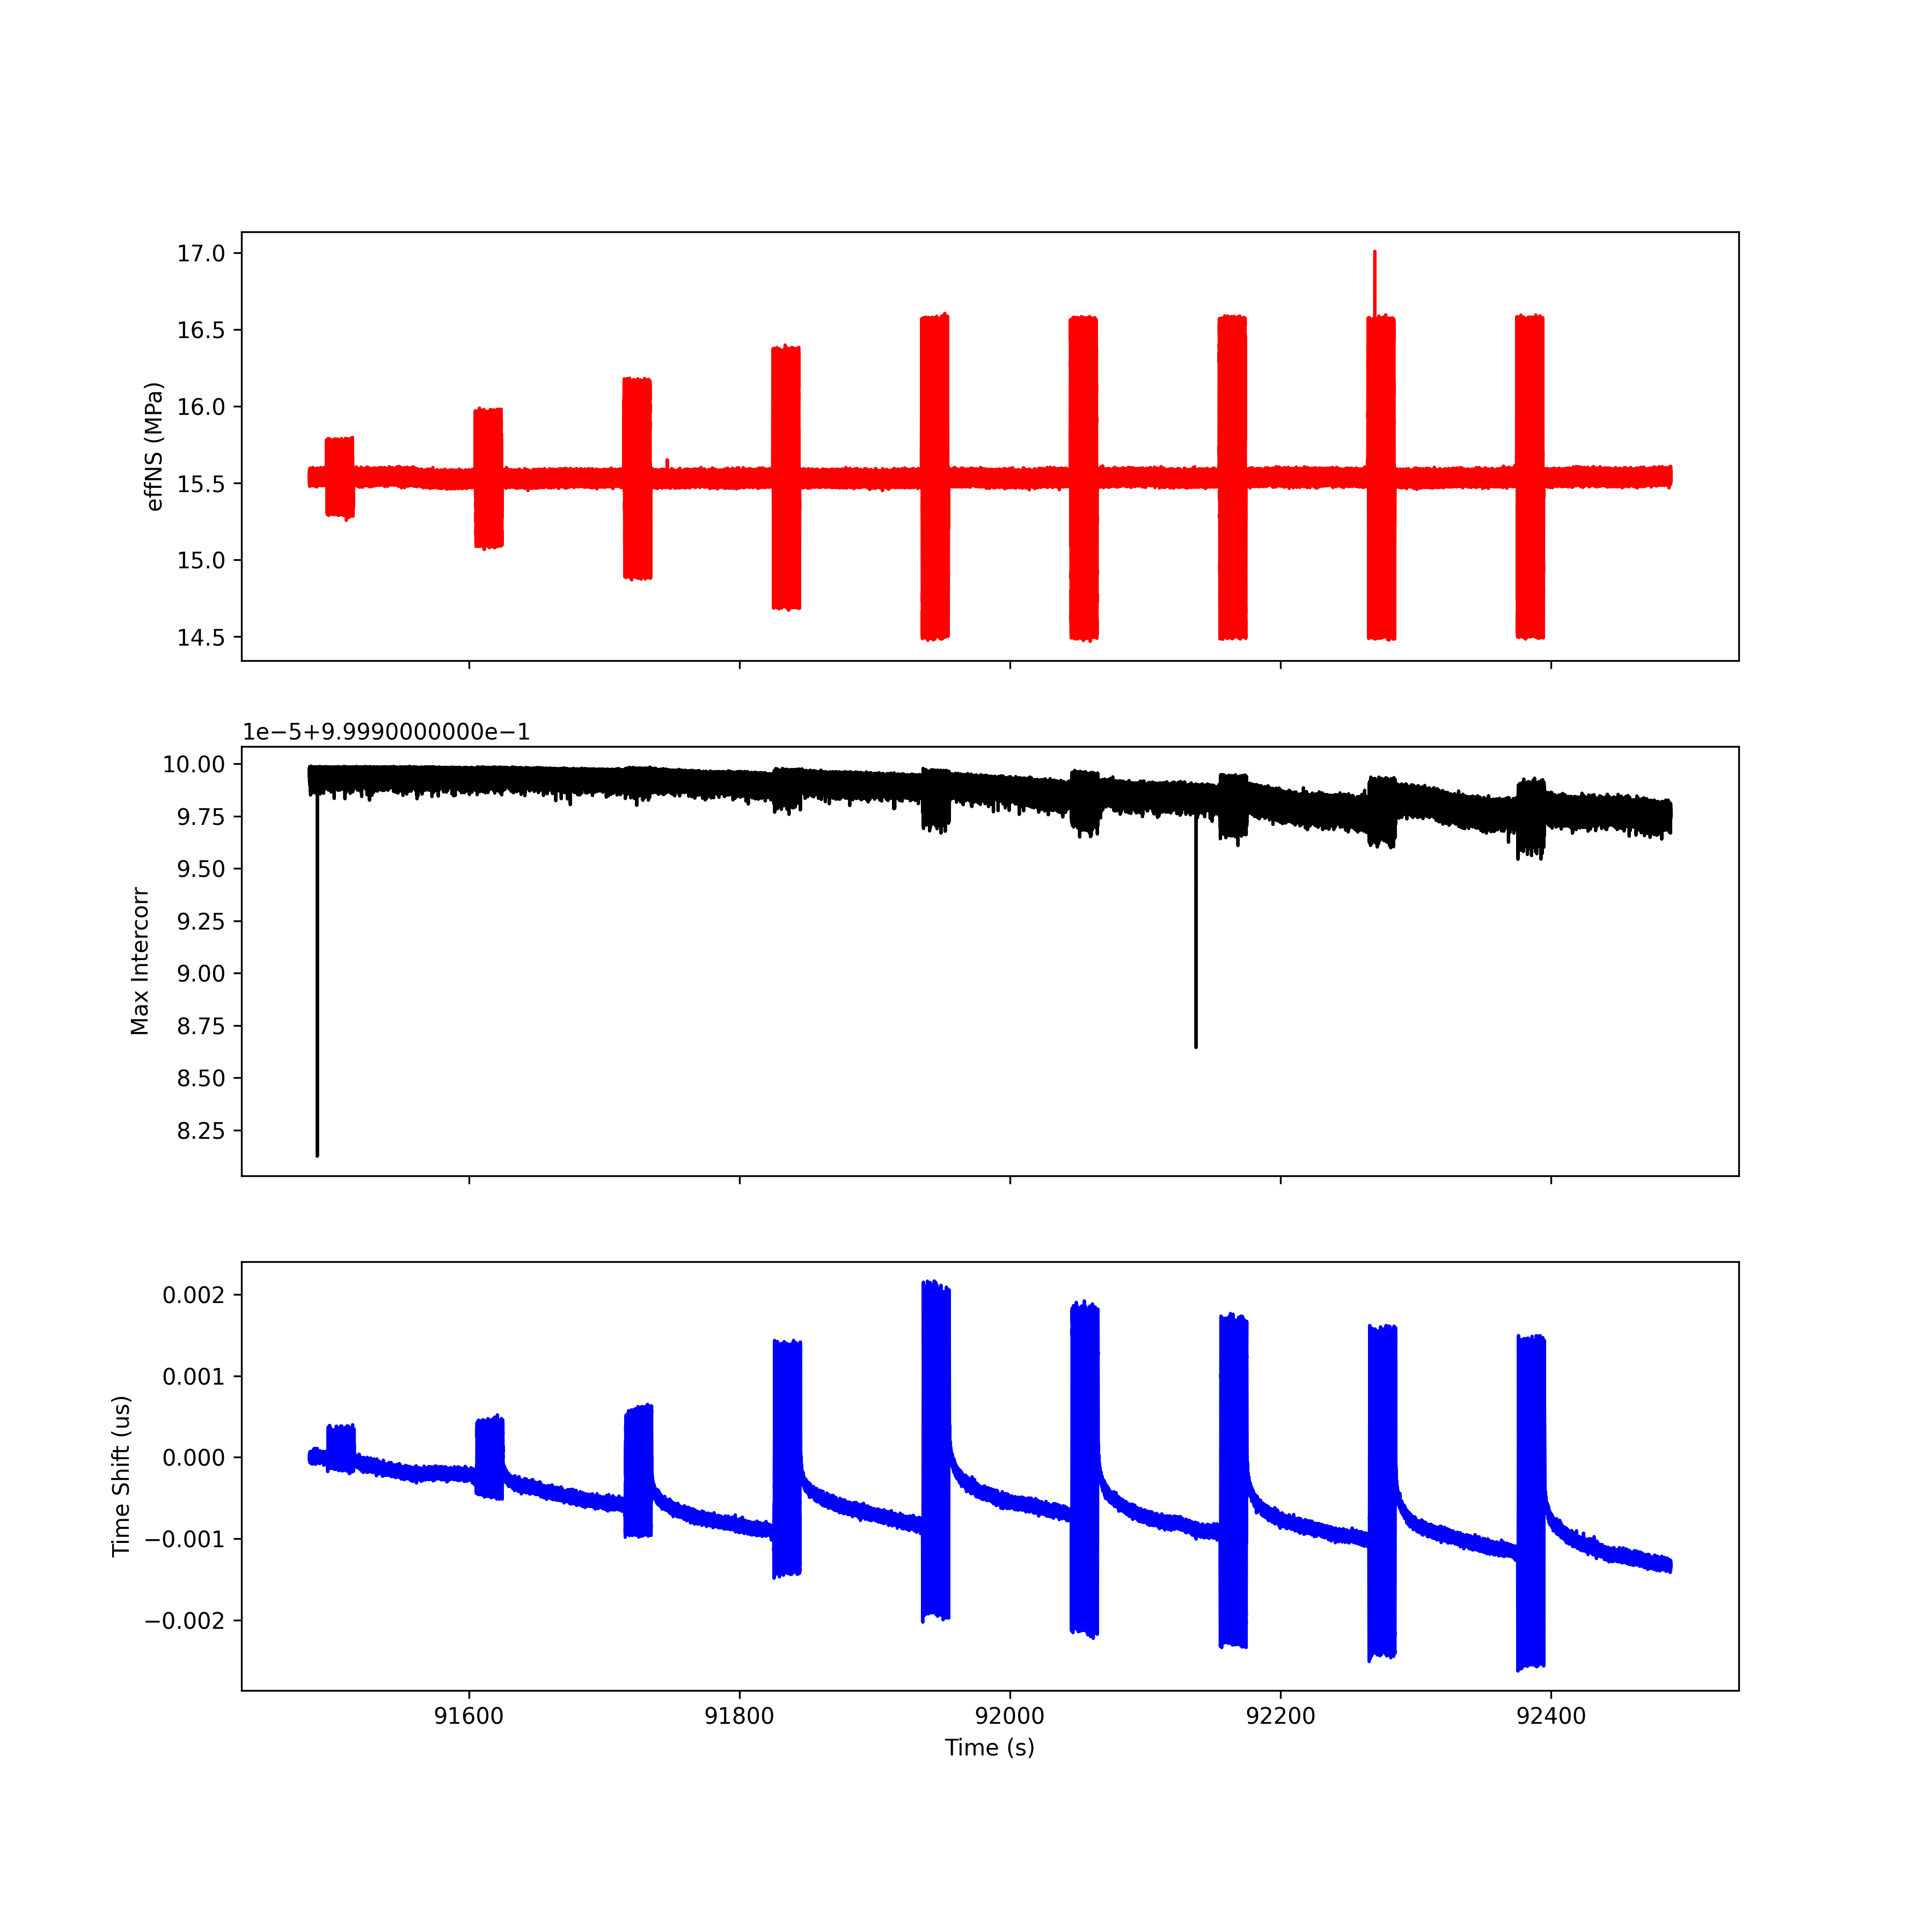
Run 6; T4 R4

Slide 45
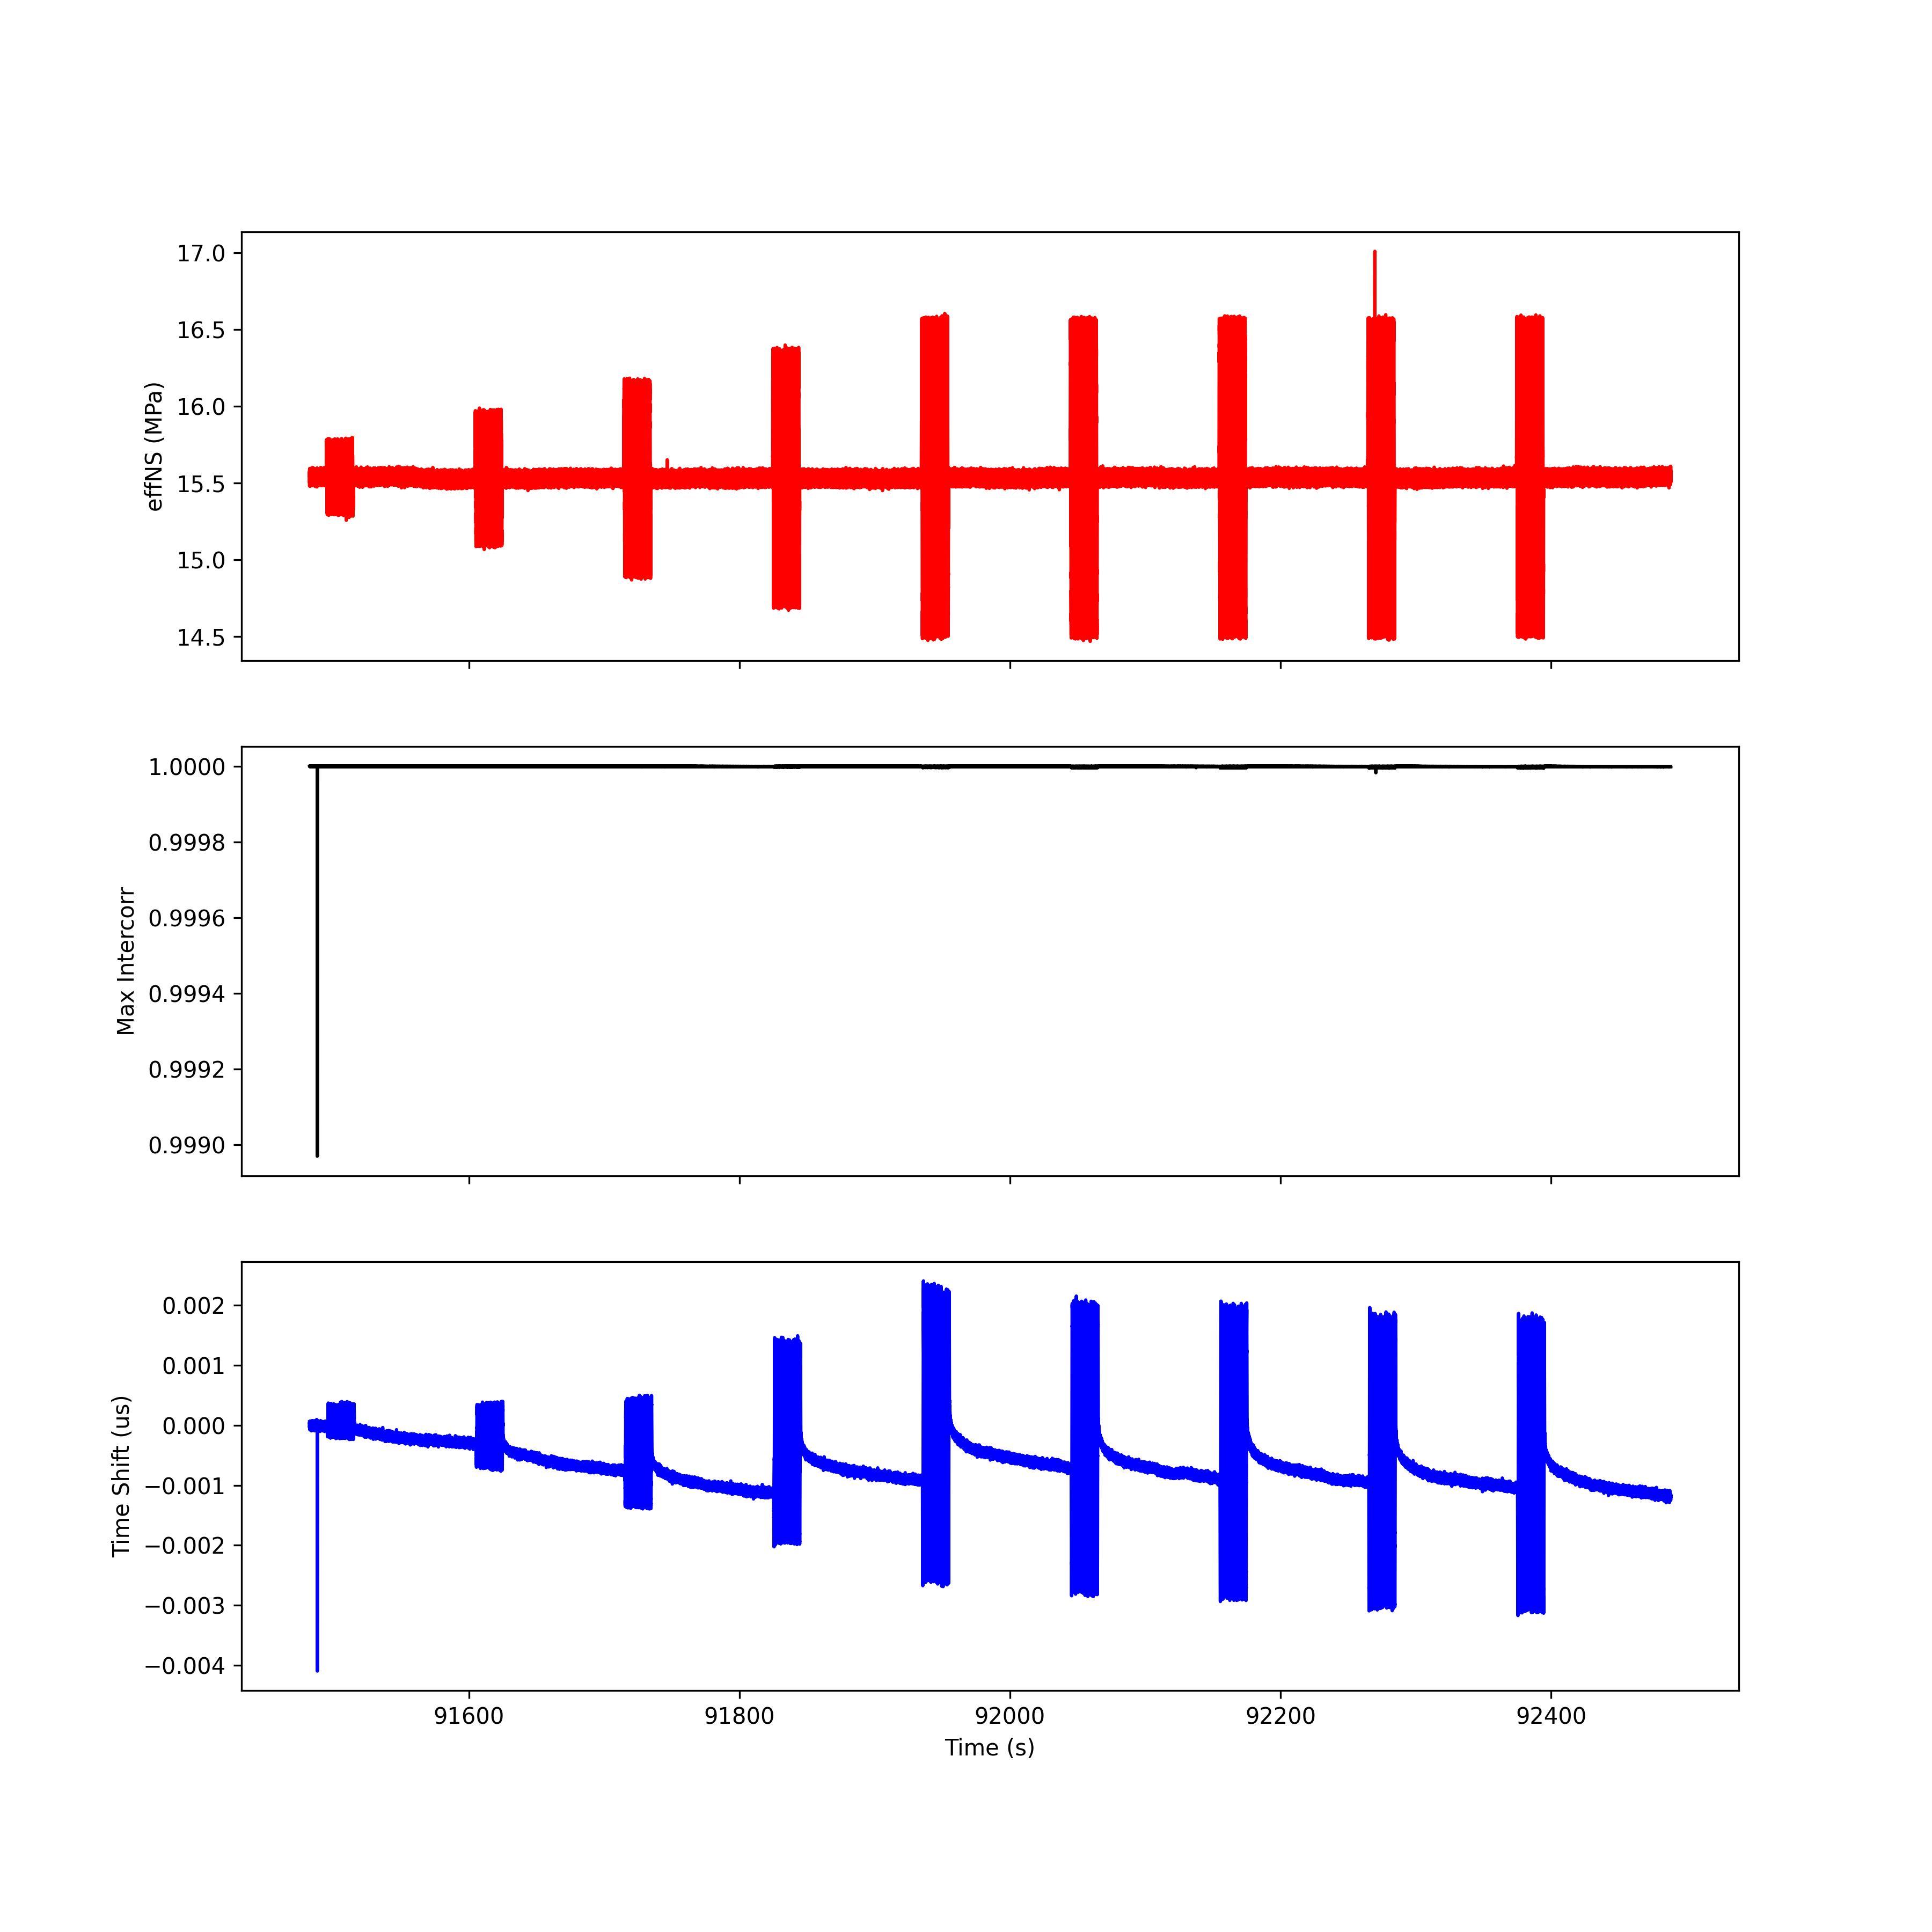
Run 6; T5 R5

Slide 46
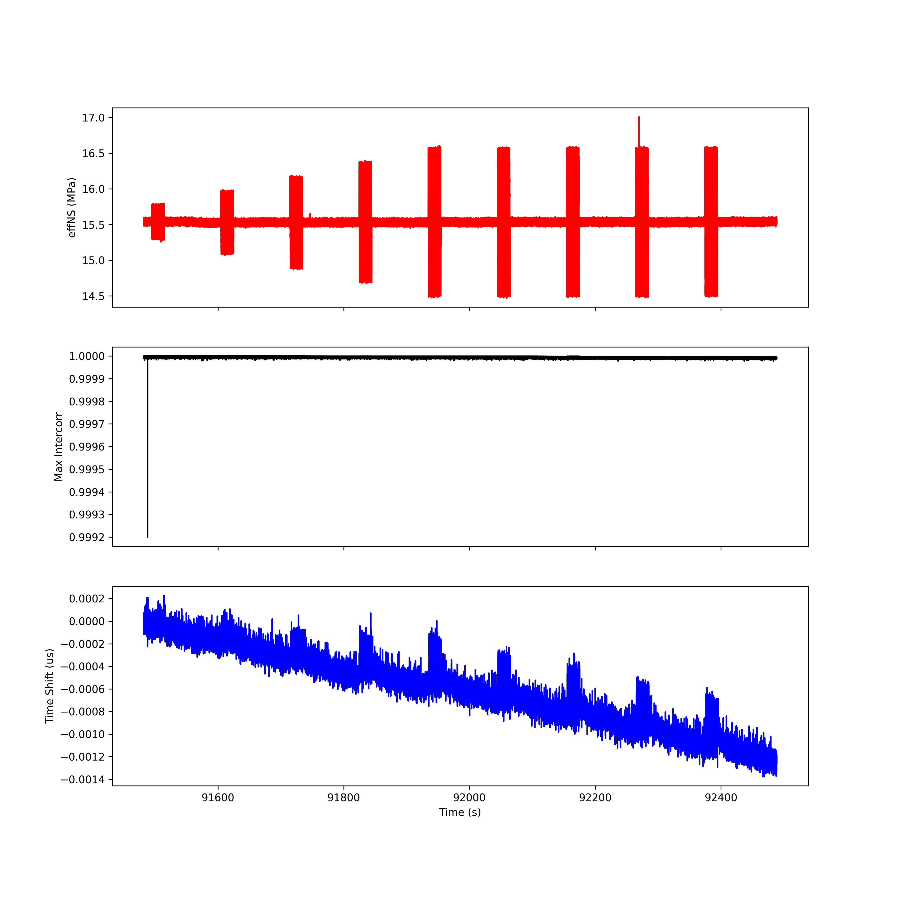
Run 6; T6 R6

Slide 47
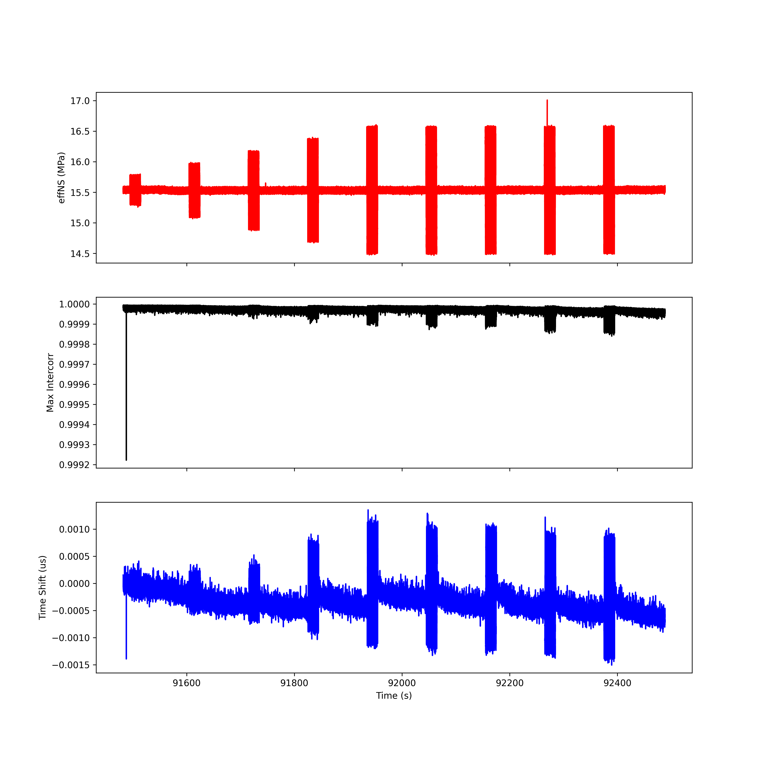
Run 6; T7 R7

Slide 48
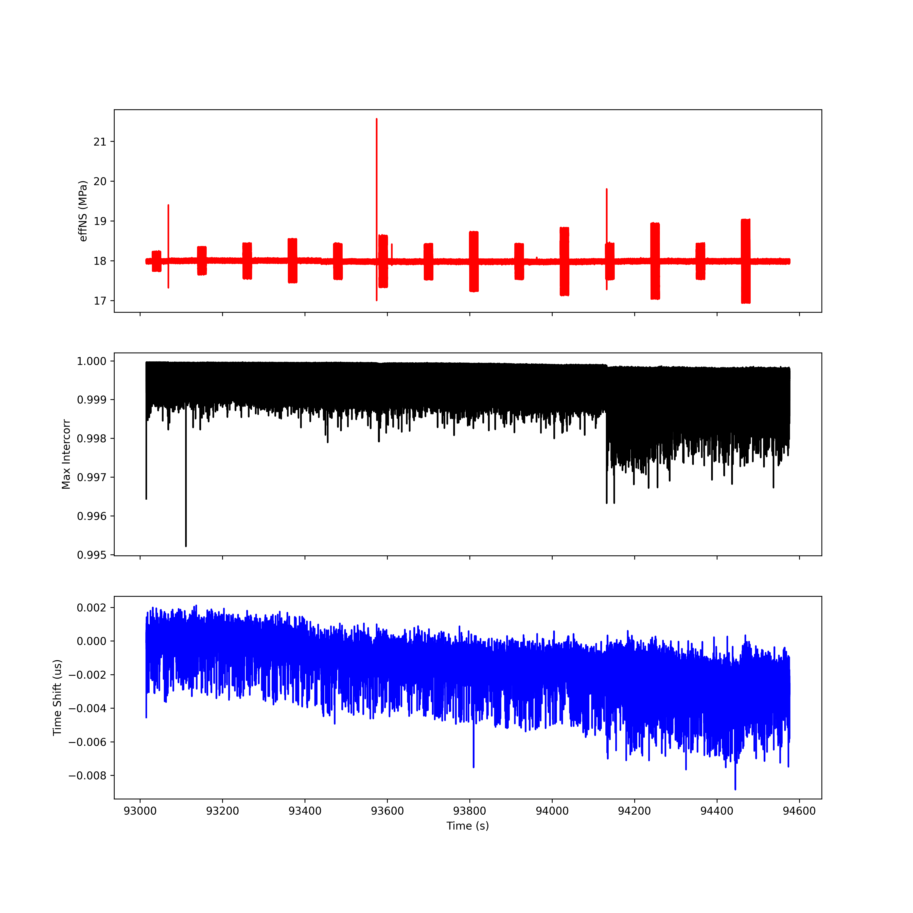
Run 7; T1 R1

Slide 49

Run 7; T2 R2

Slide 50
Run 7; T3 R3

Slide 51

Run 7; T4 R4

Slide 52

Run 7; T5 R5

Slide 53

Run 7; T6 R6

Slide 54

Run 7; T7 R7

Slide 55

Run 8; T1 R1

Slide 56

Run 8; T2 R2

Slide 57

Run 8; T3 R3

Slide 58

Run 8; T4 R4

Slide 59

Run 8; T5 R5

Slide 60

Run 8; T6 R6

Slide 61

Run 8; T7 R7

Slide 62

Run 9; T1 R1

Slide 63

Run 9; T2 R2

Slide 64

Run 9; T3 R3

Slide 65

Run 9; T4 R4

Slide 66

Run 9; T5 R5

Slide 67

Run 9; T6 R6

Slide 68

Run 9; T7 R7

Slide 69

Run 10; T1 R1

Slide 70

Run 10; T2 R2

Slide 71

Run 10; T3 R3

Slide 72

Run 10; T4 R4

Slide 73

Run 10; T5 R5

Slide 74

Run 10; T6 R6

Slide 75

Run 10; T7 R7

